Slide 1
Learning Resources
Explore your neighbourhood– Activity A – using images to stimulate thinking

Slide 2
Introduction
These pictures have been provided to get the group thinking about signs of evidence for the past in the areas in which they live.
Look at these pictures of historic things to think about where similar examples exist in your neighbourhood.
We have four types of evidence
  Landscape / layout (streets / parks / roads / rivers etc)
  Buildings
  Street furniture
  Signs and decoration

Slide 3
the natural and built environment: the layout of your neighbourhood
What physical features shape your area? Are you beside the sea? Are there rivers? Are there natural features such as mountains, hills and lochs which have affected where people can live and which influenced transport connections?
Can you see evidence of transport around your area? Roads, most likely, but are there harbours, canals, railways as well?
Can you find evidence of how people coped with natural features when they presented obstacles to travel? Did they tunnel through hills? Are there bridges over rivers?
Is there evidence of changes in modes of transport?

Slide 4
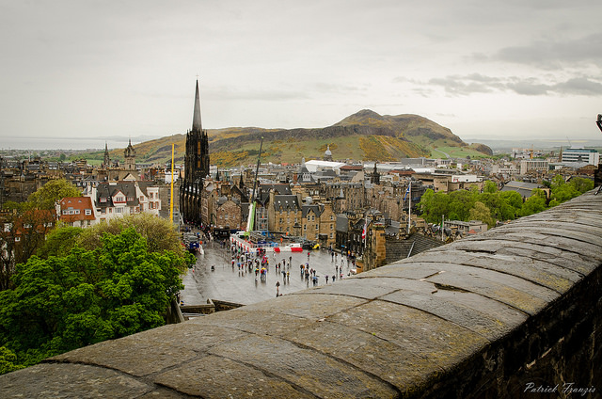
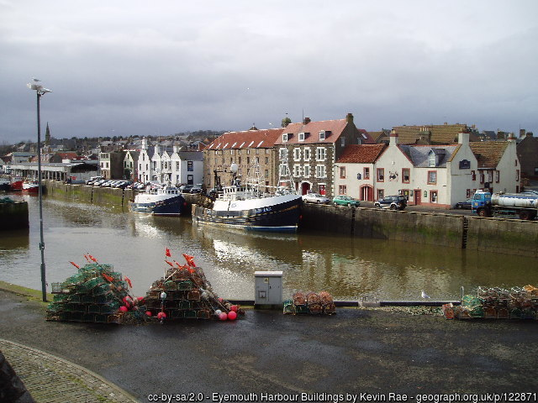
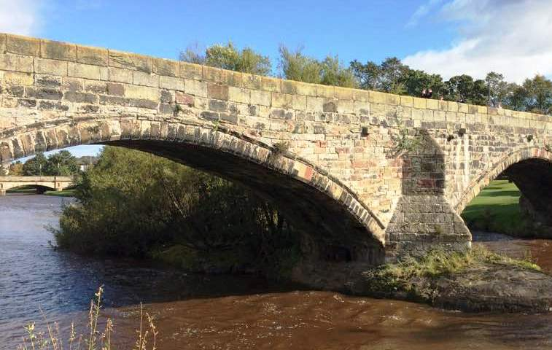
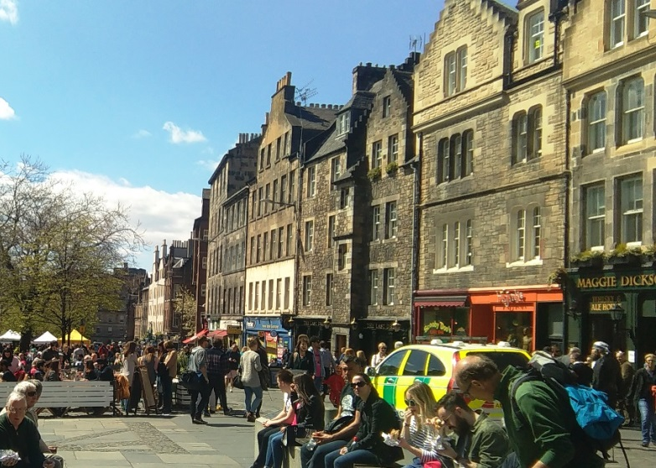
Landscape features
Photo 1: Photo credit: patrickfranzis via Foter.com / CC BY-NC-ND;; Eyemouth Harbour © Kevin Rae (cc-by-sa/2.0) ; other photos © Archaeology Scotland

Slide 5
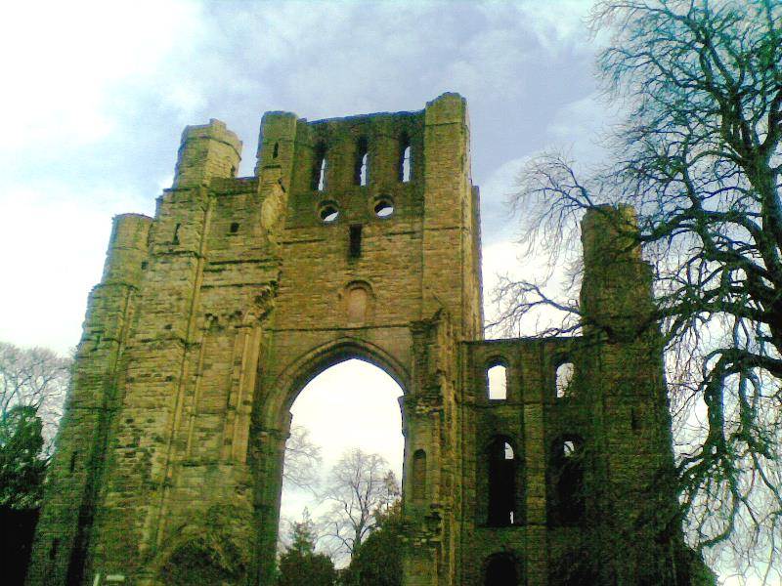
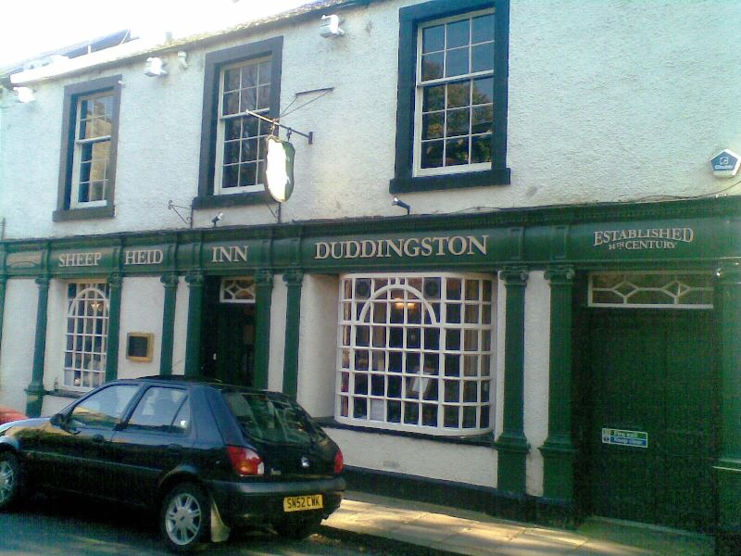
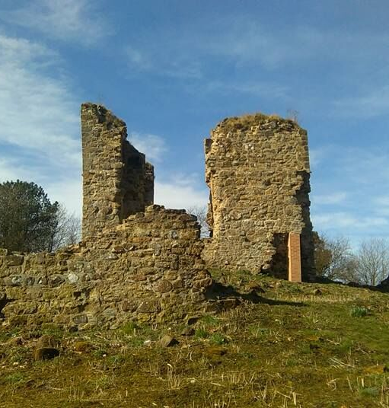
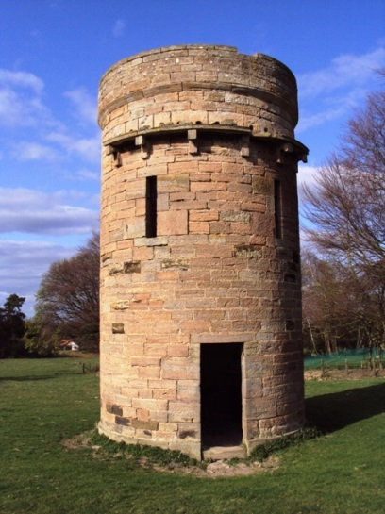
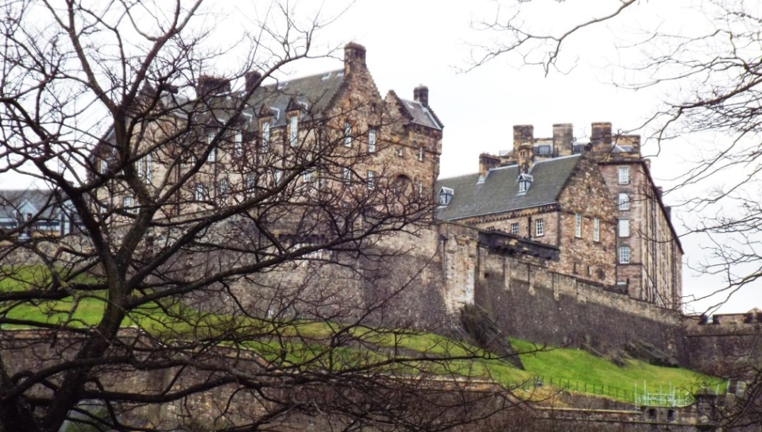
Buildings
Are there any old, or special buildings in your area?
Sheep’s Heid Inn (very old restaurant in Edinburgh); Kelso Abbey; Edinburgh Castle; Doocot, East Lothian; Lochore Castle;. All © Archaeology Scotland.

Slide 6
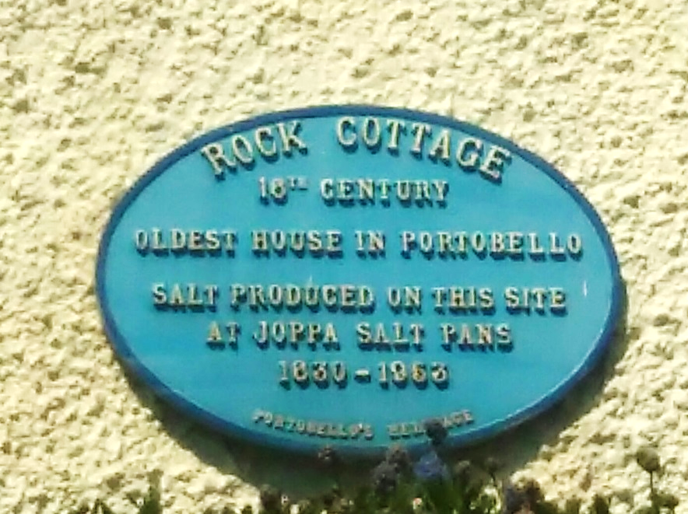
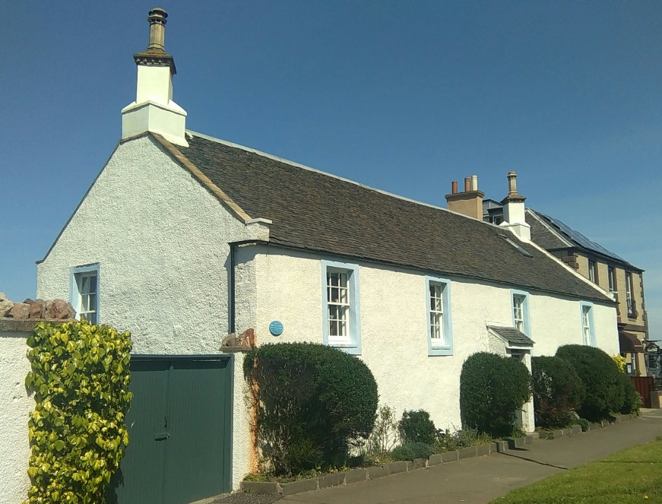
Old and interesting buildings often have a blue plaque on them to explain their history.
Rock Cottage
16th Century
Oldest house in Portobello
Salt produced on this site at Joppa Salt Pans
1630 - 1953

Slide 7
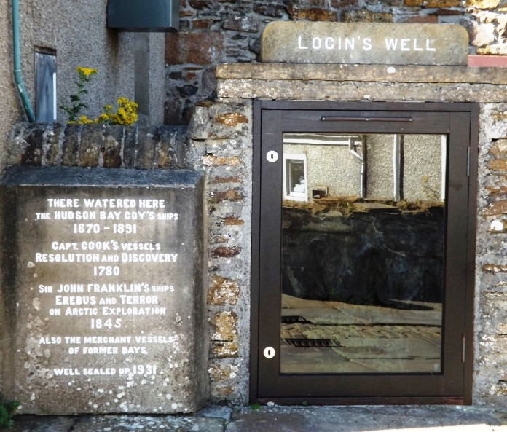
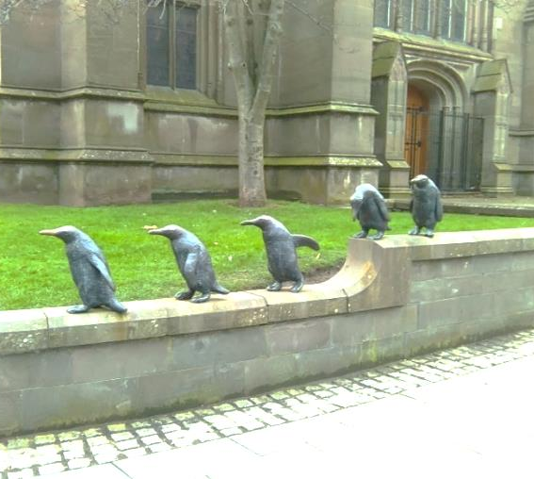
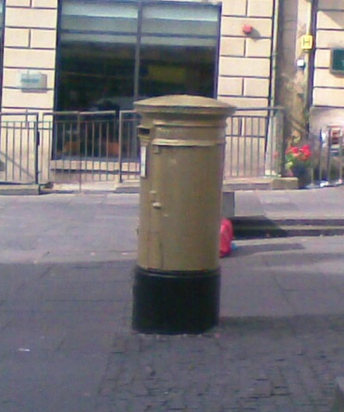
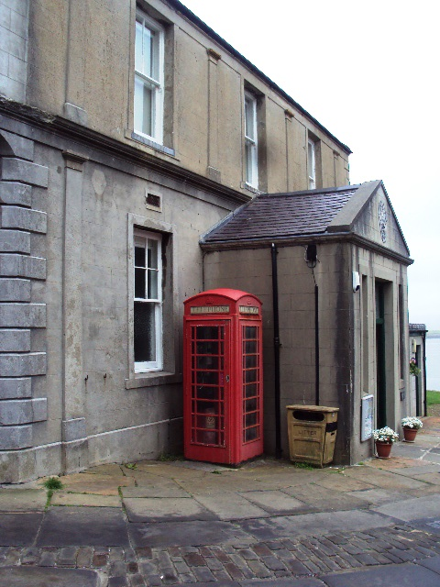
Street Furniture
Street furniture is anything you find on the street – functional or decorative - for example:
  Post boxes, Telephone boxes, Benches
  Statues, Memorials, Flower arrangements.
Login’s Well, Stromness; Penguins, Dundee; Olympics 2012 gold post-box, Edinburgh; Stromness Museum phone kiosk, Orkney.

Slide 8
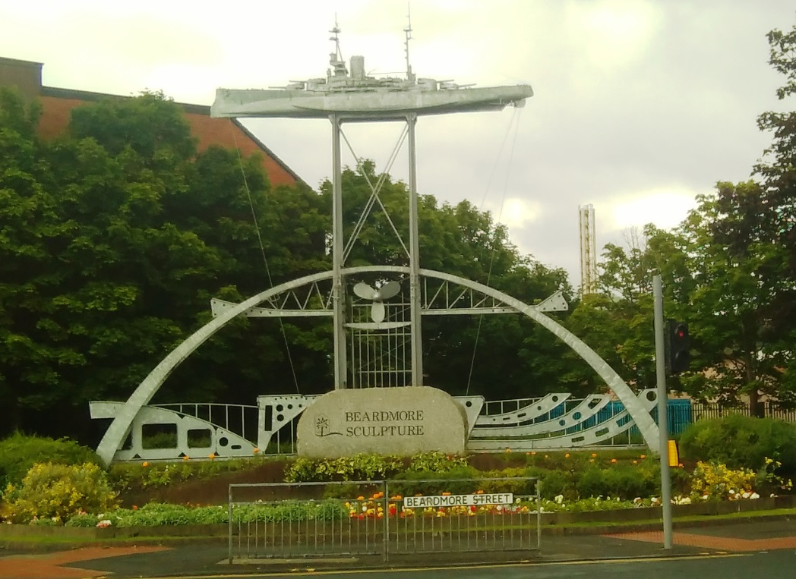
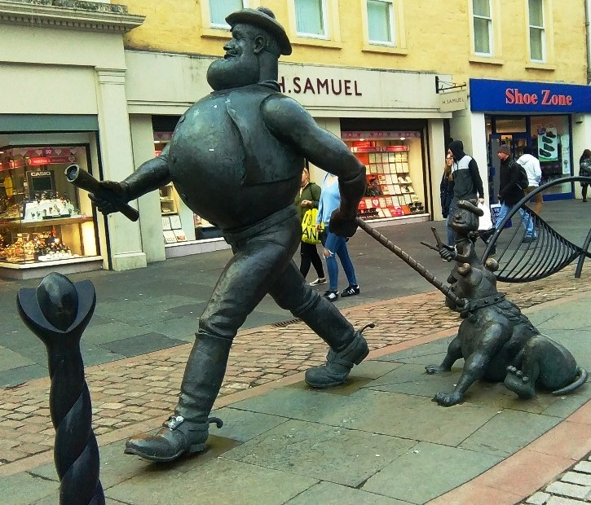
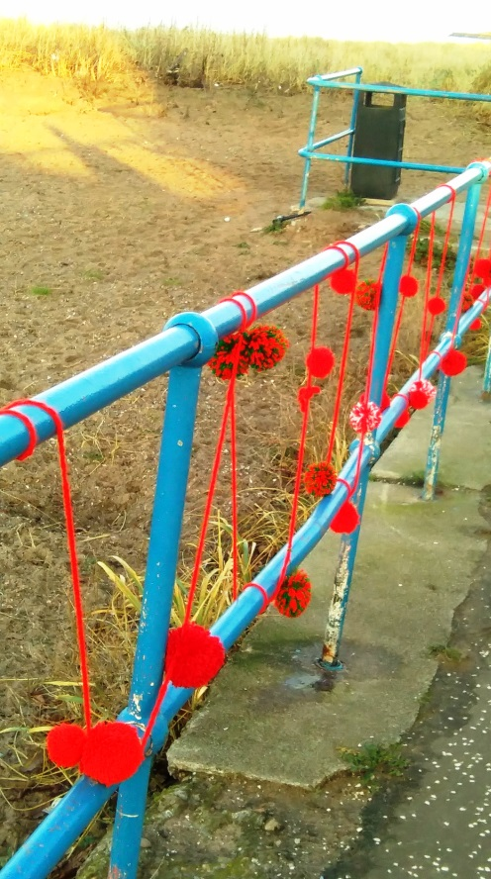
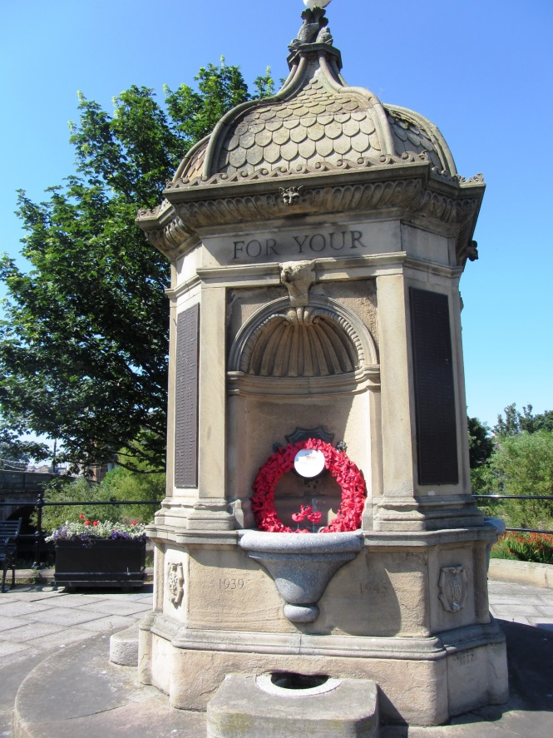
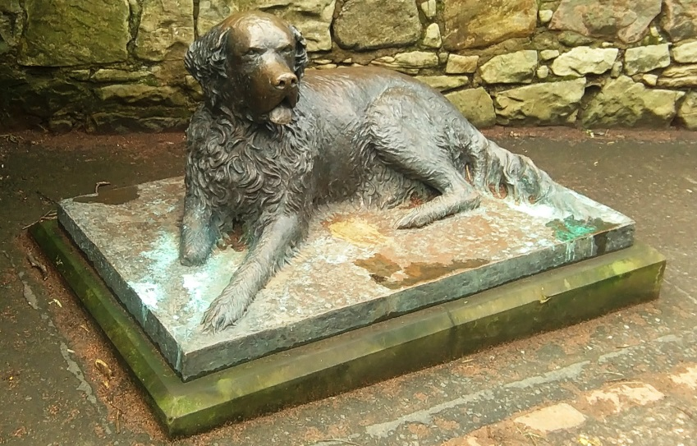
Street furniture:
Sculpture on site of former ship yard, Clydebank; Desperate Dan statue, Dundee; war memorial, Musselburgh; railings, Musselburgh; dog statue, Edinburgh.
© Archaeology Scotland

Slide 9
decoration
Decoration includes anything you find on walls and buildings – from street names, to adverts to graffiti – often old painted signs can be seen on buildings that have since changed their use.

Slide 10
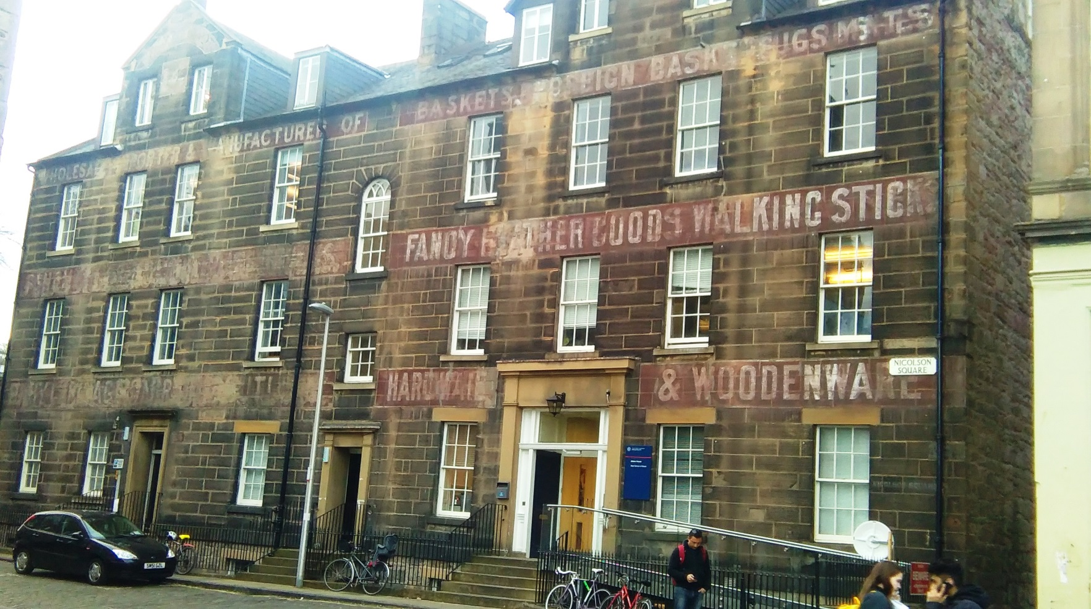
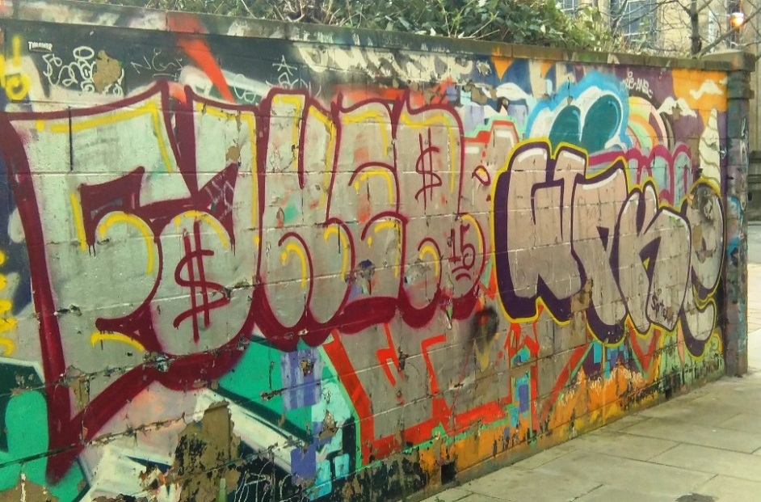
Photos © Archaeology Scotland
Ghost signs – the building is now part of the University of Edinburgh, but was previously a shop.
Graffiti is commonly seen around city centres
Notes:
Example of graffitii?

Slide 11
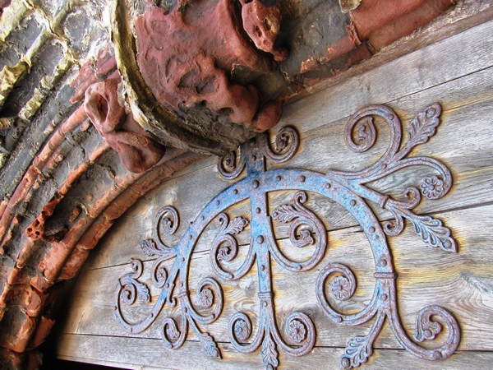
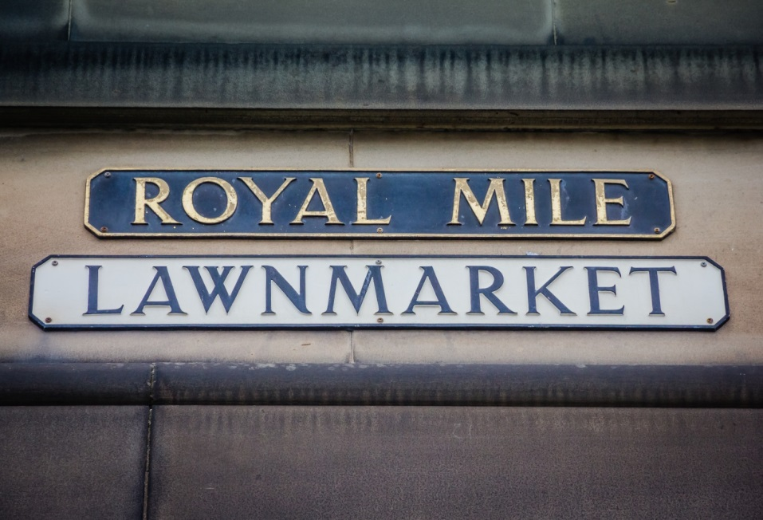
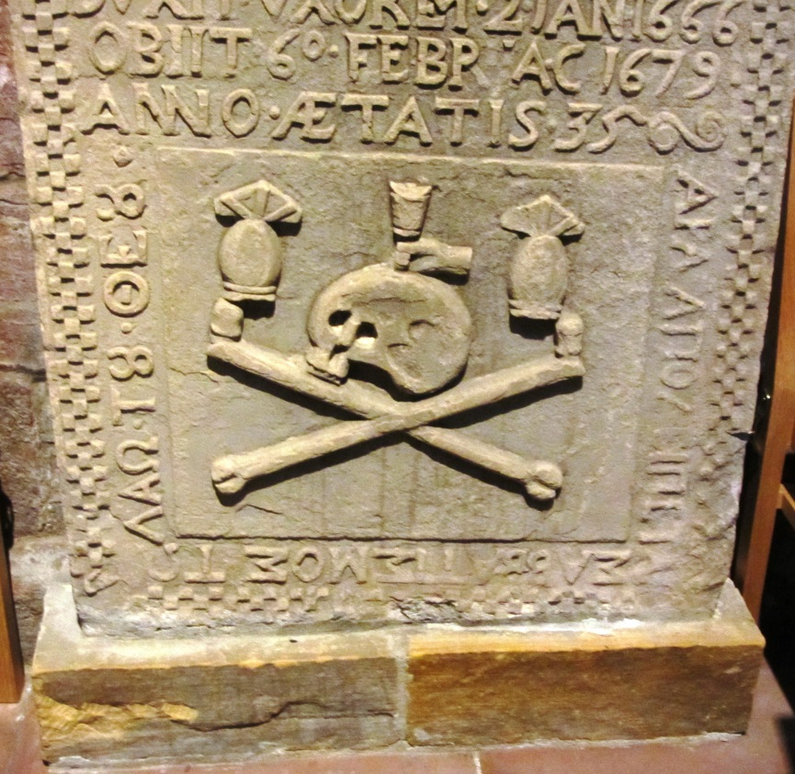
Photo credit: Mile of Royalty by Kevin Spencer / CC BY 2.0
Detail on the door, St Magnus Cathedral, Orkney © Archaeology Scotland
Gravestone, in St Magnus Cathedral, Orkney.
© Archaeology Scotland

Slide 12
Main Activity
Can you describe examples, in the area where you live, for each of these?
Street layout / landscape
Buildings
Street furniture
Decoration and signs

Slide 13
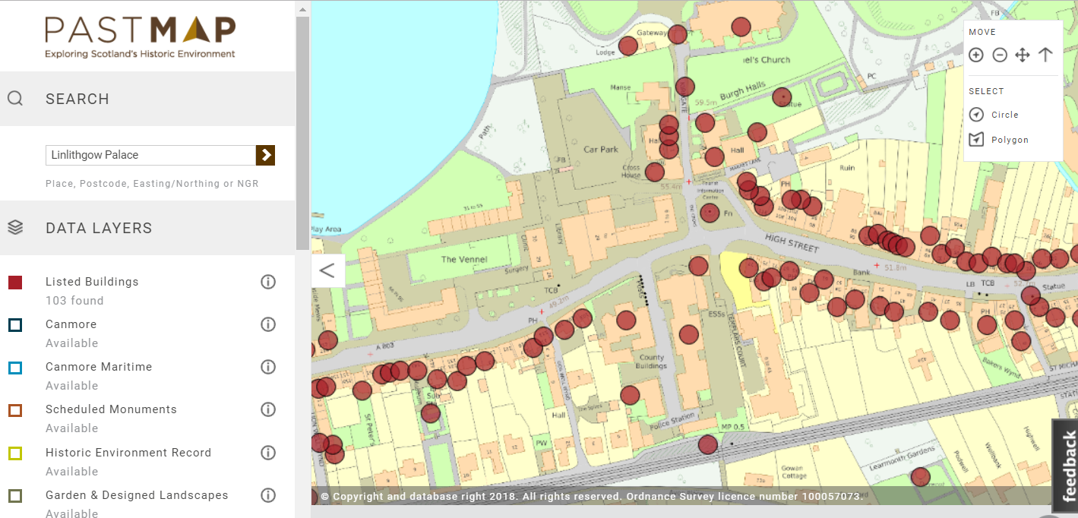
Linlithgow – on Past Map

Slide 14
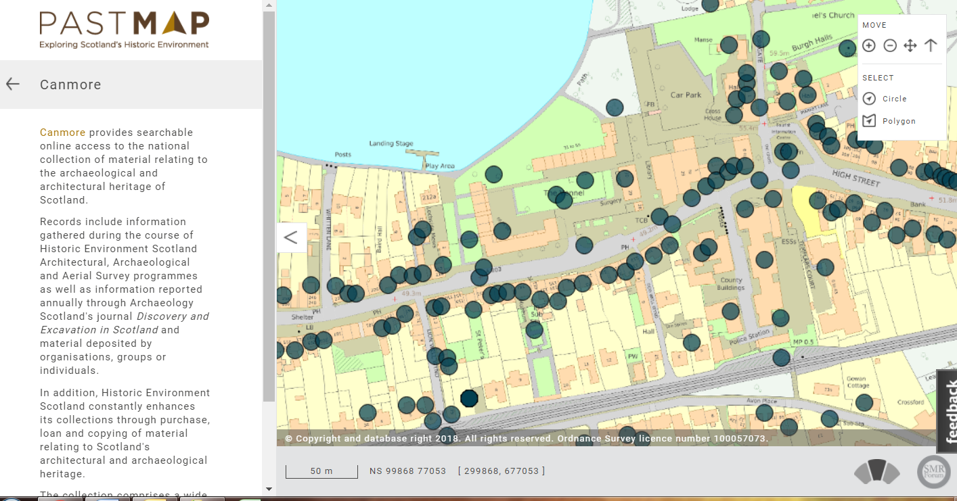

Slide 15
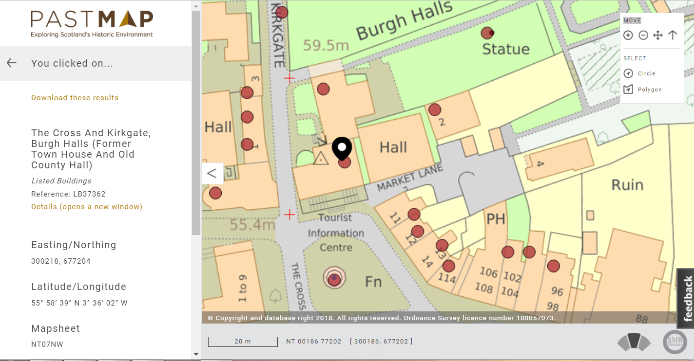
The building we’re in

Slide 16
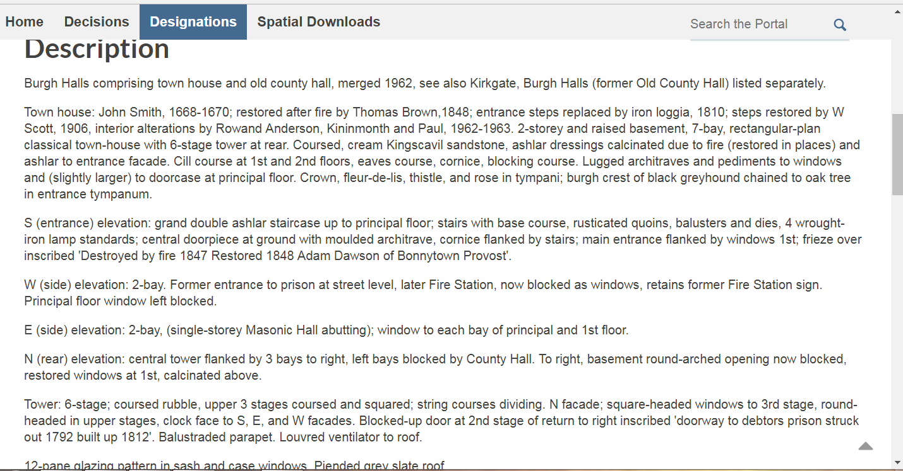
Written information

