Slide 1
Learning Resource B
Exploring change by studying maps (leaders’ guide)

Slide 2
Starter Activity
This resource shows you how to use web based resources to explore change in your local area over time.
It will guide you through how to use maps and old photographs to discover change through time.

Slide 3
Map Activity
This activity provides three examples of historic maps, set side by side with modern maps. You may want to use these examples with your learners, alternatively you could create a similar example for yourself, using your local area.

Slide 4
National Library of Scotland (NLS) map resources
The National Library of Scotland has a website that allows you to compare maps from the past with present day maps. The link to their website is on our Links page.
Notes:
.{make the word ‘links’ an actual link}

Slide 5
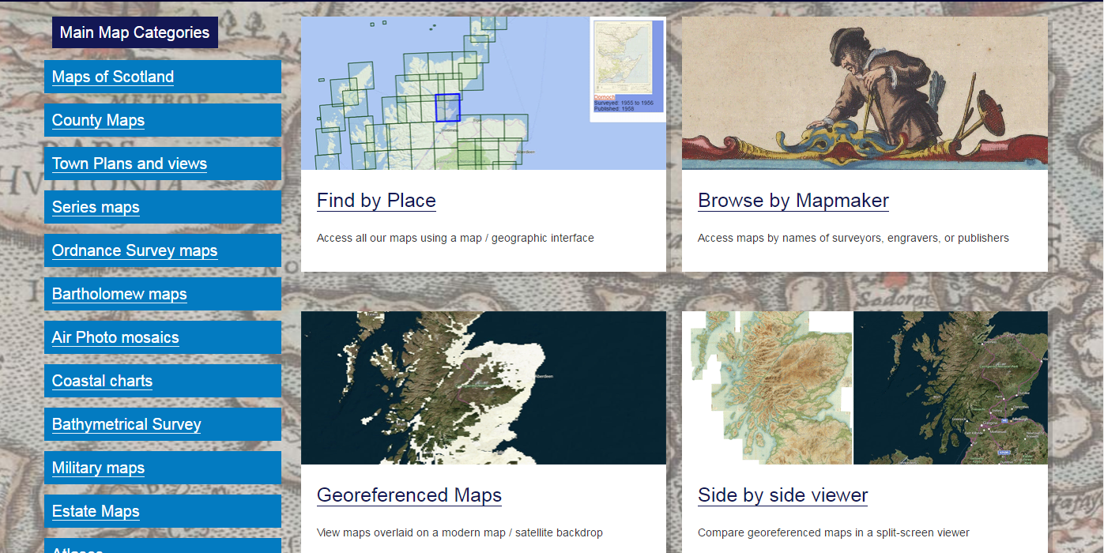
Maps.nls.uk
Click here to get your map.
Geo-referenced overlays allow you to compare old maps with modern ones. It aligns the old maps with the more recent ones.

Slide 6
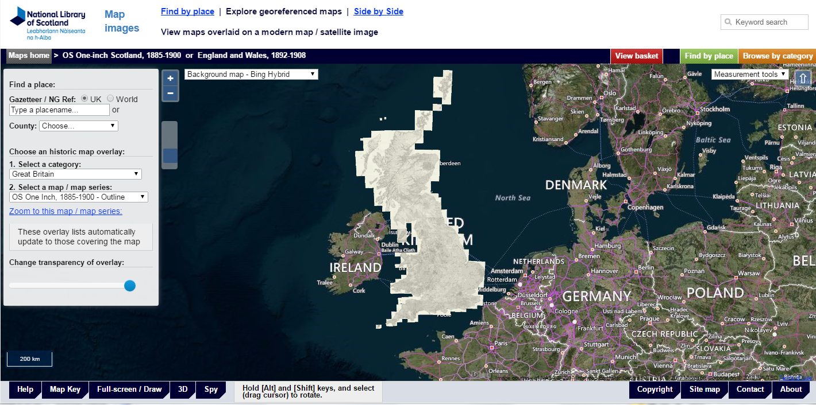
2. Choose a category – “Scotland” has a wide choice of large-scale maps
1. Type in a place name
3. Select a map / map series – 6 inch is probably the most useful
…or find your location by zooming in on the map

Slide 7
Looking for Things that change and things that stay the same
The following slides use three examples of places that have changed considerably in the last 100 years or so. The examples are from Kirkcaldy, Clydebank and Musselburgh, towns that flourished during Scotland’s industrial age.

Slide 8
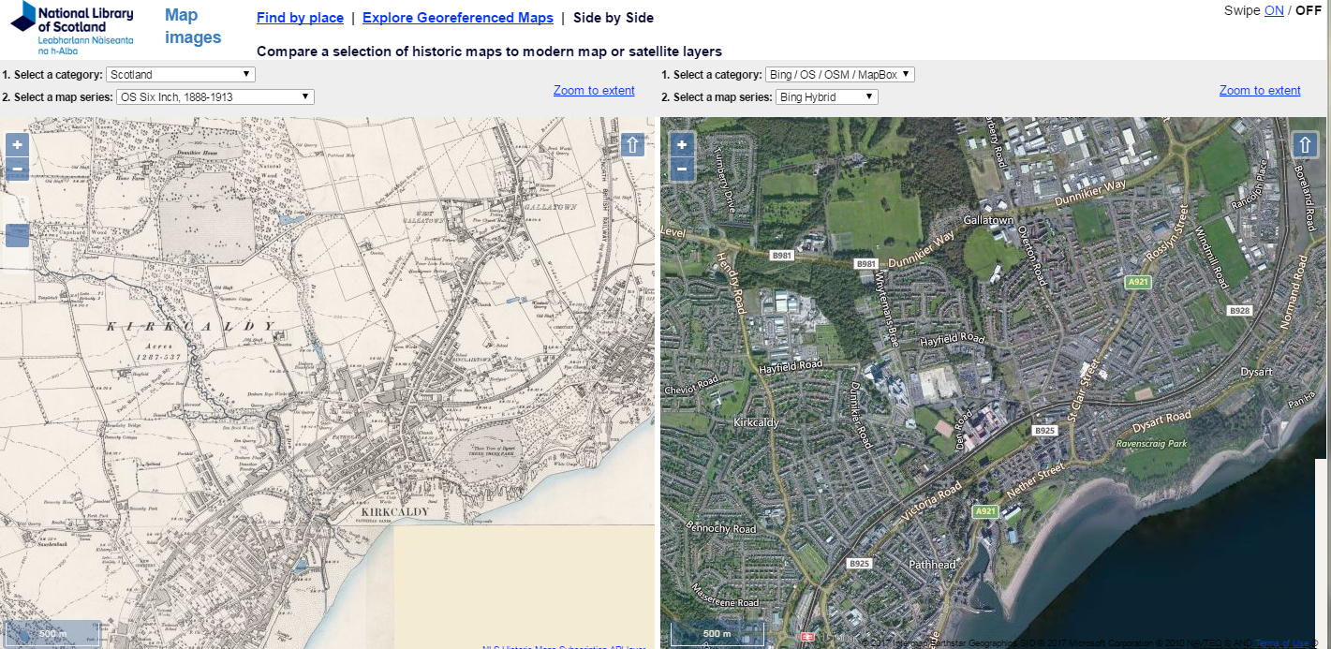
This shows Kirkcaldy, on the 1888 – 1913 Six Inch Map and a modern map / satellite image (Bing Hybrid). Comparing the two shows things that have stayed the same - the coast line, harbour, railway-line; some parks and woodlands. We can also see things that are different – the High School, new housing, new roads; the town is bigger.
Things to look for: changes in transport and industry; the oldest parts of town. Also - things that haven’t changed much (e.g. the fields and woods around the school; parks). Zooming in provides more detail, but of a smaller area.
Kirkcaldy High School
Harbour
Railway line

Slide 9
Transport and industry
Things to think about!
How do people and goods get around your neighbourhood today? Is there evidence for how things (food, fuel, building materials) were moved about in the past?
Railways
Canals
Rivers
Roads
It is interesting to look at change in these things over time. Also, look for changes in how the transport links interact with each other – how do roads cross waterways and railways?

Slide 10
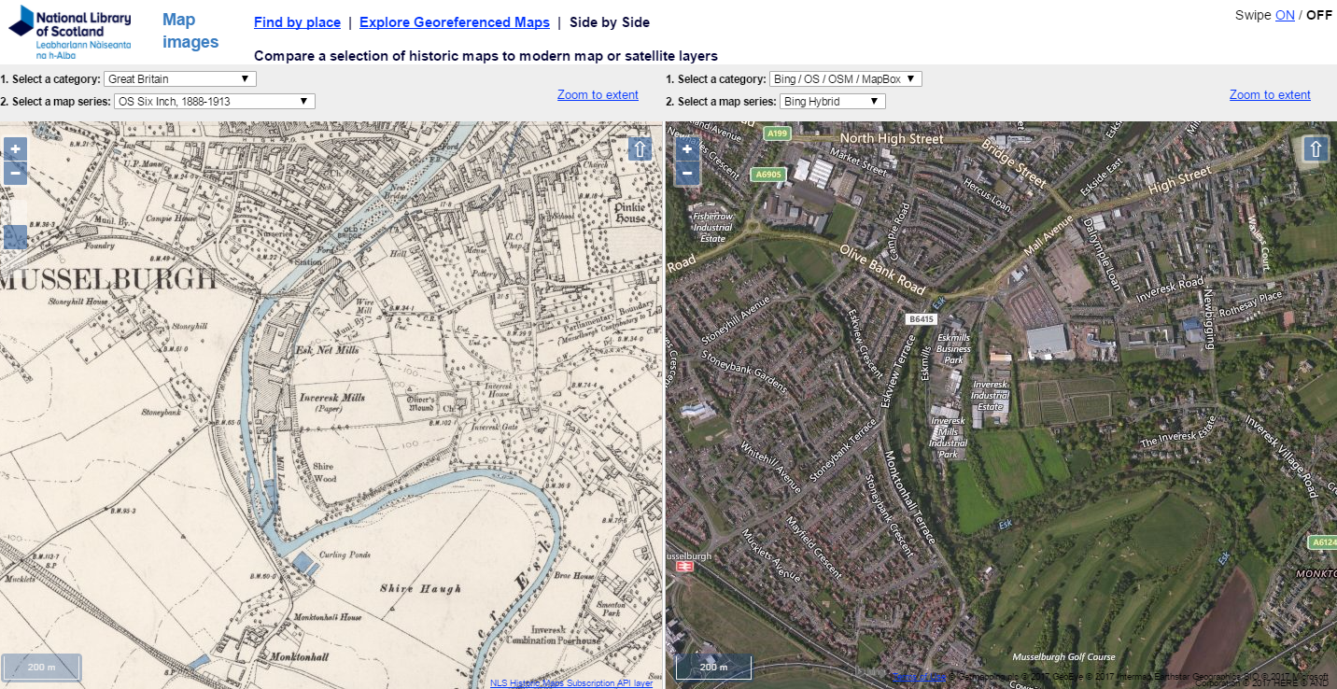
Musselburgh in 1913 compared with today
These maps of Musselburgh show that there are some changes you can see easily – the railway was replaced by the road: Open fields and farms to West of the river are now replaced by housing. Things that remain the same – woodland near the river; the line of the High Street can be seen in both maps.

Slide 11
Clydebank
The central belt of Scotland has seen huge change over the last 300 years with the rise and fall of the traditional industries, particularly coal mining, steel making and ship building.
One town very much affected is Clydebank which enjoyed an industrial boom in the late 19th to mid 20th centuries – see Clydebank Timeline (Learning Resource D).
The town has suffered with the decline of Scotland’s industry seeing the closure of the shipyards. In recent years the building of a huge, state of the art hospital (The Golden Jubilee National Hospital) and an associated hotel and conference centre, has replaced the shipyards and is a large employer in the town.

Slide 12
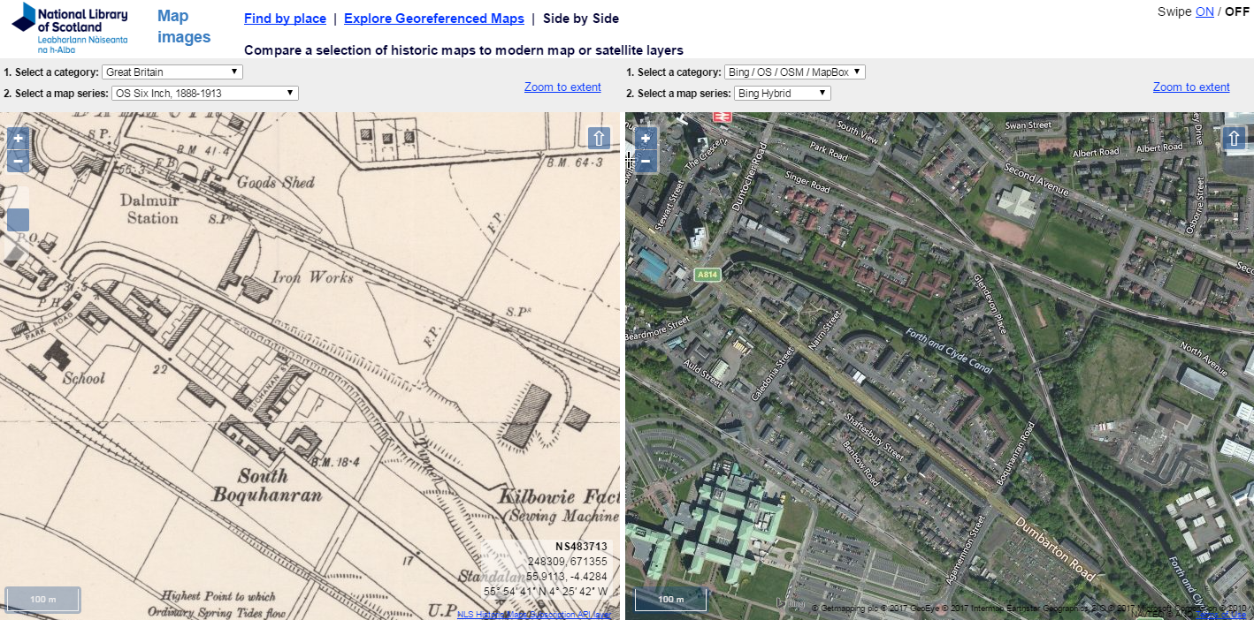
Kilbowie Factory (where Singer sewing machines were made)
Where Dumbarton Road crosses Forth-Clyde canal
Today the canal crosses (under) the road using the Dalmuir Drop Lock
Today there remains only place name evidence of the factory (Singer Street)
Clydebank in 1913, compared with today

Slide 13
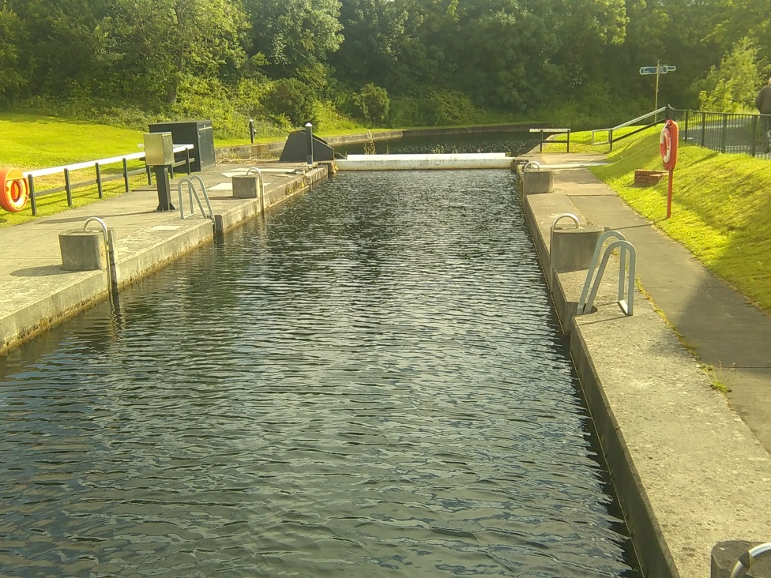
Dalmuir Drop Lock
Dalmuir Drop Lock in Clydebank allows boats on the Forth-Clyde Canal to cross underneath the busy Dumbarton Road. The road was built after the canal fell into disuse and the Drop Lock was built as part of the canal regeneration, to mark the Millennium, in 2000. to allow boats to pass underneath the road. It is thought to be the first in the world.
Boats using the canal today are mainly leisure craft, not transporting goods or people, so they have more time to spend waiting to pass through locks, to let them complete their journey.
Notes:
Look for a photo of this that shows it going under the road

Slide 14
Main Activities
Use the examples given here to investigate the changes that have happened in the last 100 years in Kirkcaldy, Musselburgh and/or Clydebank.
Create a similar set of maps of your local area to investigate change in the last 100 – 150 years
Build a time-line for your local area charting the highs and lows of its development.

