Slide 1
Learning Resources
Archaeology Detectives – Activity A – Using Maps

Slide 2
Activity A – Identifying Features on Maps
This activity is designed as an introduction to looking at different natural- and human-made features on a map, and to help you consider the reasons why people in the past chose to build sites/ monuments/ buildings in any particular place.
Look at each of the maps supplied and consider the questions printed underneath them.
A range of Ordnance Survey maps from different periods have been used for this activity, to give a sense of maps made at different times. The similarities and differences between them can be discussed.

Slide 3
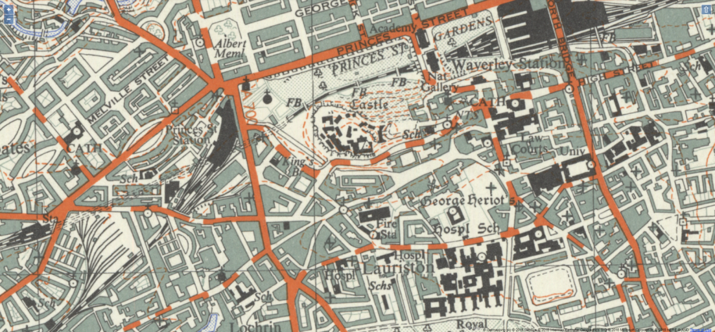
Edinburgh Castle
Reproduced with the permission of the National Library of Scotland
OS 1 inch 1945 - 1947
Find Edinburgh Castle on the map
What are the thin, dashed, orange lines around the castle site?
Are they there in real life?
What do they mean?
What is the purpose of a castle?
Why do these orange lines mean this would be a good site for a castle?

Slide 4
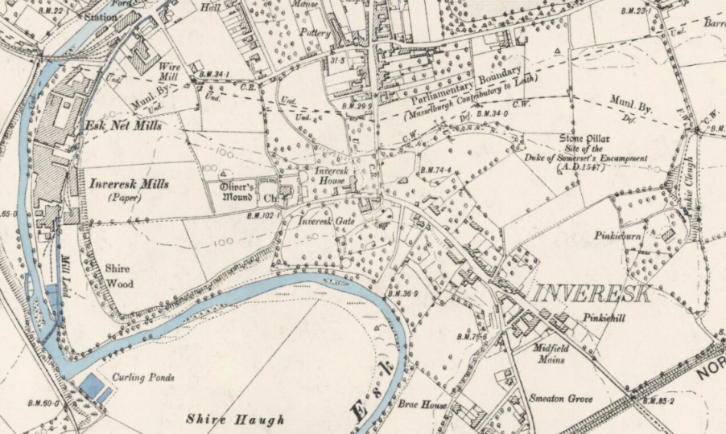
Inveresk Mills
Reproduced with the permission of the National Library of Scotland
OS 6 inch 2nd and later editions 1892 -1960
Find Inveresk Mills on the map.
Find the River Esk on the map.
How close is the river to the mill?
Can you find any evidence of the mill builders using the river?
Do you think the river was an important reason for the siting of the mill? Why?

Slide 5
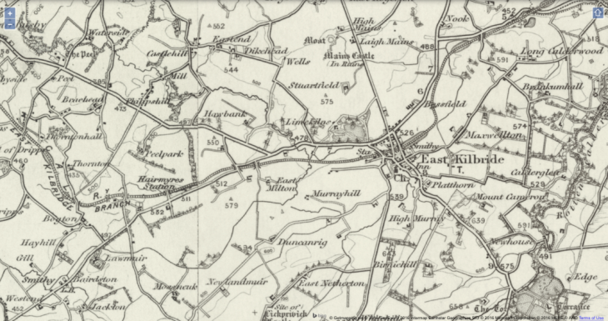
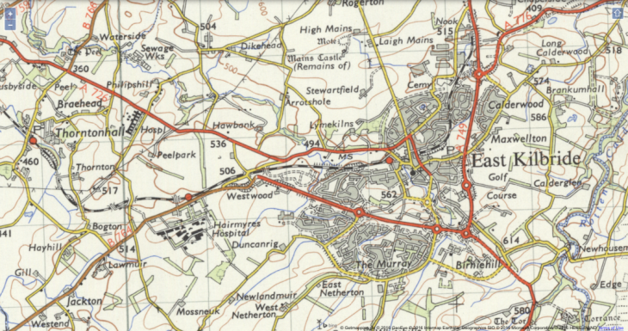
Changes in East Kilbride
Find the railway line that runs through both maps – the maps show an identical area
What can you see that shows population has grown in this area over the years?
Can you see any buildings on the more recent map that might be needed for a growing population ?
Can you see anything that has disappeared due to an increased population
OS 1 inch 1885-1900
Reproduced with the permission of the National Library of Scotland
OS 1 inch 1955 - 1961

Slide 6
Activity A – Potential Answers
The next three slides show some of the answers you can give to the questions

Slide 7
Edinburgh Castle - Answers
Reproduced with the permission of the National Library of Scotland
OS 1 inch 1945 - 1947
Find Edinburgh Castle on the map. The red arrow points to it.
What are the thin, dashed, orange lines around the castle site? Contour lines – drawn close together they show the steepness of the Castle Rock where the castle sits.
Are they there in real life? No, they are just a mapping symbol to represent the gradient of the Castle Rock’s slopes.
What do they mean? They show that Edinburgh Castle was built on a high point of land surrounded by very steep cliffs.
What is the purpose of a castle? Defensive – to protect people – hard to break into. Possibly to intimidate enemies, or even local people.
Why do these orange lines mean this a good site for a castle? High up – steep, so hard to attack – can be seen/ can see from miles around – can see people approaching by land and sea.

Slide 8
Inveresk Mills - Answers
OS 6 inch 1888 - 1913
Reproduced with the permission of the National Library of Scotland
Reproduced with the permission of the National Library of Scotland
OS 6 inch 2nd and later editions 1892 -1960
Find Inveresk Mills on the map. Red arrow
Find the River Esk on the map. Blue arrow
How close is the river to the mill? It runs right past/ through the building
Can you find any evidence of the mill builders using the river? There is a mill lade to the south of the mill buildings. This is a channel diverting river water into the Inveresk Mill buildings and the Esk Net Mills next door.
Do you think the river was an important reason for the siting of the mill? Why? Yes – the river was the power source for the mills. The water powered machinery in both of the mills.

Slide 9
Changes in East Kilbride - Answers
Find the railway line that runs through both maps – the maps show an identical area.
Red arrows
What can you see that shows population has grown in this area over the years?
Red circle – large areas of new building
Can you see any buildings on the more recent map that might be needed for a growing population ?
Hairmyres Hospital – blue circle
Can you see anything that has disappeared due to an increased population.
Large amounts of woodland – green circles. Small farms – purple circles.
OS 1 inch 1885-1900
Reproduced with the permission of the National Library of Scotland
OS 1 inch 1955 - 1961

Slide 10
Our Site (Template)
Reproduced with the permission of the National Library of Scotland
Map description
Questions

Slide 11
Example Questions for Our Site page
Is the site on high ground, in a valley or on the flat – how can you tell?
Do you think the chosen position is important for your site? Why?
Is the site near any sources of water? Do you think this would be important? Why?
Is the site near a large population/ near a village or on its own?
Is the site near good transport links – roads, railways or canals?
Is the site near the sea? Would this be important?
Does your site look like it has good farming ground near it?
Can you see any other buildings near your site that might be from the same period?
Is your site near an area of woodland? Would this be useful?

Slide 12
Plenary
What have we learned about our site today?
Do we think that the people who built our site chose a good location? Why?
What else should we look at to add more detail to what we’ve learned so far?
Where might we find more information?

