Slide 1
Learning Resources
Archaeology Detectives – Activity B – Using Aerial Photography

Slide 2
Activity B – Using Aerial Photography
This activity is designed to help pupils gain a better understanding of the landscape by using aerial photographs to get a ‘bird’s-eye view’.
Look at each of the photographs supplied and spot the similarities and differences.
Both vertical (a bird’s eye view looking straight down) and oblique (a bird’s eye view looking down at an angle) aerial photographs have been supplied.

Slide 3
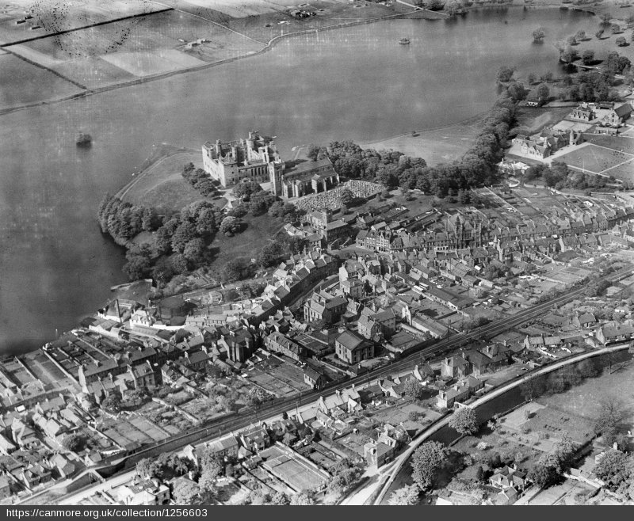
Historic Oblique of Linlithgow
Can you spot…
The High Street?
A ruined palace?
A railway line?
A canal?
A graveyard?
A crannog (an artificial island)?
A gasworks?
Farm fields?
Long gardens (riggs)?
Reproduced with the permission of Historic Environment Scotland.
Linlithgow, general view, showing Linlithgow Palace, St Michael's Church and Loch. Oblique aerial photograph taken facing north. 1929

Slide 4
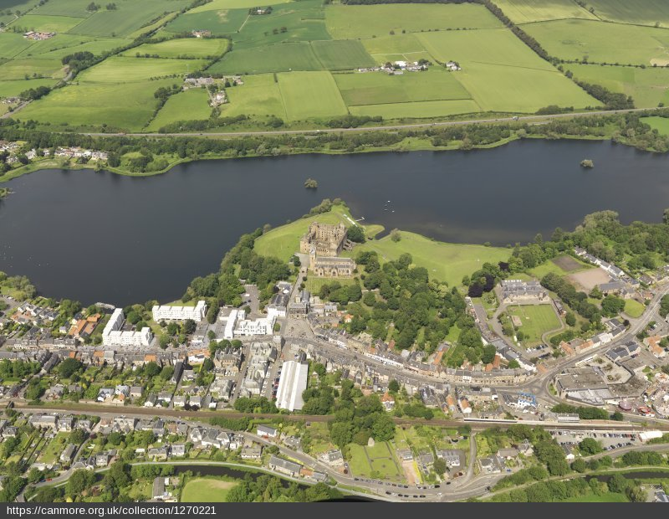
Modern Oblique of Linlithgow
Can you spot…
The High Street?
Modern flats?
The M9 motorway?
The railway station car park?
The long white roof of the bus depot?
Some small woodland areas?
Reproduced with the permission of Historic Environment Scotland.
General oblique aerial view of Linlithgow centered on Linlithgow Palace, taken from the SSE. 2011

Slide 5
Historic Vertical of Linlithgow
Look at this historic photo and the modern image of the same place. Can you spot at least three differences?

Slide 6
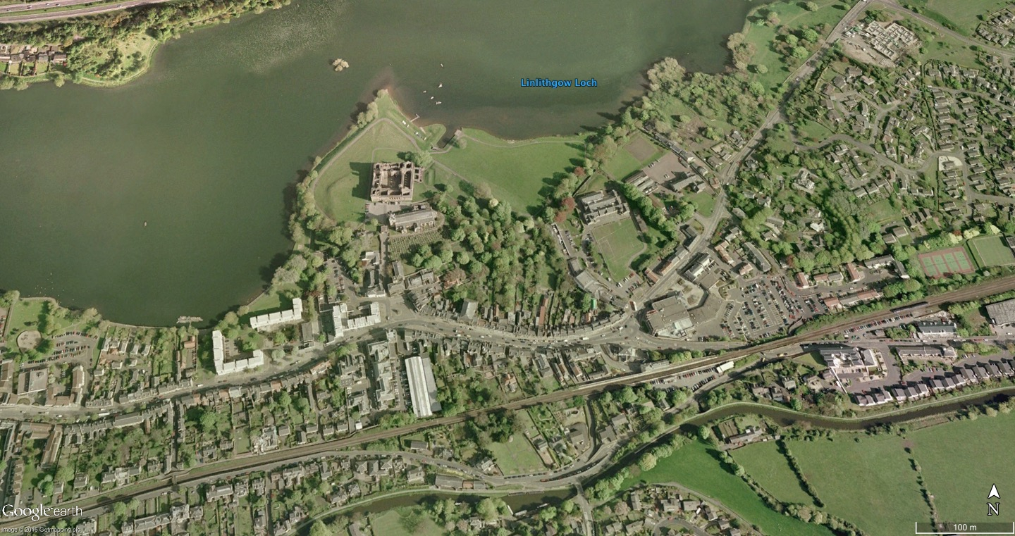
Modern Vertical Satellite Image of Linlithgow (Google Earth)
Google Earth. Image © 2016 Getmapping plc
Look at this modern photo and the historic image of the same place. Can you spot at least three differences?

Slide 7
Activity C – Answers
The next four slides show some of the answers you can give to the questions

Slide 8
Historic Oblique of Linlithgow
Farm fields
Graveyard
Crannog (an artificial island)
High Street
Ruined palace
Long gardens (riggs)
Town gasworks
Canal
Railway line
Reproduced with the permission of Historic Environment Scotland
Linlithgow, general view, showing Linlithgow Palace, St Michael's Church and Loch. Oblique aerial photograph taken facing north. 1929

Slide 9
Modern Oblique of Linlithgow
Small woodland areas
M9 motorway
Modern flats
High Street
Railway station car park
Long white roof of the bus depot
Reproduced with the permission of Historic Environment Scotland
General oblique aerial view of Linlithgow centered on Linlithgow Palace, taken from the SSE. 2011

Slide 10
Historic Vertical of Linlithgow
Field
Gasworks and
old buildings
Gardens
Factory
Distillery
Look at this historic photo and the modern image of the same place. Can you spot at least three differences?

Slide 11
Modern Vertical Satellite Image of Linlithgow (Google Earth)
Google Earth. Image © 2016 Getmapping plc
Flats
Mature trees
Supermarket
Housing
Look at this modern photo and the historic image of the same place. Can you spot at least three differences?

Slide 12
Our site (Template)
Can you spot…
…
...
...
Reproduced with the permission of ….
Photo description

Slide 13
Our site (Template)
Reproduced with the permission of ….
Photo description
Look at this modern photo and the historic image of the same place. Can you spot at least three differences?

Slide 14
Ideas for investigating aerial photographs
Identify features that have obviously stayed the same. Look for well known landmarks.
Identify features that are markedly different – how do they differ, and when did these changes happen?
Look at the surrounding landscape – what features can you spot which make it a good location for our site?
Has the way people use the landscape changed much over time? How?
Compare historic aerial photographs with historic maps to see if you can identify long lost buildings or sites and their functions.

Slide 15
Plenary
How are aerial photographs useful to archaeologists?
How much has our site changed since the historic (and modern) photographs were taken? Has it changed at all?
What sorts of things can you spot in your aerial photograph?
What have we learned about how people have used this place over the years?
What else should we look at to add more detail to what we’ve learned so far?
Where might we find more information?

