Slide 1
Learning Resources
Archaeology Detectives – Activity C – Investigating Historic Photographs

Slide 2
Activity C – Investigating Historic Photographs
This activity suggests looking at historic and modern photographs to understand what a site was and how it might have been used.
Look at each of the photos supplied and consider the questions that accompany them. There are questions for the historic photo, the modern photo, and questions to consider when comparing them both.

Slide 3
Questions to Ask
For both the past and present consider:
  What was this place used for?
  How was it designed and built?
  Why was it built, and Why this location?
  When was it built and When was it changed?
  Who built it and Who lived here?

Slide 4
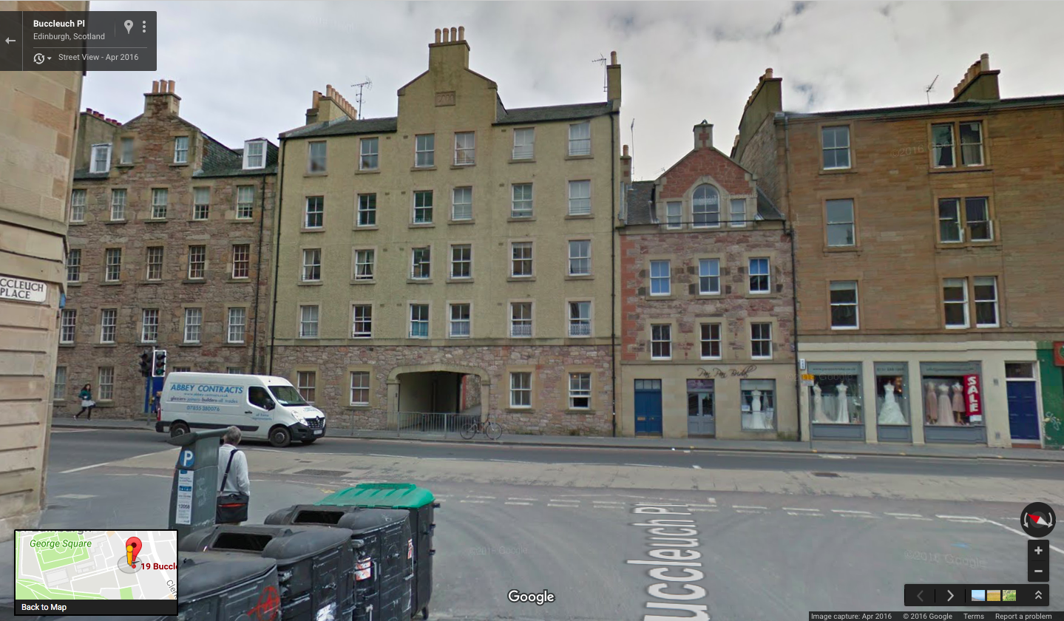
Edinburgh – 2016
Google Street View 2016
19-29 Buccleuch Street, Edinburgh

Slide 5
Edinburgh – Modern Photo Questions
What does this place look like?
Why does this place look like this?
Does it remind you of anywhere?
How is this place connected with other places?
Is this place changing at all? Describe how and why.
What would it feel like to be in this place?

Slide 6
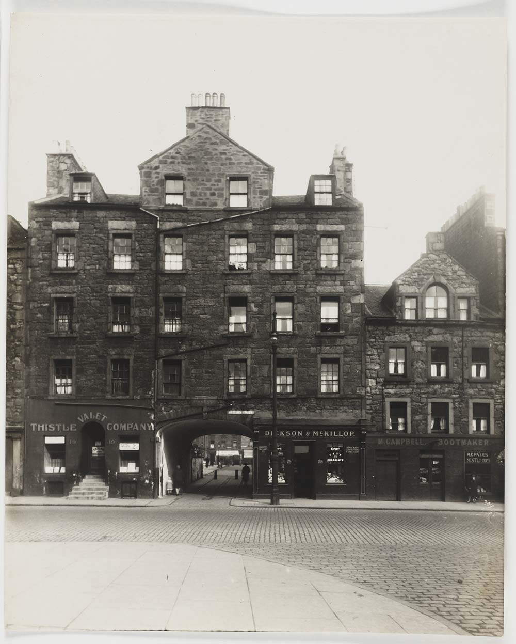
Edinburgh - 1929
National Library of Scotland http://digital.nls.uk/74507022
Used under the Creative Commons Attribution 4.0 International Licence
19-29 Buccleuch Street, Edinburgh

Slide 7
Edinburgh – Historic Photo Questions
What was this place like?
Why did this place look like this?
Does it remind you of anywhere?
How was this place connected with other places?
How did this place change and why?
What would it have felt like to be in this place?

Slide 8
Comparing Both Images- Edinburgh
How did this place change?
What evidence of the past can we still see?
Does this place now look historic or modern?
Why did people want to make this place look this way?
What would it feel like to be in this place? What atmosphere would you feel more – the present day or historic times?

Slide 9
Questions for Our Site (Template)
For both the past and present consider:
  What was this place used for?
  How was it designed and built?
  Why was it built, and Why this location?
  When was it built and When was it changed?
  Who built it and Who lived here?

Slide 10
Our site Modern (Template)
Reproduced with the permission of …
Description

Slide 11
Our Site – Modern Photo Questions
What is this place like?
Why does this place look like this?
Does it remind you of anywhere?
How is this place connected with other places?
Is this place changing at all? Describe how and why.
What would it feel like to be in this place?

Slide 12
Our Site Historic (Template)
Reproduced with the permission of
Description

Slide 13
Our Site – Historic Photo Questions
What was this place like?
Why did this place look like this?
Does it remind you of anywhere?
How was this place connected with other places?
How did this place change and why?
What would it have felt like to be in this place?

Slide 14
Comparing Both Images
How did this place change?
What evidence of the past can we still see?
Does this place now look historic or modern?
Why did people want to make this place look this way?
What would it feel like to be in this place? What atmosphere would you feel more – the present day or historic times?

Slide 15
Plenary
What have we learned about our site today?
When did this place look better, in the past or in the present?
What are the most important changes?
What else should we look at to add more detail to what we’ve learned so far?
Where might we find more information?

