Slide 1
Learning Resources
Archaeology Detectives – Activity G – Presenting Your Information

Slide 2
Activity G – Presenting Your Information
This activity is designed to prompt discussion and decision making about ways to present the information you have discovered about your site to a wider audience.
The art of presenting information about heritage to the public in engaging and inspiring ways is called Interpretation.
There are many ways that heritage is interpreted for the public. Some of these are shown in this Learning Resource.
Look at each of the images supplied and consider the the advantages and disadvantages of each method. A few suggestions have been included to start off your discussion. What would work best for your site?

Slide 3
Activity G – Presenting Your Information
To help your discussion think about the following for each type of interpretation:
What you want your interpretation to say, What you need to do to create it and What resources you will need?
Who your interpretation is for and Who is going to do the work?
Where it will go when it is finished?
Why would people find this sort of interpretation interesting?
How will you publicise your interpretation when it is done?

Slide 4
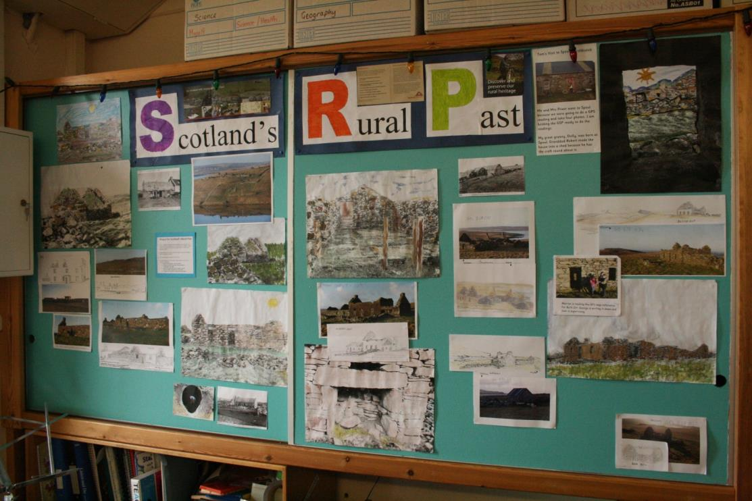
Wall Display
Photograph reproduced with permission of Brian Wilkinson

Slide 5
Wall Display
Images and text.
No objects.
Limited space?
…..

Slide 6
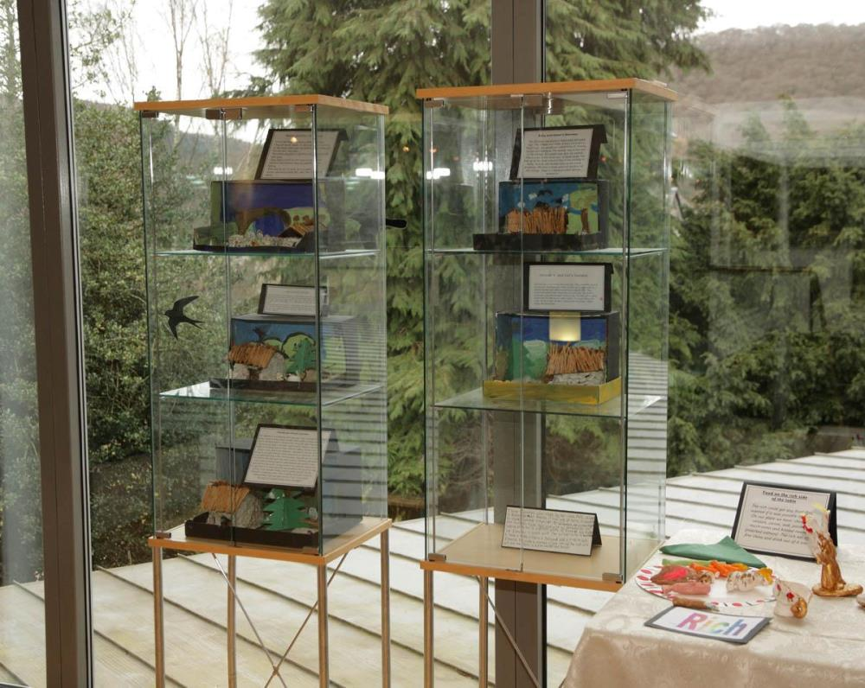
Exhibition
Photograph reproduced with permission of Brian Wilkinson

Slide 7
Exhibition
Images, texts, objects, presentations
Where could it go on display?
How much time will it take to prepare?

Slide 8
Leaflet
Photograph reproduced with permission of Brian Wilkinson

Slide 9
Leaflet
Images and text
Is there much space for a lot of information?
Who would they be for?

Slide 10
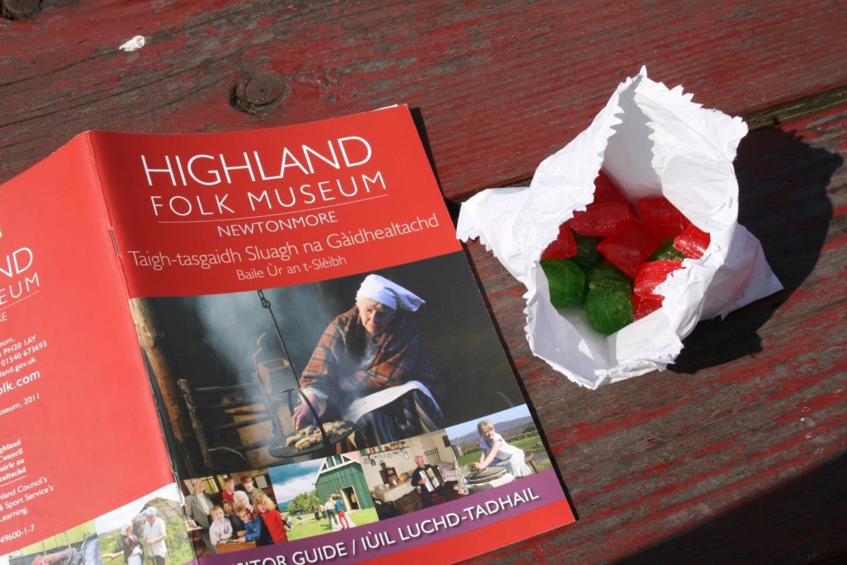
Booklet
Photograph reproduced with permission of Brian Wilkinson

Slide 11
Booklet
High quality photographs
Interesting writing
Lots of space for information
…

Slide 12
Guided Walk
Photograph reproduced with permission of Brian Wilkinson

Slide 13
Guided Walk
Face to face presentation
Time for questions and answers
Weather might be a problem
How many people can deliver at once?

Slide 14
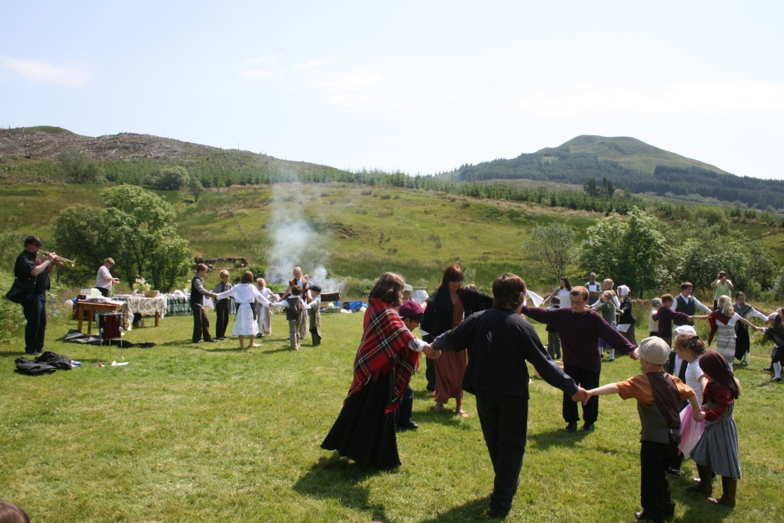
Performance
Photograph reproduced with permission of Brian Wilkinson

Slide 15
Performance
Plays, storytelling…
Creative and imaginative
Opportunity for music and movement
Opportunity for the whole group to work together

Slide 16
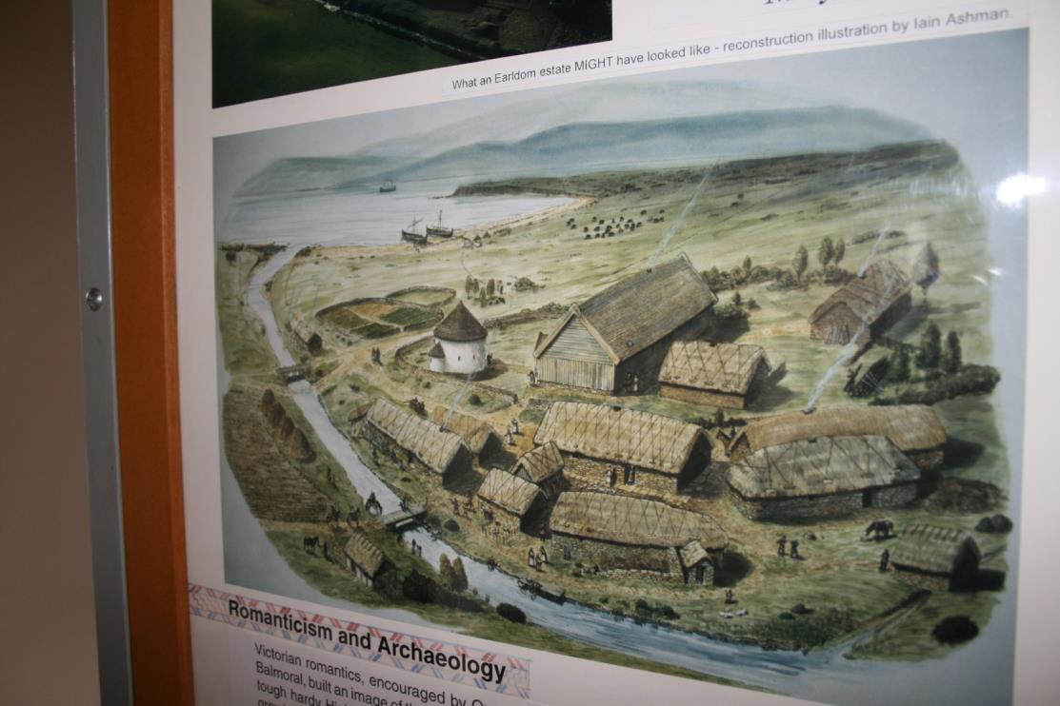
Reconstruction Drawings
Photograph reproduced with permission of Brian Wilkinson

Slide 17
Reconstruction Drawings
Imagination and creativity
Opportunity for research
Can use sketches, maps, site plans etc.

Slide 18
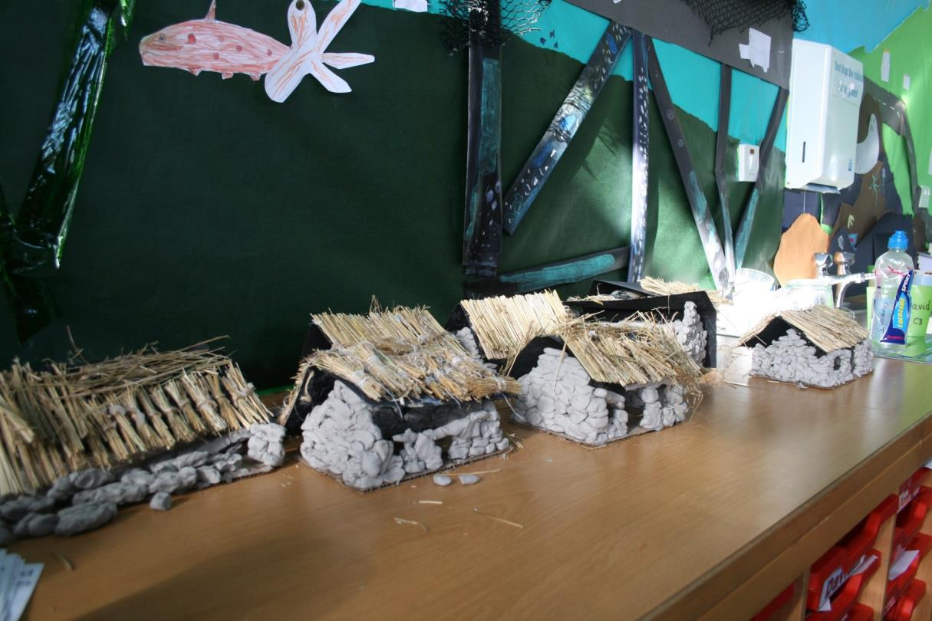
Models
Photograph reproduced with permission of Brian Wilkinson

Slide 19
Models
Artistic and creative
Can use measured drawings for dimensions

Slide 20
Other Ideas?
Add any other ideas you have here.

