Slide 1



Stories in Stone
Welcome to Greyfriars!
1

Slide 2
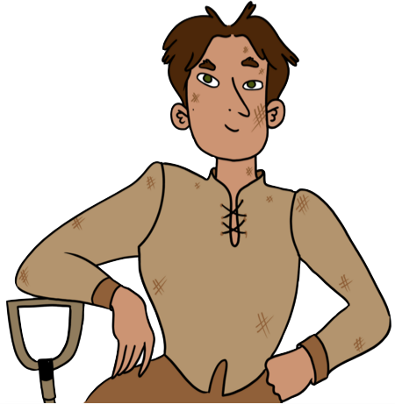
Learning Intentions
We are learning about Greyfriars Kirkyard and the Riddell gravestone to understand:
the importance of gravestones as a historical source
the connections people today make with historic graveyards
Success Criteria
I can describe different types of burial and gravestone.
I can explain how the way in which someone was buried and commemorated tells us about their place in a past society.
I can give one reason why Greyfriars Kirkyard is such a popular tourist attraction.

Slide 3
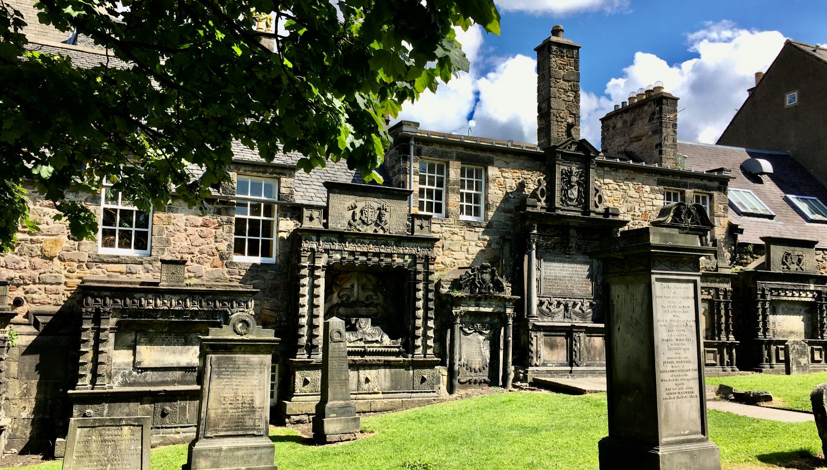

Slide 4
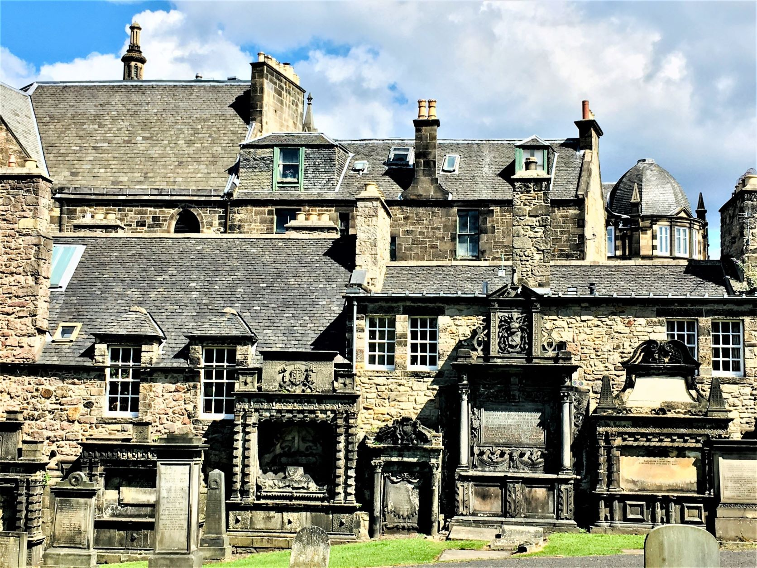
Welcome to Greyfriars Kirkyard!
Has anyone visited Greyfriars before?
Why did you visit?
Did you know…
Greyfriars Kirkyard is the third most popular free visitor attraction in Scotland!

Slide 5
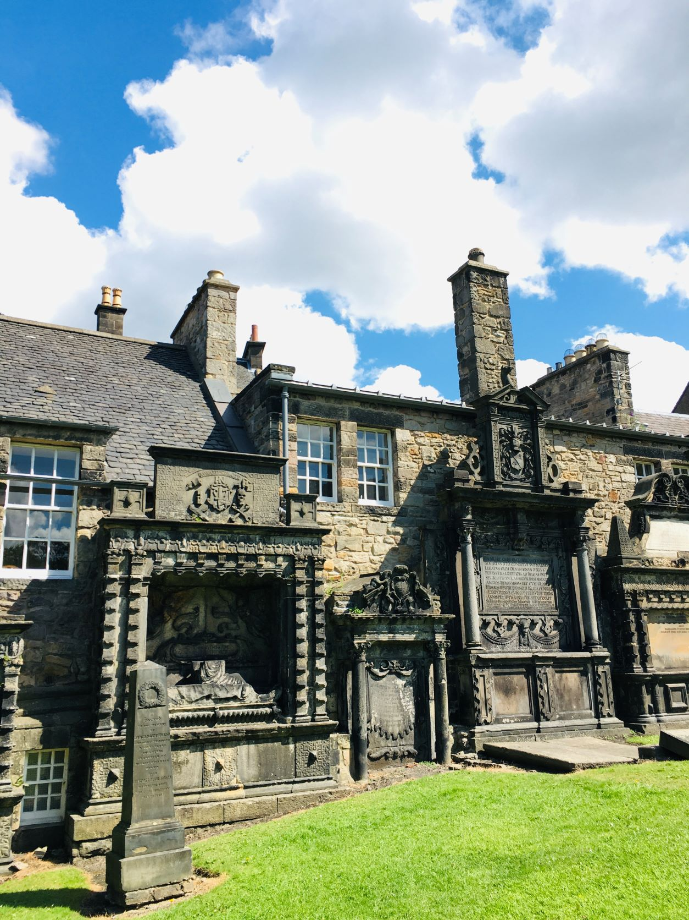
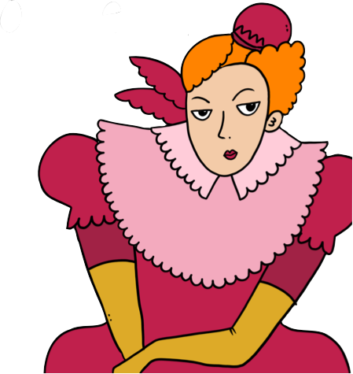
Greyfriars Kirkyard
Greyfriars Kirkyard is the graveyard surrounding Greyfriars Kirk in Edinburgh on land given to the town by Mary Queen of Scots in 1562.

Slide 6

Why are the kirk and kirkyard called
Grey
friars?
They’re named after the Grey Friars, a group of men who lived in a large building that stood here between 1447 and 1559.
Who were the
Grey
Friars?

Slide 7
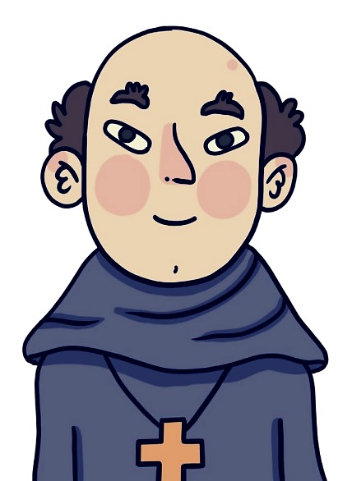

The Grey Friars were a bit like monks. They were Franciscans, followers of St Francis of Assisi.
The word friar comes from the French word for brother, ‘frere’.
They got the name Grey Friars from the grey robes they wore.
Why did they wear drab, grey robes?
They believed that the grey robes symbolized their vow of poverty.

Slide 8
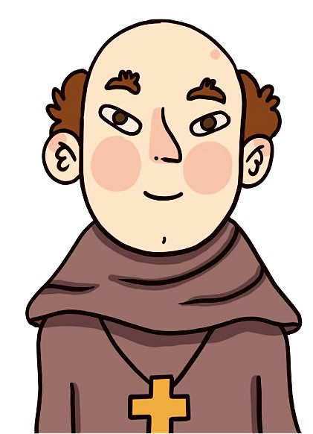

What’s the difference between
a friar
and
a monk?
Friars would go out into the world to care for the sick and poor.
Monks lived their lives inside the monastery, away from the world, in quiet contemplation.

Slide 9


Greyfriars Timeline
1436
Friary built by James I to entice the Franciscan Grey Friars to settle near Edinburgh.
1638
28th February. National Covenant drawn up and signed in Greyfriars Kirk.
1447
Franciscan Friary established in the Grassmarket.
1679
After the Battle of Bothwell Bridge, 1200 covenanters are imprisoned in Greyfriars Kirkyard. Prisoners were kept without shelter and with little food or water for 5 months.
1559
Friary dissolved and destroyed by protestant reformers.
1832
The Anatomy Act puts an end to the need for body snatching by allowing practitioners to use unclaimed bodies.
1561
Petition from the Town Council to open a new graveyard due to overcrowding at St. Giles
Queen Mary granted Friars’ Yards as the common burial place for Edinburgh.
1863
The Littlejohn ‘Report on the Sanitary condition of Edinburgh’ notes that Greyfriars is overcrowded and there are too many bodies in the area of common
ground that is allocated
for burials of the poor.
1562
1602
Building begun on Greyfriars Kirk
1606
John Jackson built a monument to his father, establishing a pattern of mural monuments along the walls in Greyfriars, saving the rest of the ground for grass and trees.
c.1870s
Greyfriars is closed to all new burials
1620
Greyfriars Kirkyard opens to the public

Slide 10
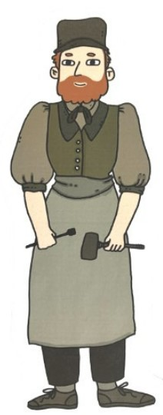
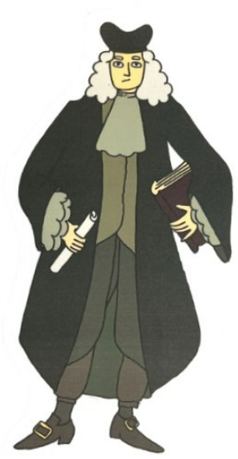
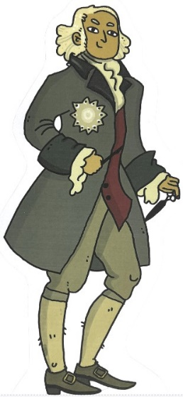
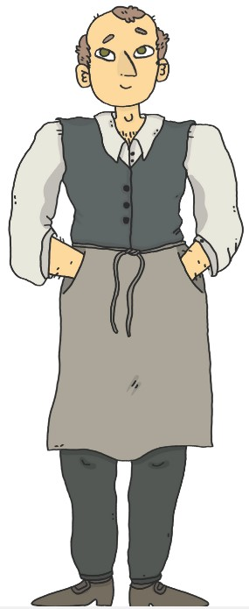
Greyfriars Kirkyard
How can we find out more about the people buried in the kirkyard?

Slide 11





Material
As we explore Greyfriars, we’re going to look at lots of different sources, different types of evidence.
Visual
Can you name any historical sources?
Written
Oral

Slide 12


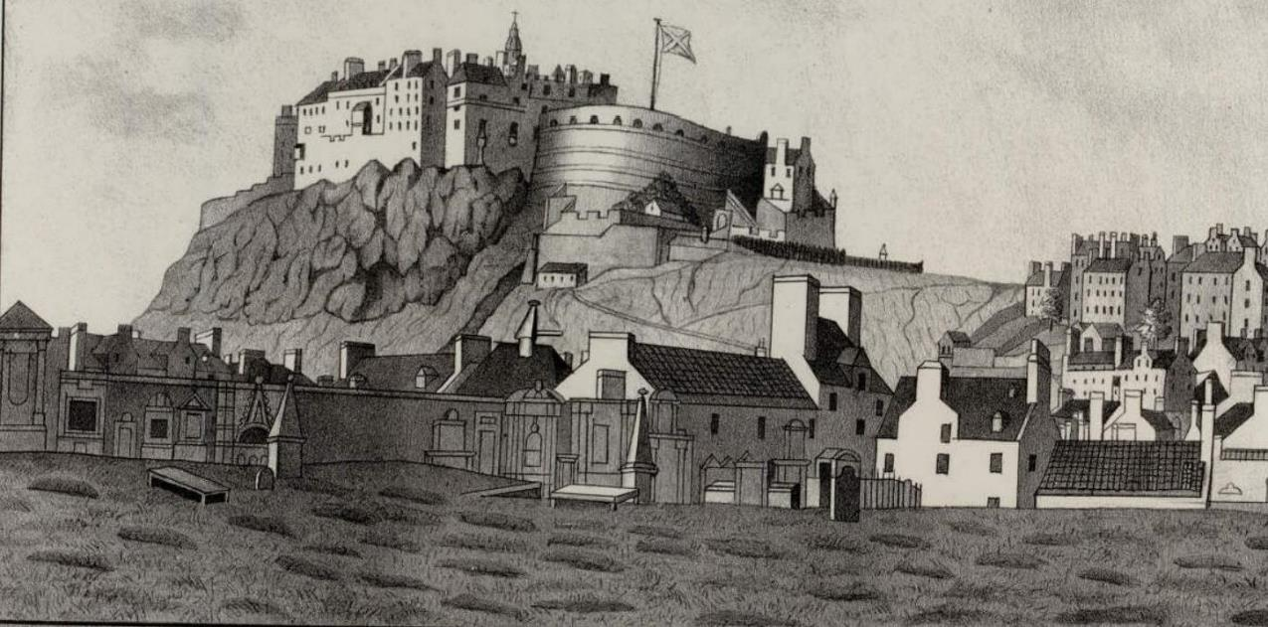
Look at this print of Greyfriars from 1816. What kind of source is this?
It’s a visual source

Slide 13
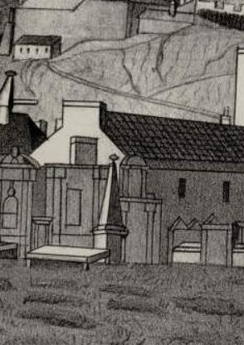


Take a closer look
What can you see above ground in this picture of the kirkyard?
There are different types of burials for different types of people.
How many different types of burial can you see?
Large monuments
Headstones
Table tombs
Body mounds

Slide 14

Why are there different types of burial and gravestone?
Lots of different people are buried in Greyfriars Kirkyard.
Who might be buried where?
merchant
lawyer
weaver
surgeon
poet
candle maker
stone mason
architect
soldier
optician

Slide 15
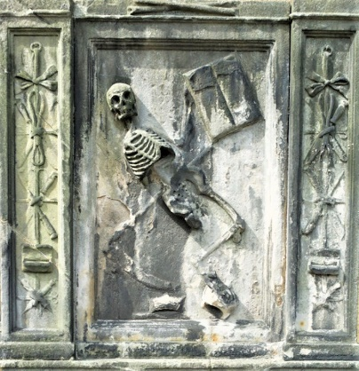
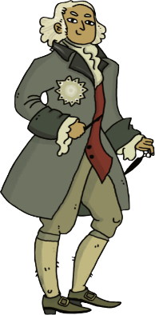
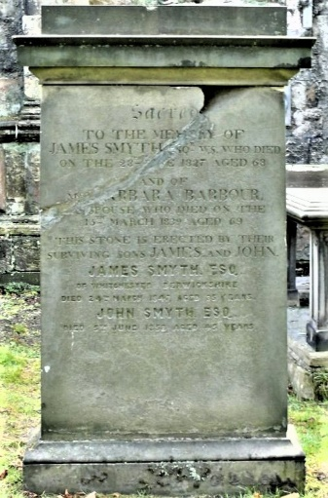
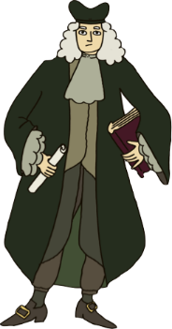
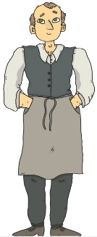
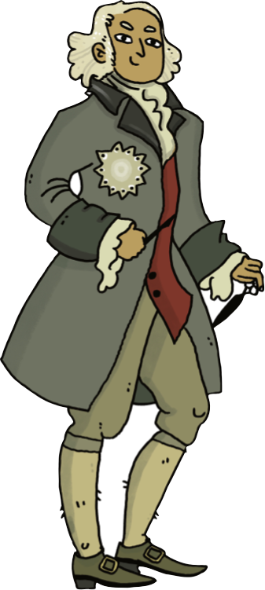
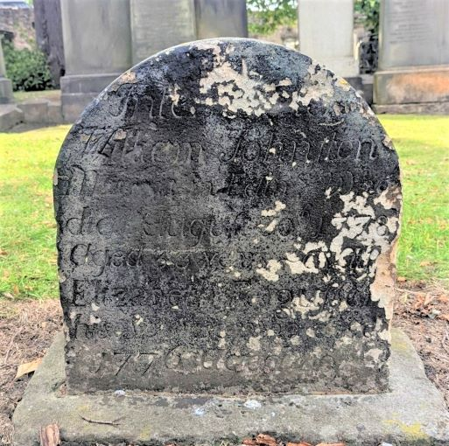
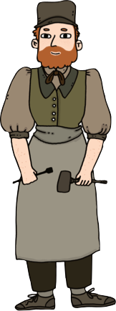
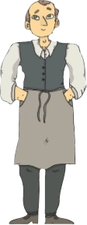
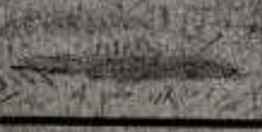
Different types of people are commemorated in different ways, depending on their wealth or status.
Who might be buried where? Can you guess?
Wall Monument
Henry Steele, weaver
James Borthwick, surgeon
Large Headstone
William Johnston, stone mason
Small Headstone
James Smyth, lawyer
Body Mound

Slide 16

‘It’s the inconvenient truth that women have always been 50% of the population, but only occupy around 0.5% of recorded history.’
Where are the women?
Bettany Hughes believes that women’s roles were systematically diminished over thousands of years as power and warfare became the main measure of success in societies.
Dr Bettany Hughes Historian
In the 1800s women had few rights. When a woman got married, any property she owned passed into the ownership of her husband.
We are, therefore, less likely to find the details of women’s lives in official historical sources.

Slide 17
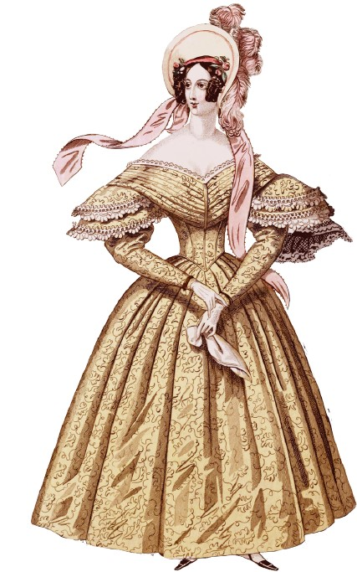

‘It’s the inconvenient truth that women have always been 50% of the population, but only occupy around 0.5% of recorded history.’
Where are the women?
Graveyards are a great source of historical information because we DO see women on gravestones and other memorials. We will see basic information like their name, age, year of birth and names of children. However, further research into their lives is likely to be more difficult than research into their male relatives because they appear in fewer official records.
Dr Bettany Hughes Historian

Slide 18
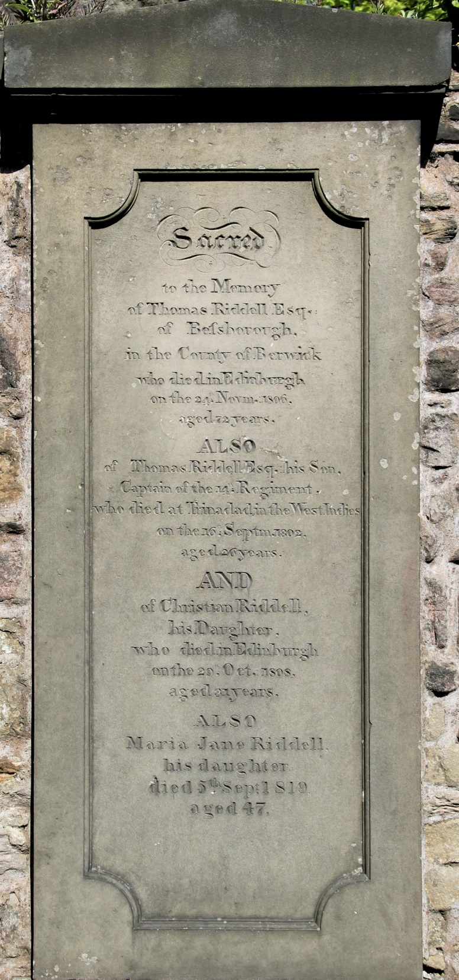





Let’s take a closer look at one of the gravestones in Greyfriars.
What type of source is a gravestone?
It’s a material
and written source
What can we find out about a person from their gravestone?

Slide 19
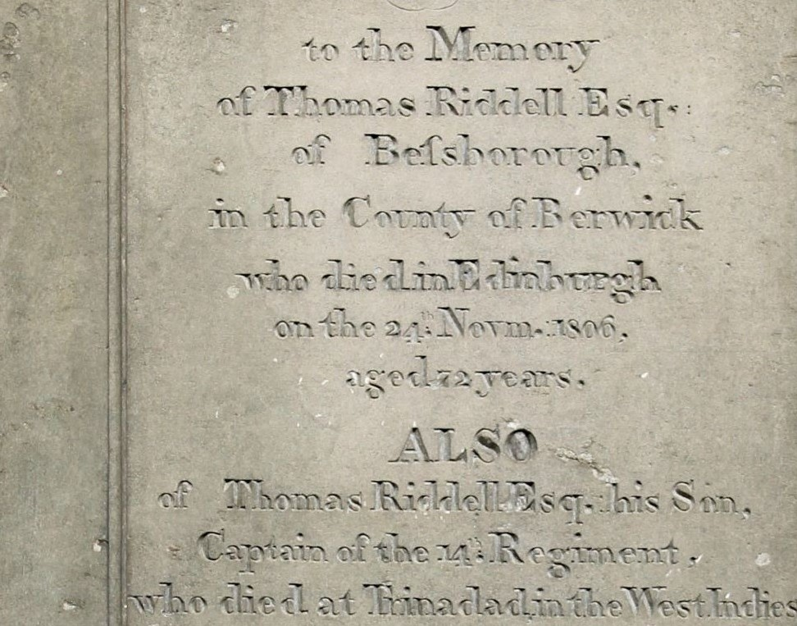

We might find out…
their name
where they lived
when they died
how old they were
what job they did
names of their family members
Can you see any of this information on the gravestone?

Slide 20


This is the grave of Thomas Riddell
Thousands of Harry Potter fans visit Thomas Riddell’s grave every year.
Do you know why?

Slide 21
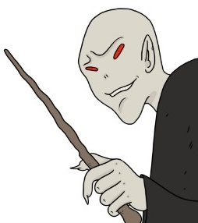

Thomas Riddell’s Grave
Thousands of Harry Potter fans visit Thomas Riddell’s grave every year.
But why?
Harry Potter fans believe that the author JK Rowling named some of her characters after people buried in Greyfriars. The character of the evil wizard Lord Voldemort was born Tom Riddle. Sound familiar?
Do you recognize him?

Slide 22
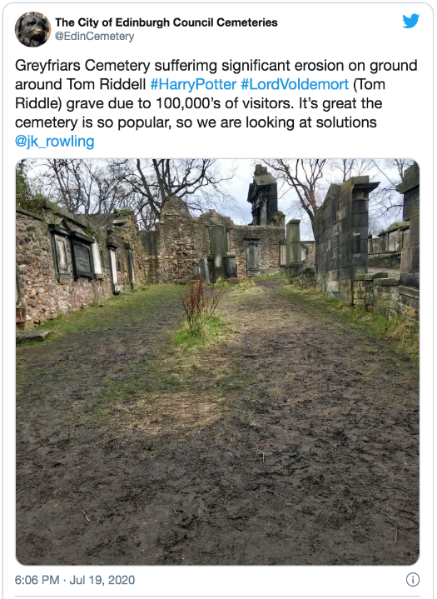


The link to Lord Voldemort attracts thousands of Harry Potter fans to Thomas Riddell’s grave every year
Attracting visitors is a good thing… isn't it?
Read the tweet and newspaper article extract below.
Edinburgh's Greyfriars cemetery suffering 'significant' erosion due to Harry Potter fans' visits.
In the JK Rowling books, Lord Voldemort, played in the films by Ralph Fiennes, was born Tom Marvolo Riddle.
It has been reported that the grave of Thomas Riddell – a general who died on 24 November 1806 at the age of 72 – in Greyfriar’s Cemetery could have inspired JK Rowling when she was naming the character, although the spelling differs.'
From Edinburgh Evening News article by Caitlyn Dewar
20th July 2020

Slide 23


What type of source are these?
They are written sources
Are both sources saying the same thing?
What do they tell us?
Edinburgh's Greyfriars cemetery suffering 'significant' erosion due to Harry Potter fans' visits.
In the JK Rowling books, Lord Voldemort, played in the films by Ralph Fiennes, was born Tom Marvolo Riddle.
It has been reported that the grave of Thomas Riddell – a general who died on 24 November 1806 at the age of 72 – in Greyfriar’s Cemetery could have inspired JK Rowling when she was naming the character, although the spelling differs.'
What problems are the Harry Potter fans creating?
Can you think of any solutions to this problem?

Slide 24

The Council’s solution was to build a path for visitors to Thomas Riddell’s grave, so they no longer have to walk across the grass.

Slide 25
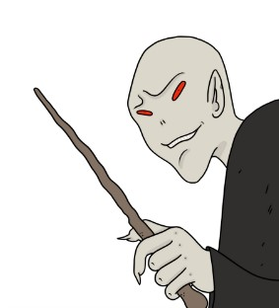

We’ve discovered that the grave of Thomas Riddell may have inspired one of the greatest fictional villains of the 20th century.
Lord Voldemort!
But who was the REAL Thomas Riddell?
And did he have anything in common with his villainous namesake?
Let’s find out!

Slide 26

Stories in Stone
Welcome to Greyfriars!
Extension Activity

Slide 27
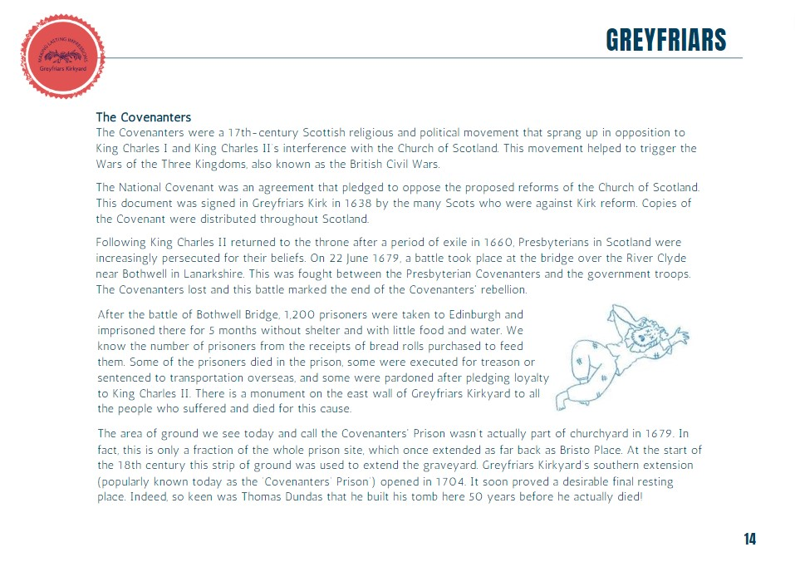
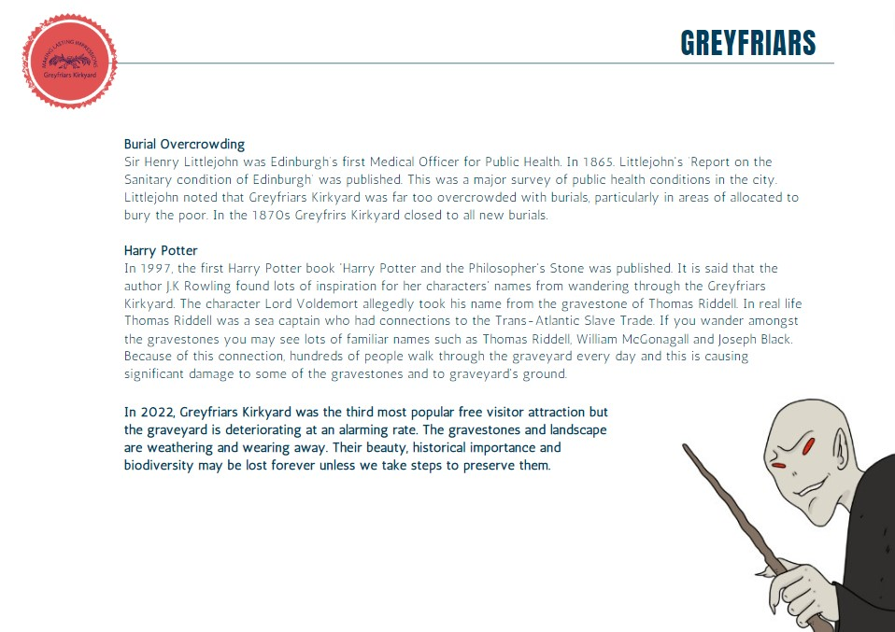
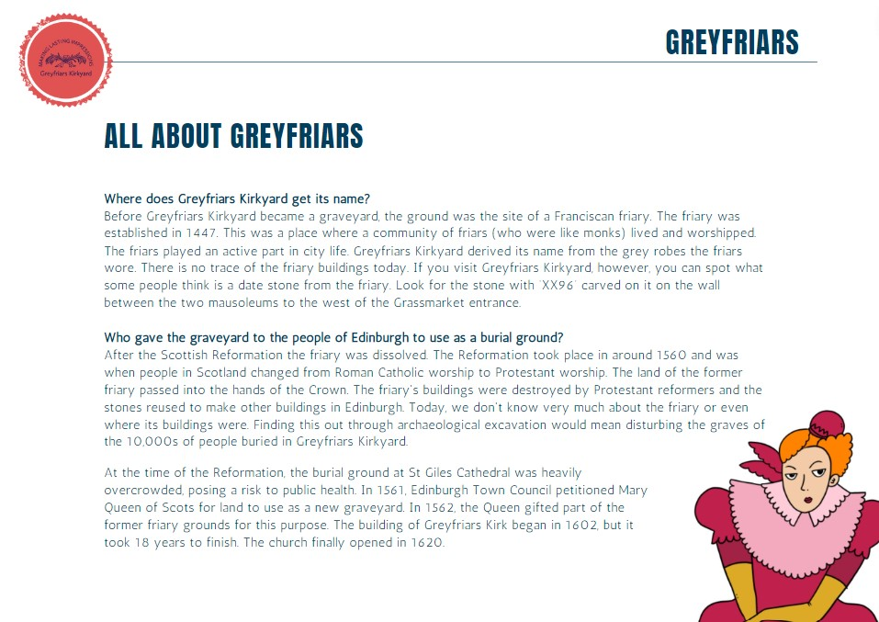
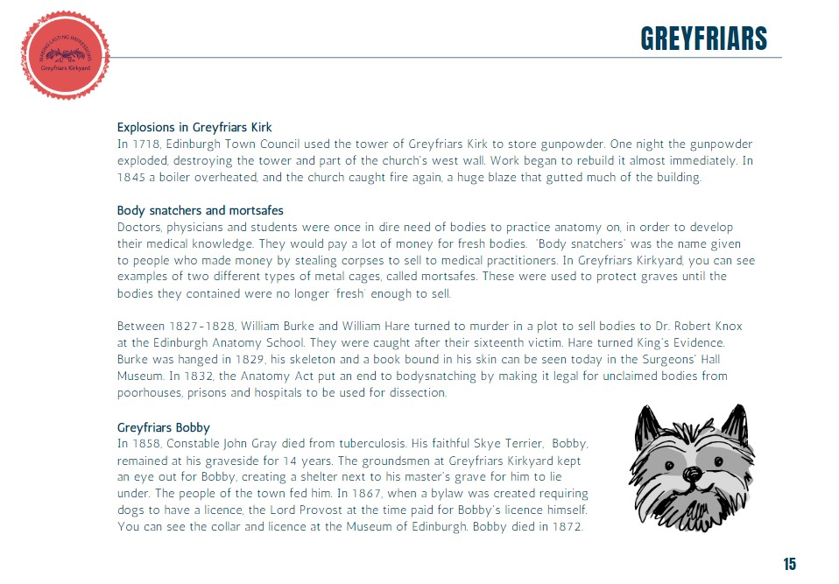
Greyfriars Timeline Quiz
Work in groups to complete the quiz.
Use the All About Greyfriars information sheets.

Slide 28

Test your Knowledge!
Greyfriars Timeline Quiz
1.
2.
3.
4.
Where does Greyfriars Kirkyard get its name from?
The grey stones of the graveyard
The grey robes of the friars who lived in the friary
The grey skies of Edinburgh
Who gave the land to the city of Edinburgh to use as a burial ground in 1562?
Mary Queen of Scots
Sir George 'Bluidy' Mackenzie
J.K Rowling
The building of Greyfriars Kirk began in 1602. How long did it take to build?
18 months
18 years
28 years
After the Battle of Bothwell Bridge in 1679, 1,200 Covenanters were imprisoned in Edinburgh?
True
False
5.
6.
7.
8.
What was a mortsafe used for?
To lock up body snatchers
To keep bodies safe until they were too decayed for body snatchers to steal
This was where the gravediggers kept their tools
Why was Greyfriars Kirkyard closed to new burials in 1870?
It had become too haunted
Too full because of too many bodies
Too full because of too many tourists
The name of the character Lord Voldemort was inspired by which real life person buried in Greyfriars Kirkyard?
Captain Thomas Riddell
William McGonagall
James Black
Greyfriars Kirkyard is one of the most popular FREE visitor attractions in Scotland today.
True
False

Slide 29
