Slide 1



Stories in Stone
Finding the Real Riddells
2

Slide 2
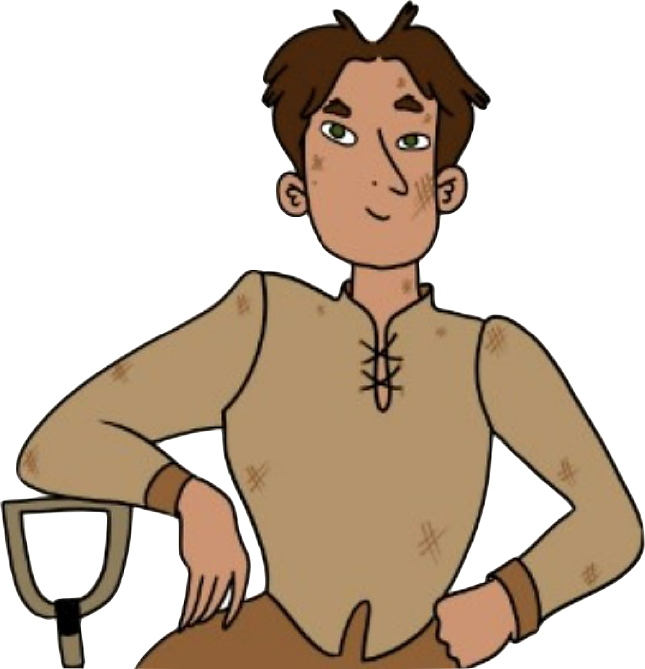
Learning Intentions
We are learning about Greyfriars Kirkyard and the Riddell gravestone to understand:
how we can gather historical information about people in the past from gravestones.
how we can share historical information in different ways to make it easier to understand.
Success Criteria
I can identify and give examples of the four different types of historical source.
I can list the information a gravestone can give us about the person or people it’s dedicated to.
I can draw a family tree using information from the Riddell family gravestone.

Slide 3
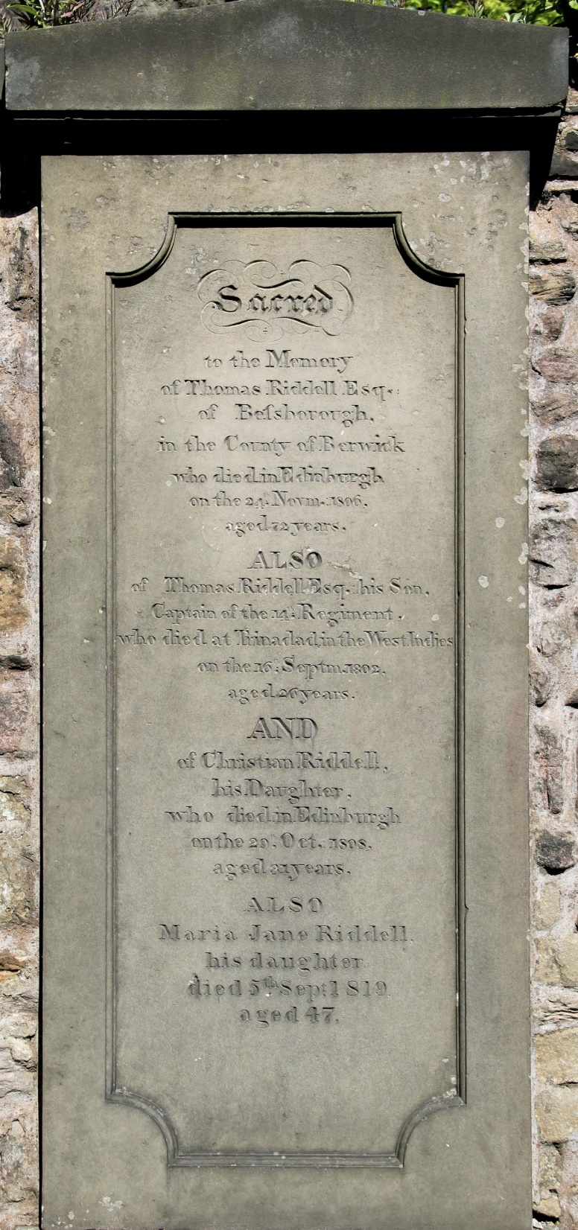
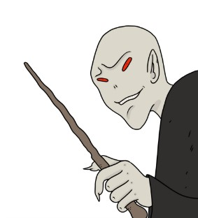
Who was the real Thomas Riddell?
We discovered that Harry Potter fans believe that Thomas Riddell was the inspiration behind the villainous character, Lord Voldemort.
But was it just a name they shared, or did they have anything else in common?
Time to do some historical detective work!
Let’s take a closer look at the Riddell family gravestones and other historical sources to see what we can find out!

Slide 4


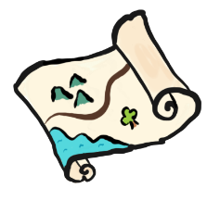


To uncover the true story of Thomas Riddell and his family we’ll need to look for clues…
What types of sources are these?
…in historic documents
material
visual
written
oral
…on historic maps
What information do the different types of sources give us?
…in paintings
…on gravestones

Slide 5
Where would you uncover the following information?
Names of other members of their family
A person’s name
historic
documents
The year they were born
What they looked like
historic
maps
paintings
The name of the place where they lived
gravestones
What job they did

Slide 6
Look how much information we can get from gravestones!
We don’t always get all this information but sometimes we get even more. Some gravestones have pictures or sculptures of the person carved onto them.
Names of other members of their family
A person’s name
historic
documents
The year they were born
What they looked like
historic
maps
paintings
The name of the place where they lived
gravestones
What job they did

Slide 7
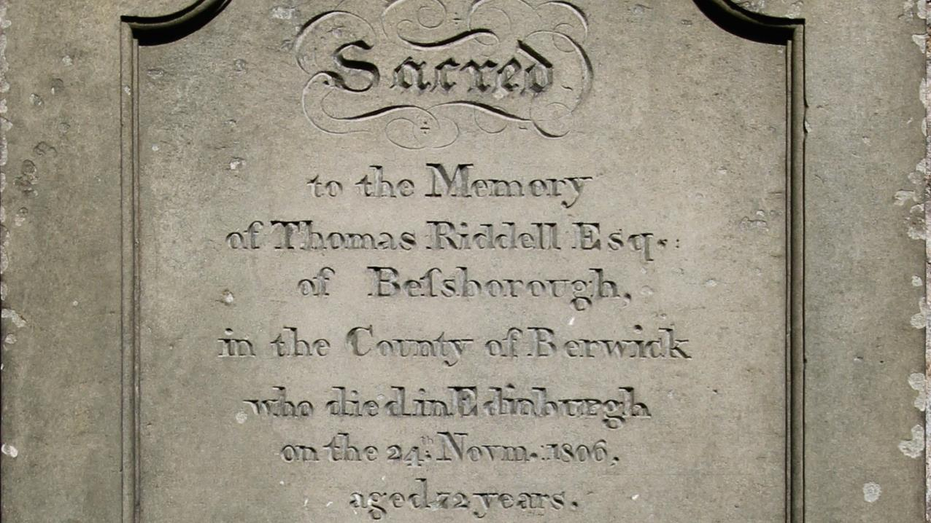
Discovering the Real Thomas Riddell
What clues do the gravestones give us about the real Thomas Riddell and his family?
Look at the Riddell gravestones and complete the questions and activities on the Explore Card

Slide 8
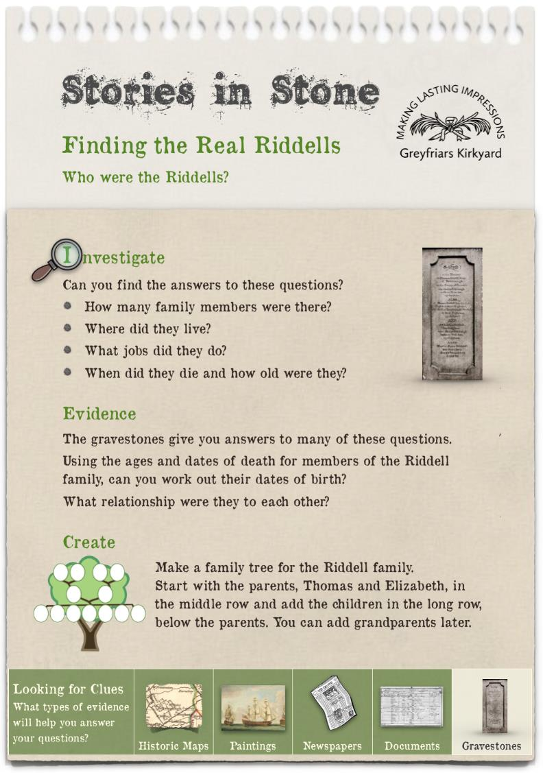
Discovering the Real Riddells
To complete the activities on the Explore Card you will need:
Photographs of the Riddell gravestones (there are 2 stones for the Riddell family)
Paper and pencil or pen
Family tree template
A calculator (optional–you might want to try doing the calculations without a calculator)

Slide 9
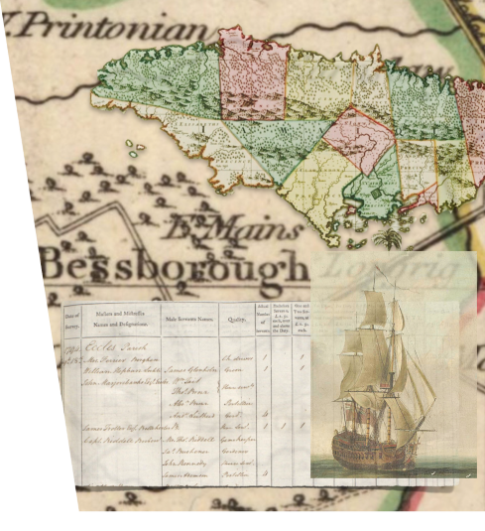
Have we come any closer to uncovering the story of the real Riddell family?
The gravestone gives us lots of facts about the Riddell family but to really explore their story, we’ll need to look at other sources of evidence.
The Riddell family story begins and ends in Scotland but their lives take us on a journey around the world and back into one of the darkest chapters from Scotland's past.
Let’s uncover their story!
Maps reproduced with the permission of the National Library of Scotland

Slide 10
Stories in Stone
Finding the Real Riddells
Extension Activity

Slide 11
Other Faiths
We have found the Riddell family in Greyfriars Kirkyard. Greyfriars is a Church of Scotland burial ground but it is important to consider how other faiths in Scotland deal with their dead. Some of you may not have experienced Church of Scotland traditions but will be more familiar with practices from other faiths.
Investigation
What can you find out about the traditions and practices of other faiths, for example Hinduism, Sikhism, Judaism, Islam or choose a religion that interests you.
Where are the places of importance for these groups in Edinburgh?

Slide 12




