Slide 1
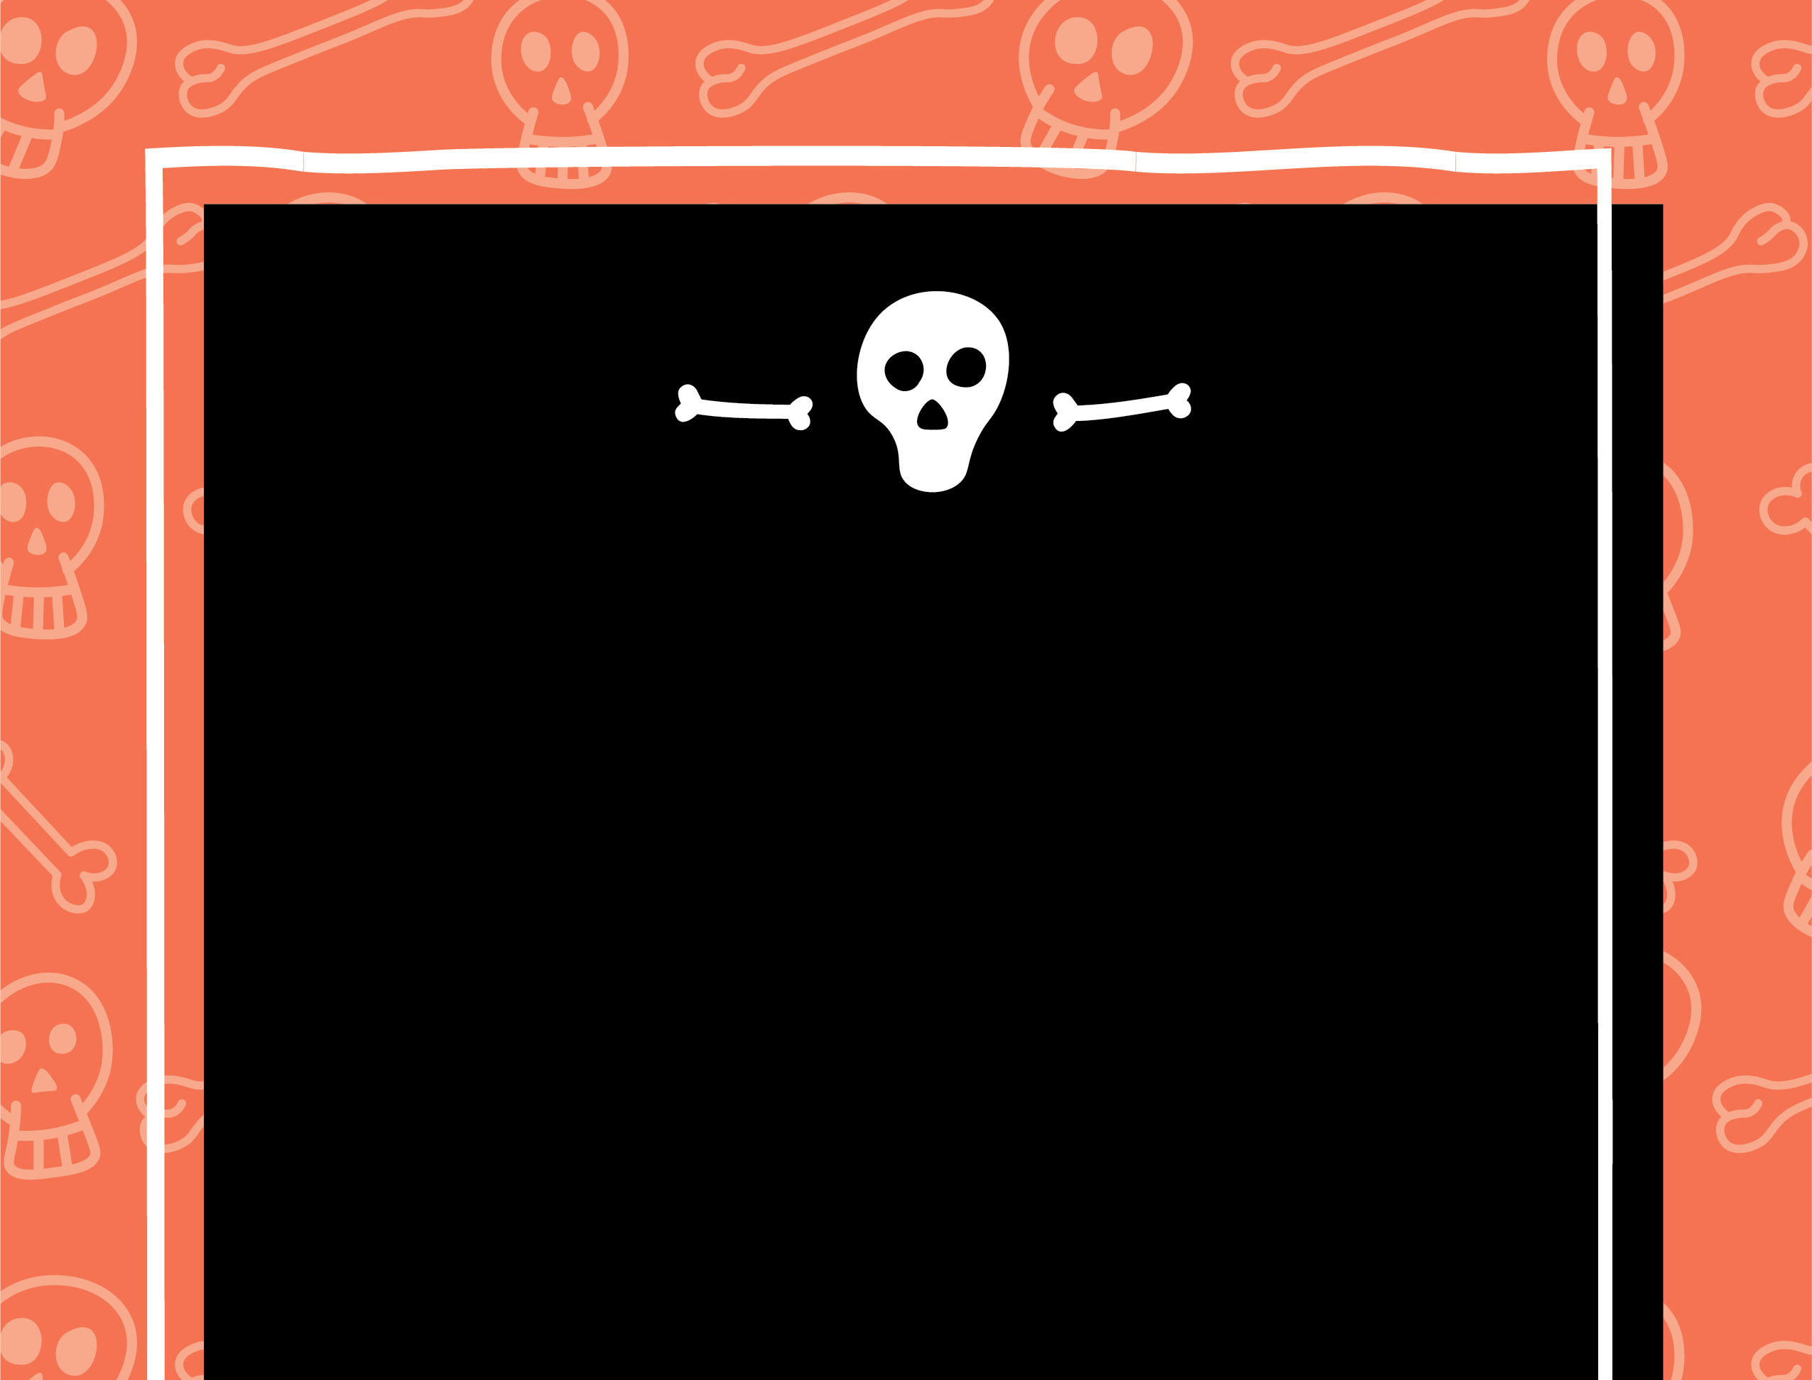
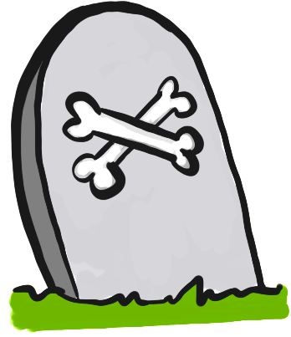

Greyfriars Kirkyard
Greyfriars Kirkyard
DARK TOURISM

Slide 2
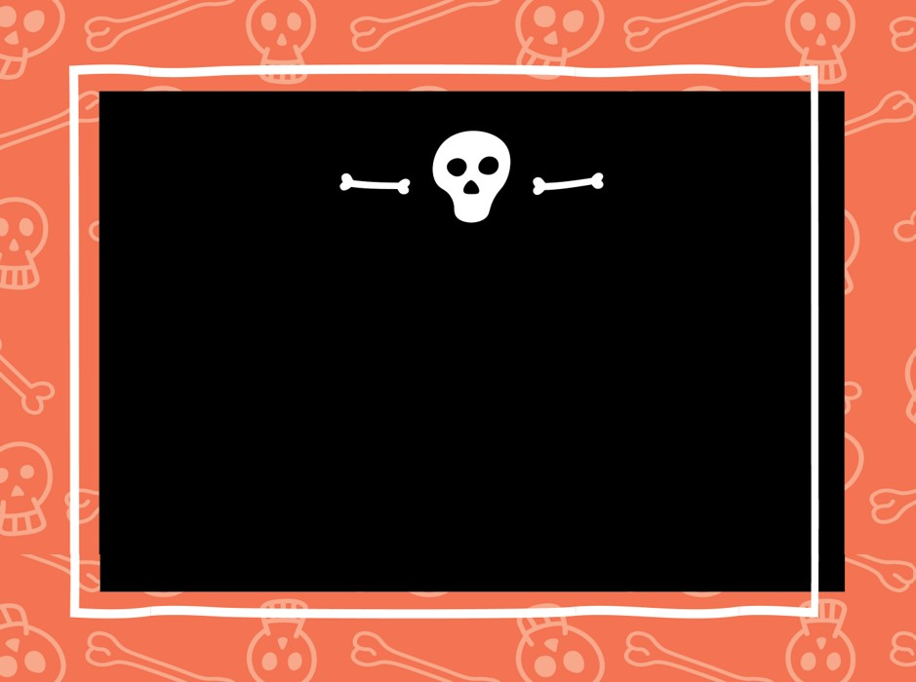
DARK TOURISM
What is dark tourism?
Dark Tourism is tourism that is associated with death, tragedy or the macabre. It has become increasingly popular in the last few years.

Slide 3
DARK TOURISM
Let’s explore some dark tourism themes that link to Greyfriars Kirkyard and the City of Edinburgh.

Slide 4
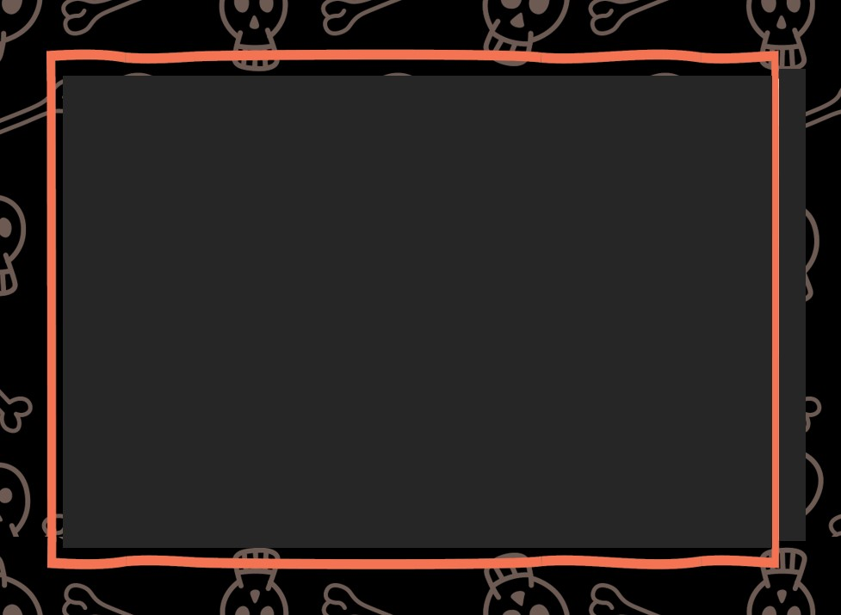
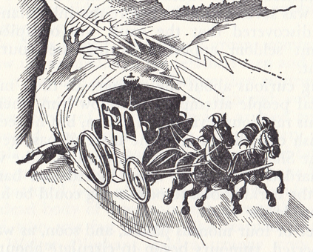
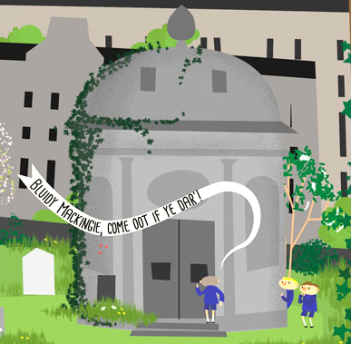
Ghosts
Tragedies and villains from Edinburgh’s past are said to haunt people today.

Slide 5
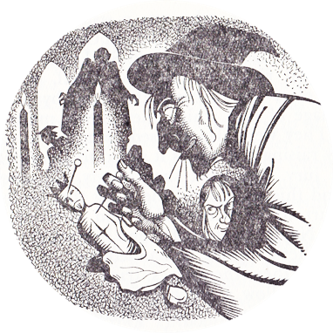
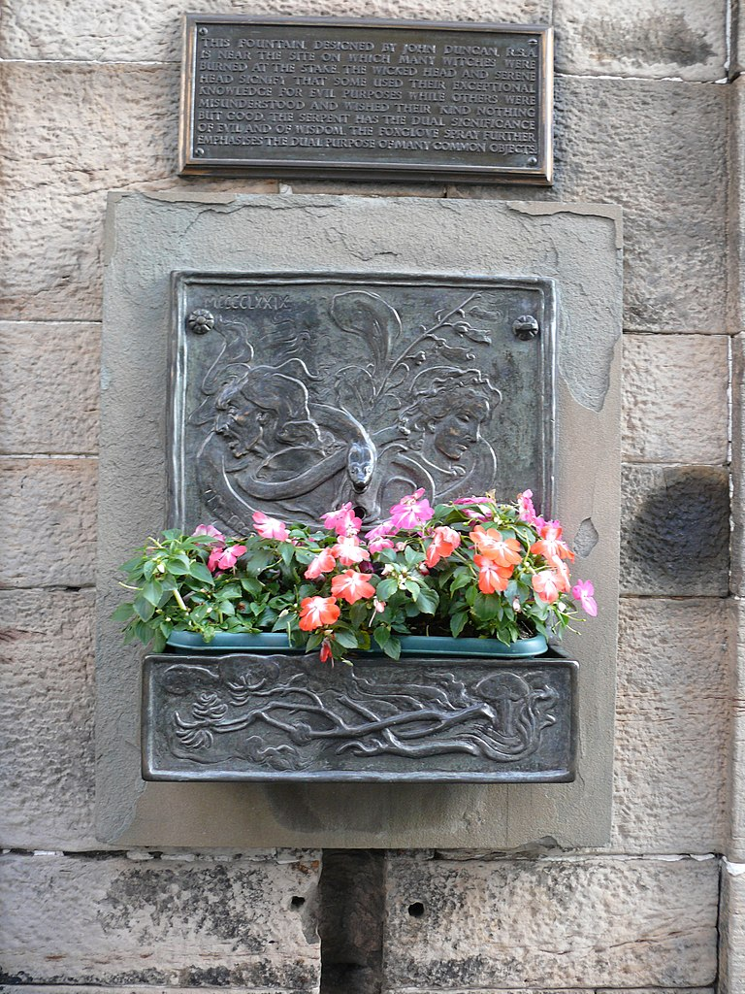
Witches
The Witches’ Well by Edinburgh Castle is near to where 300 women were burned as witches.

Slide 6
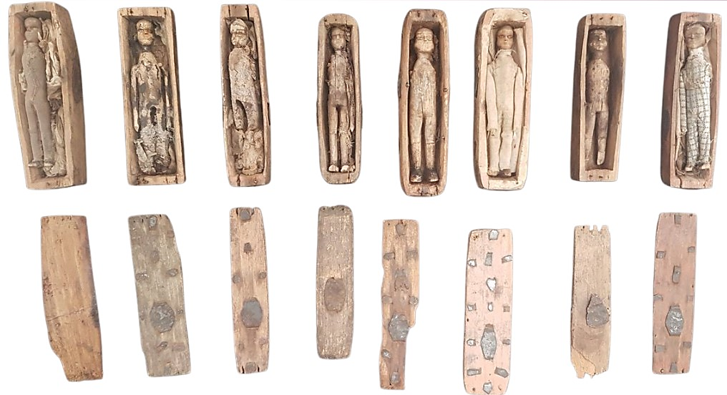
Burials of all kinds
In 1836 a group of boys found 17 small coffins in a cave on Arthur’s Seat. Who made them and why, is a mystery.
You can see the Arthur’s Seat coffins in the National Museum of Scotland

Slide 7
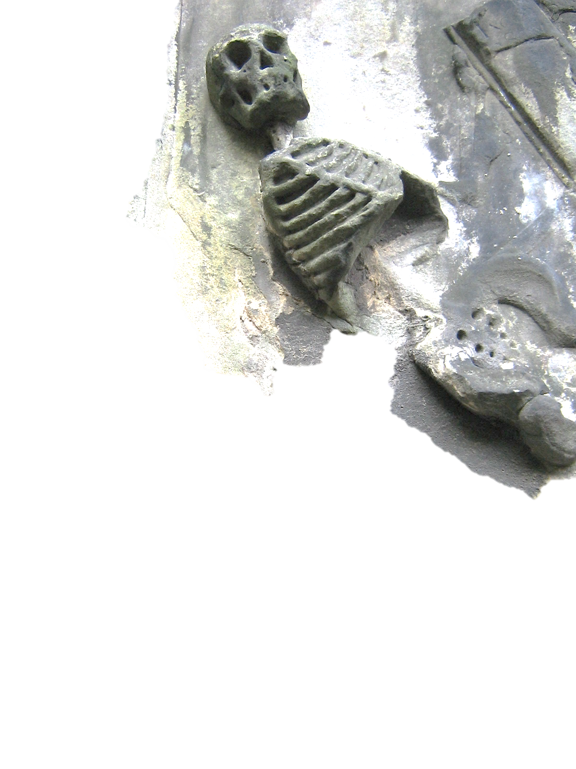
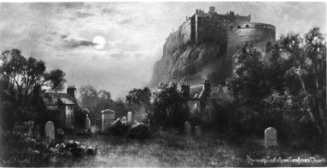
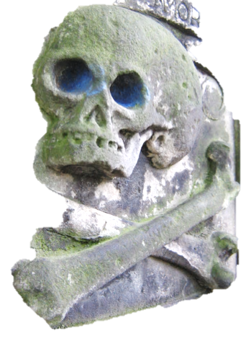
Graveyards
Greyfriars Kirkyard is said to be the world’s most haunted graveyard.

Slide 8
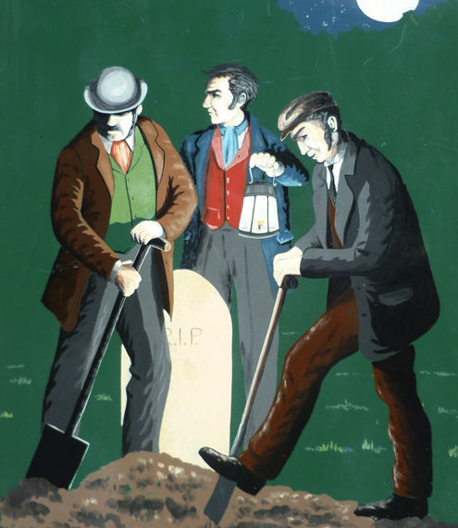
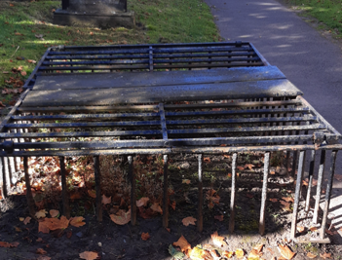
Grave robbing
The crime of stealing bodies to sell to medical schools.

Slide 9
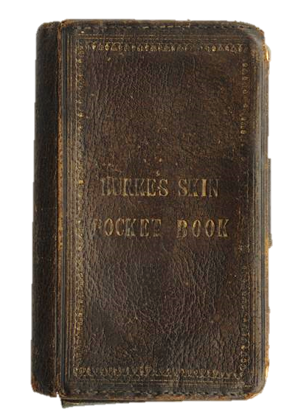
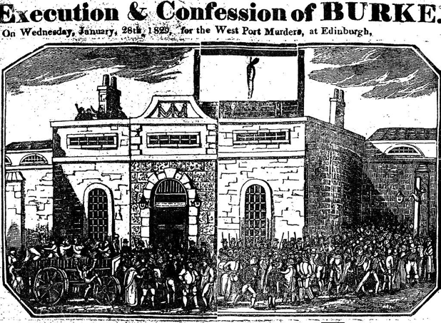
Burke and Hare
Murderers who sold their victims’ bodies to Dr Knox for medical dissection.

Slide 10
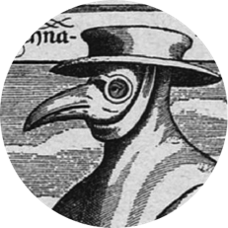
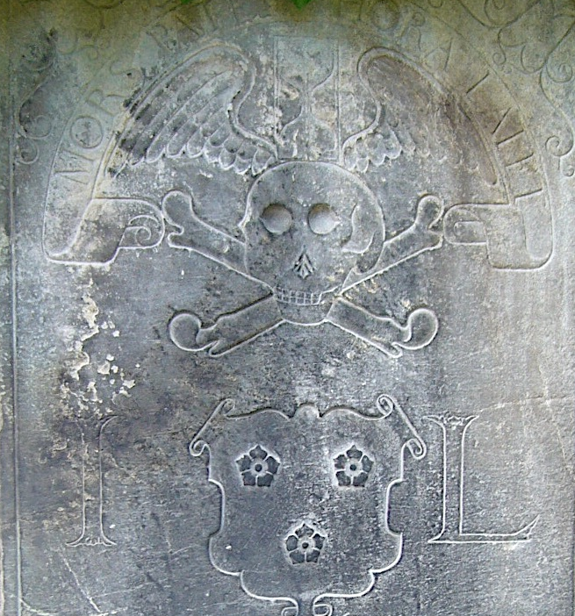
Plagues and epidemics
The Burgh Muir was an area of open ground outside the city. In early times, when people were infected by the plague they were brought here. Many died and were buried here.

Slide 11
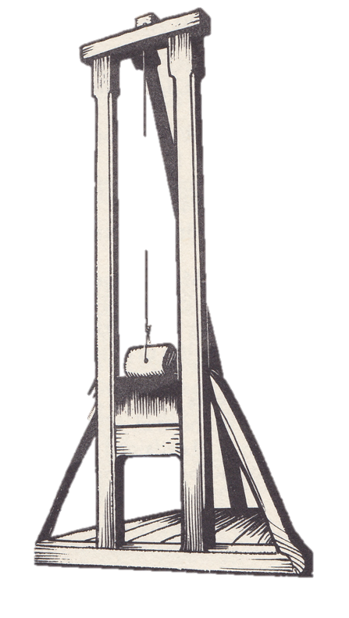
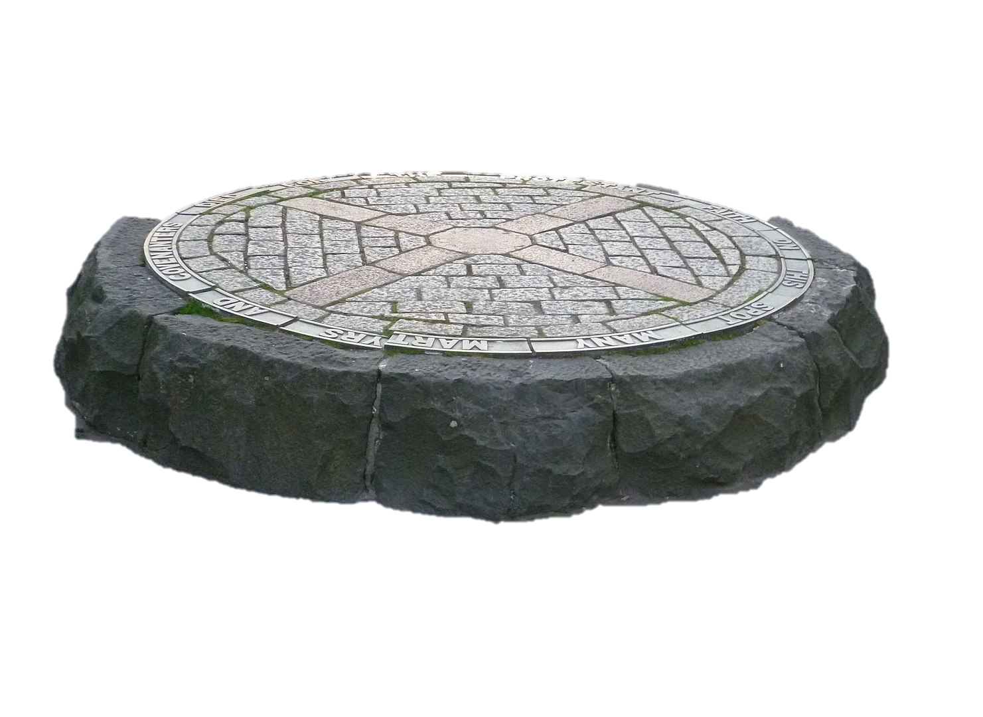
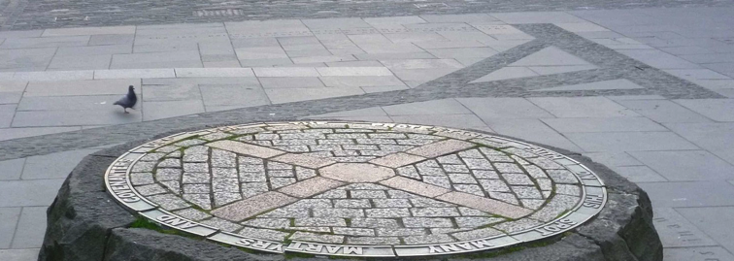
Executions
Spot the hangman’s gibbet marked out in the pavement on the Grassmarket.

Slide 12
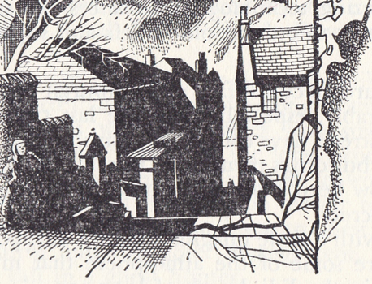
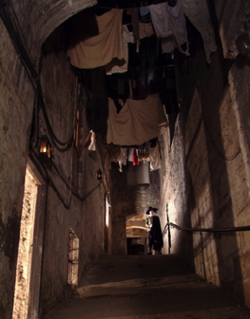
Closes
Edinburgh’s Old Town has many closes, narrow passageways that run between tall buildings. Sometimes, like in the case of Mary King’s Close, these are now below-ground.

Slide 13
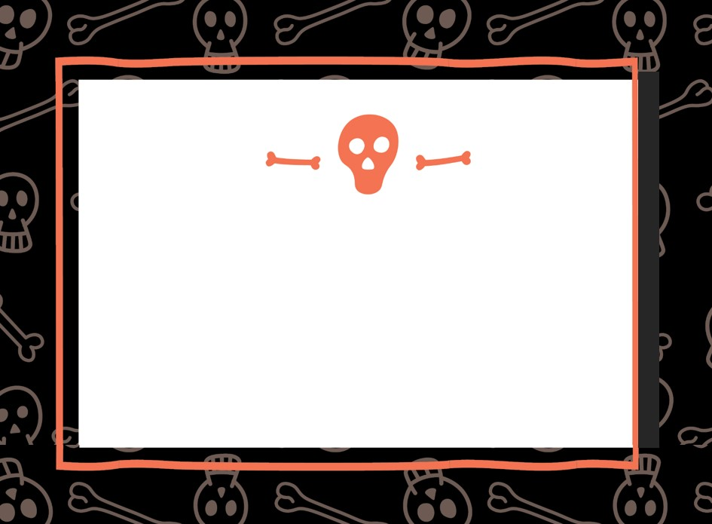
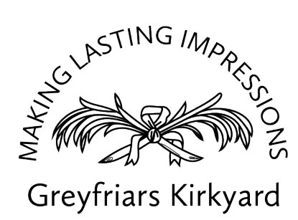




Slide 14

Acknowledgements
Slide 4: Ghosts – Illustration of Bloody Mackenzie’s Tomb by Carmen Moran
Slides 4 (Ghosts), 5 (Witches) and 12 (Closes) Black and white illustrations by John Mackay fromthe 1975 book Curiosities of Old Edinburgh by Charles W Cameron printed by Albyn Press.
Slide 5: Witches - Witches’ Well: Foto Ad Meskens
Slide 8: Grave Robbing - mortsafe photo by Colin Cargil
Slide 9: Burke and Hare - Probably a supplement of the Edinburgh Courant, Public domain, via Wikimedia Commons
©Surgeons' Hall Museums - Pocketbook is made from the skin of William Burke after his corpse had been publicly dissected by Professor Alexander Monro tertius at the University of Edinburgh. On the back an inscription reads 'Executed 28 Jan 1829' and there is a pencil inside.
Slide 10: Plagues – Burgh Muir Stone - Kim Traynor, CC BY-SA 3.0 <https://creativecommons.org/licenses/by-sa/3.0>, via Wikimedia Commons
Illustration by John Mackay in J F Birrell's an Edinburgh Alphabet published in 1980 by James Thin.
Plague mask https://commons.wikimedia.org/wiki/File:Paul_Fürst,_Der_Doctor_Schnabel_von_Rom_(Holländer_version).png
Slide 11: Executions - Shadow of the gibbet, Grassmarket Edinburgh Kim Traynor, CC BY-SA 3.0 <https://creativecommons.org/licenses/by-sa/3.0>, via Wikimedia Commons
Slide 12: Closes - The Real Mary King's Close at en.wikipedia, Public domain, via Wikimedia Commons

