Slide 1


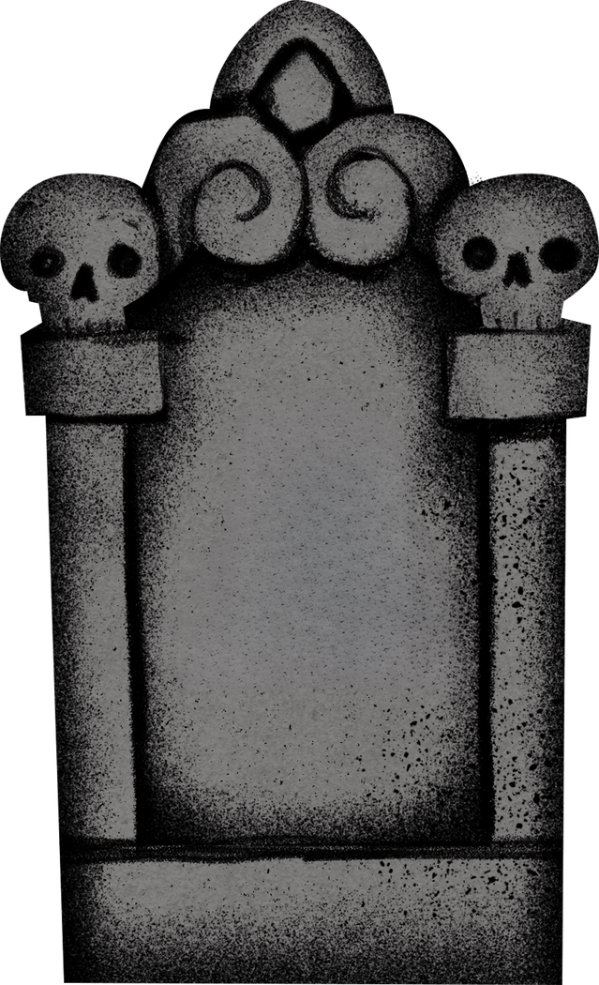

DUNFERMLINE ABBEY CHURCHYARDS
Travel Back in Time at the Dunfermline Abbey Churchyards
RESOURCES FOR PRIMARY SCHOOLS

Slide 2
Activities:
  Dunfermline Abbey Churchyards Timeline
  Looking at how the Abbey Churchyards have changed over time
RESOURCES FOR PRIMARY SCHOOLS

Slide 3
Travel Back in Time at the Dunfermline Abbey Churchyards
  Dunfermline Abbey Churchyards Timeline
RESOURCES FOR PRIMARY SCHOOLS

Slide 4
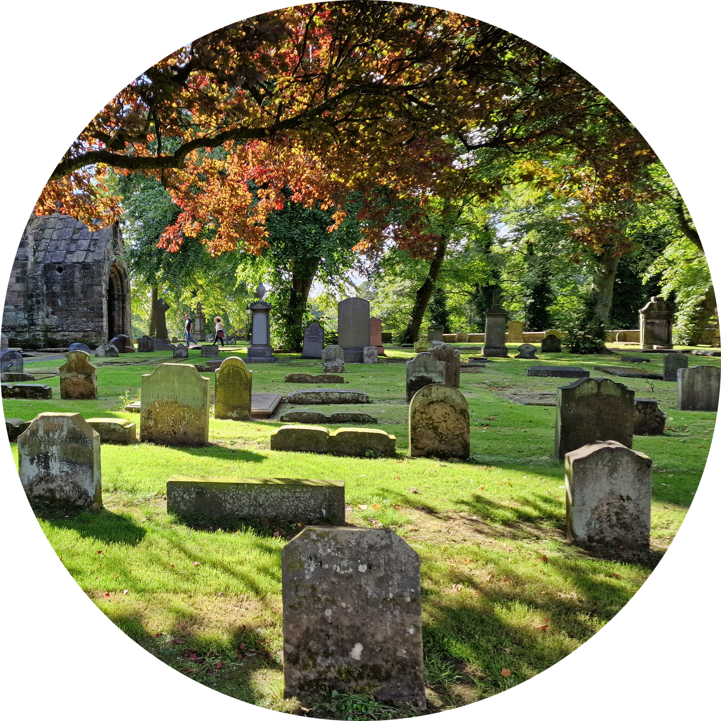
Dunfermline Abbey Churchyards Timeline
Our timeline shows the dates of when important events happened in the history of:
  Dunfermline Abbey
  Dunfermline the place
  Scotland
Looking at the next two slides, decide whether events are important to the history of the Abbey, Dunfermline or to the whole of Scotland.

Slide 5
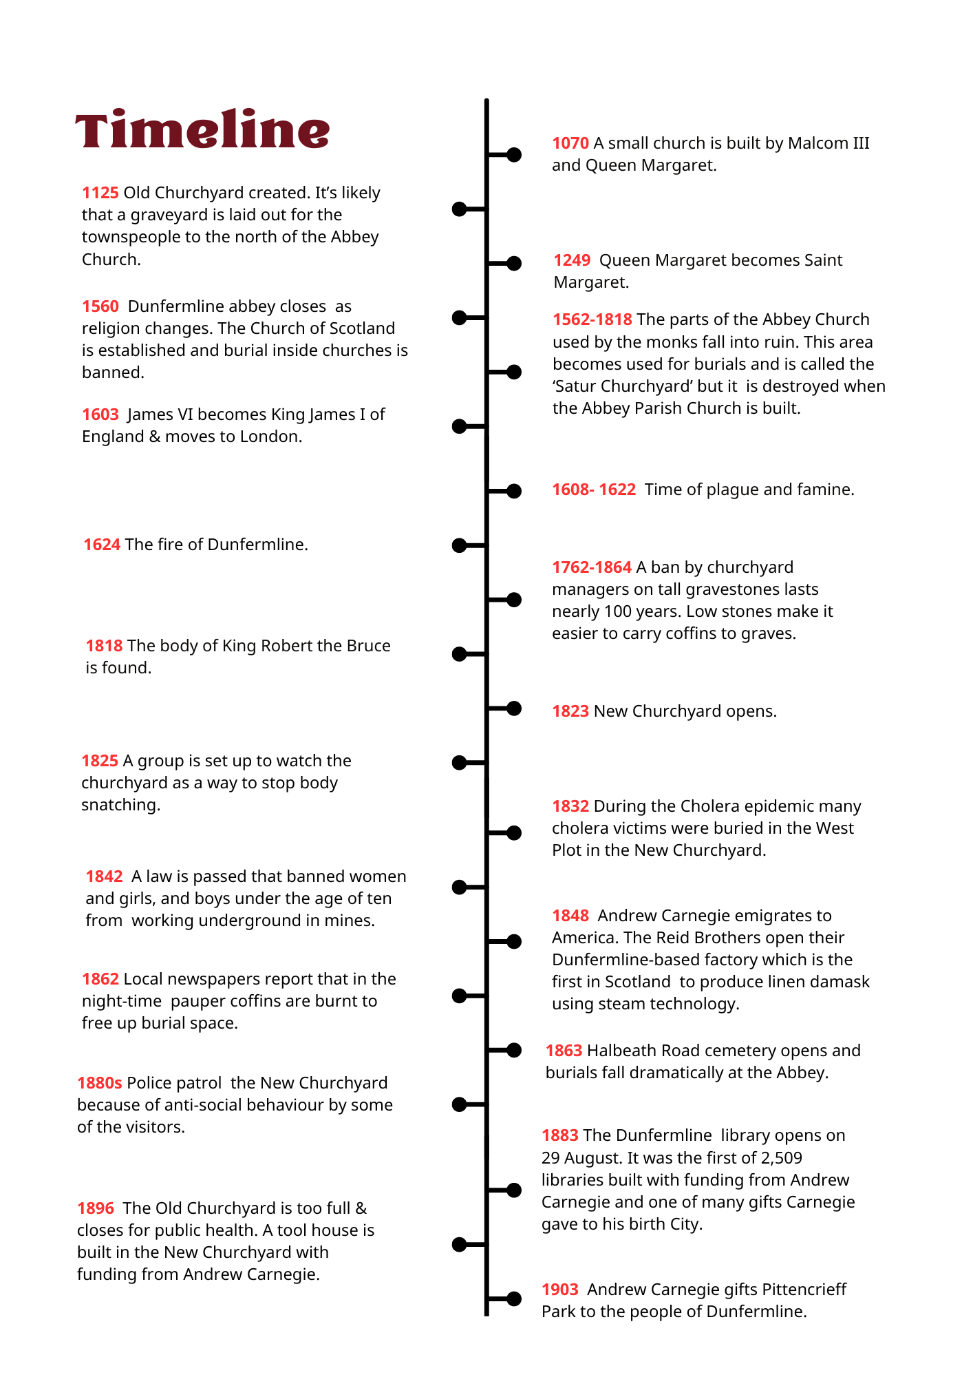
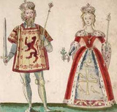
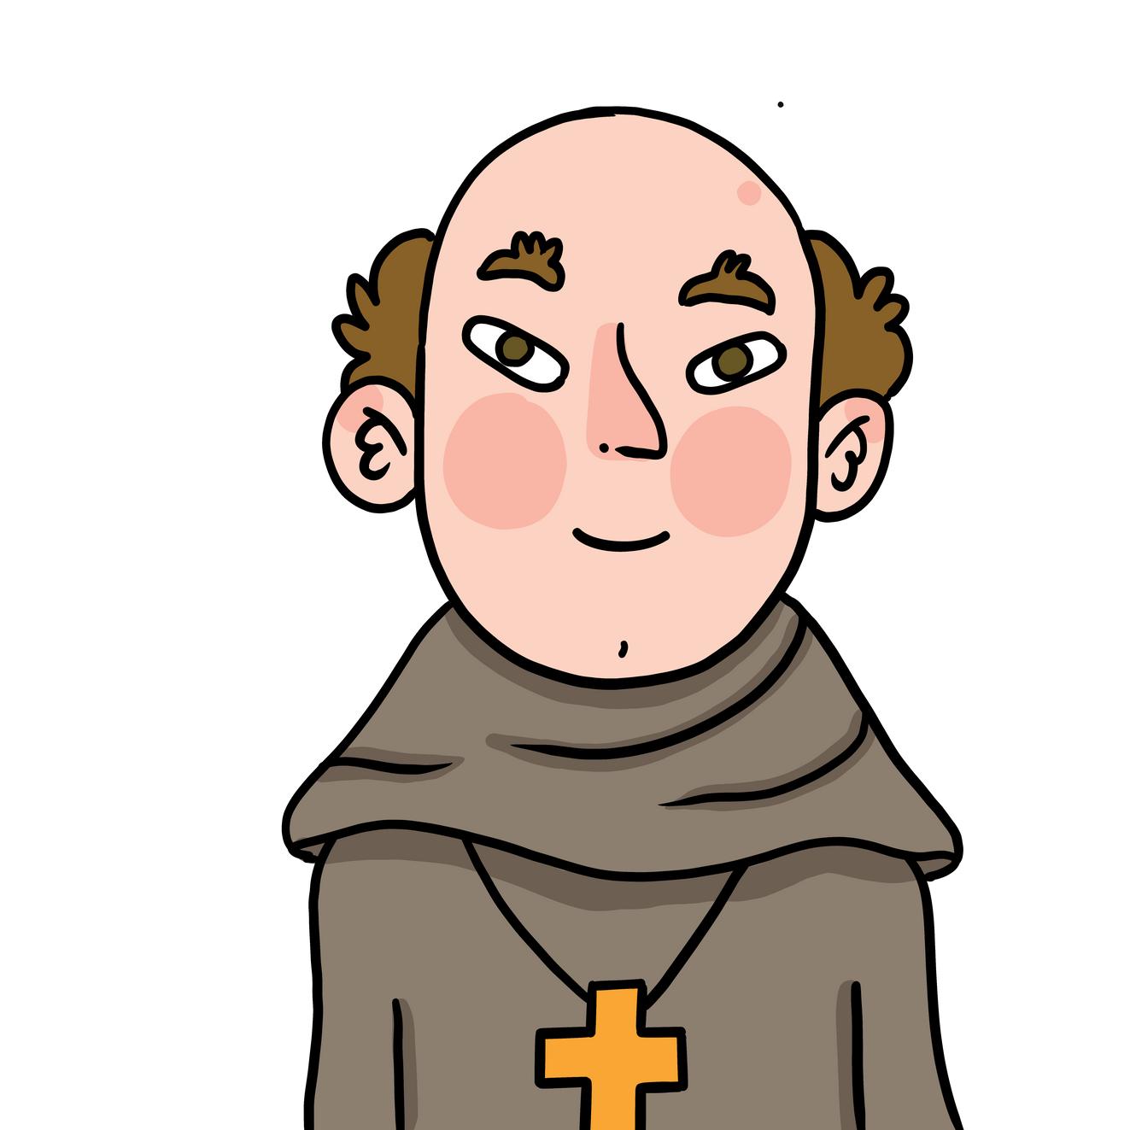
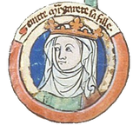
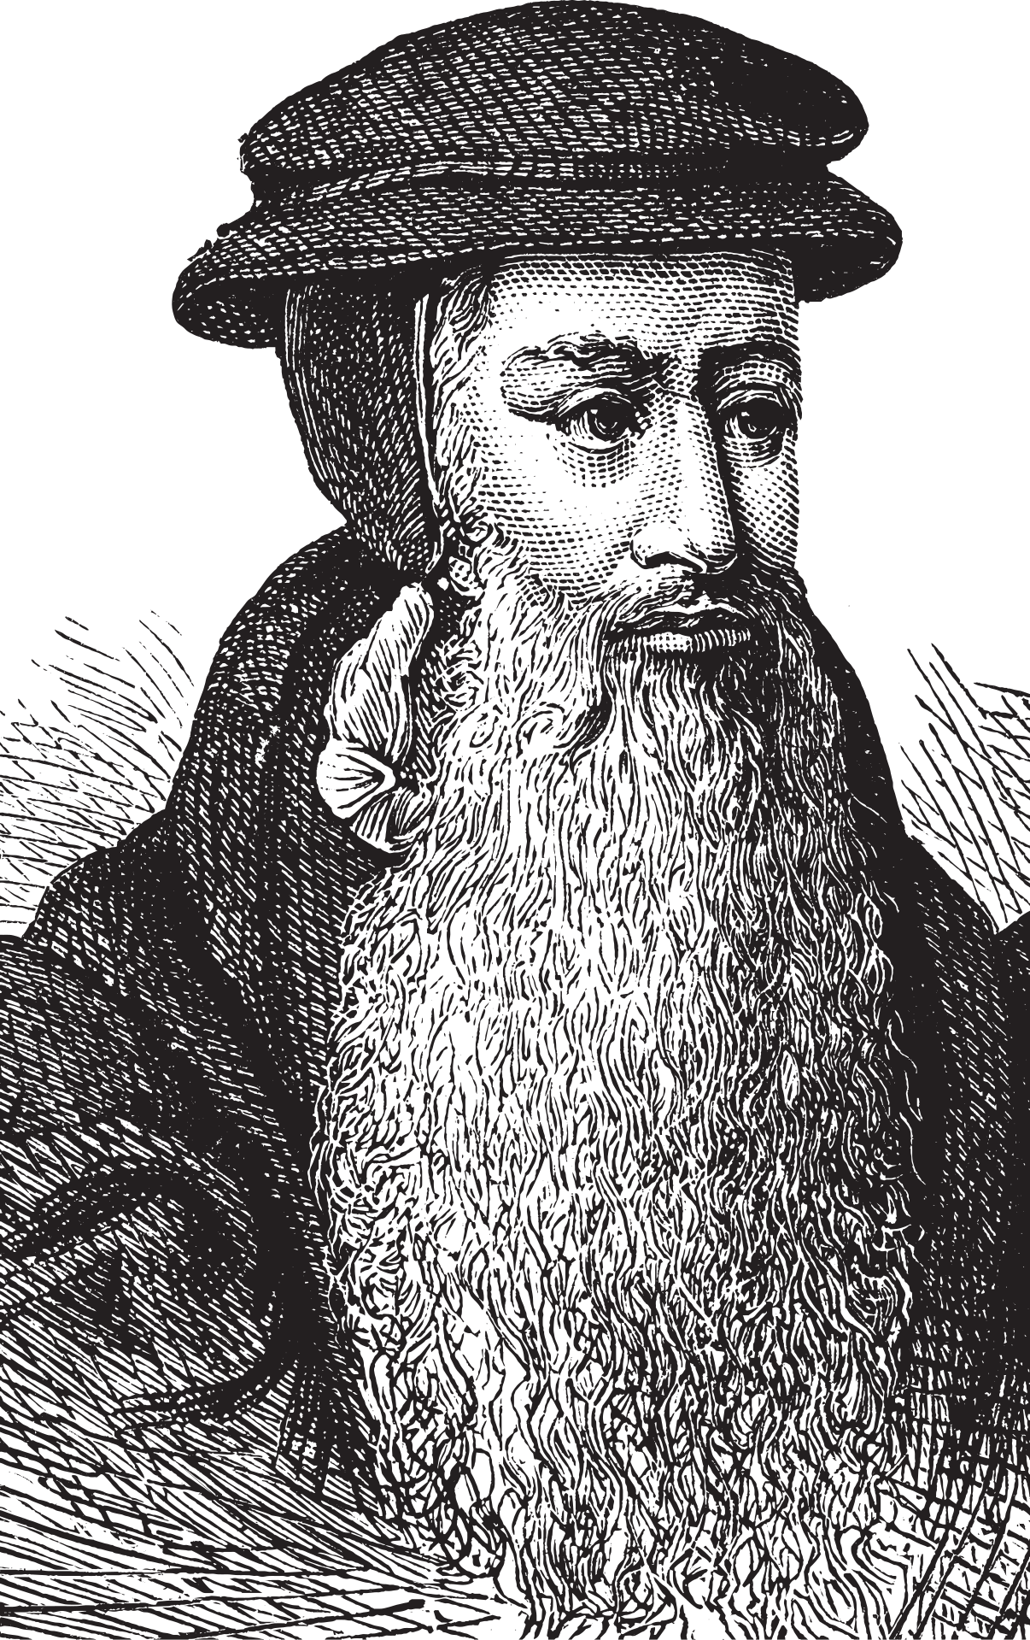
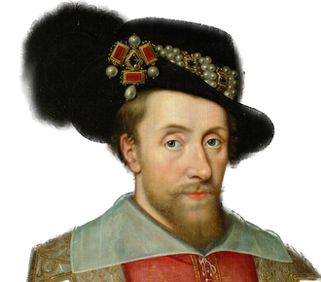
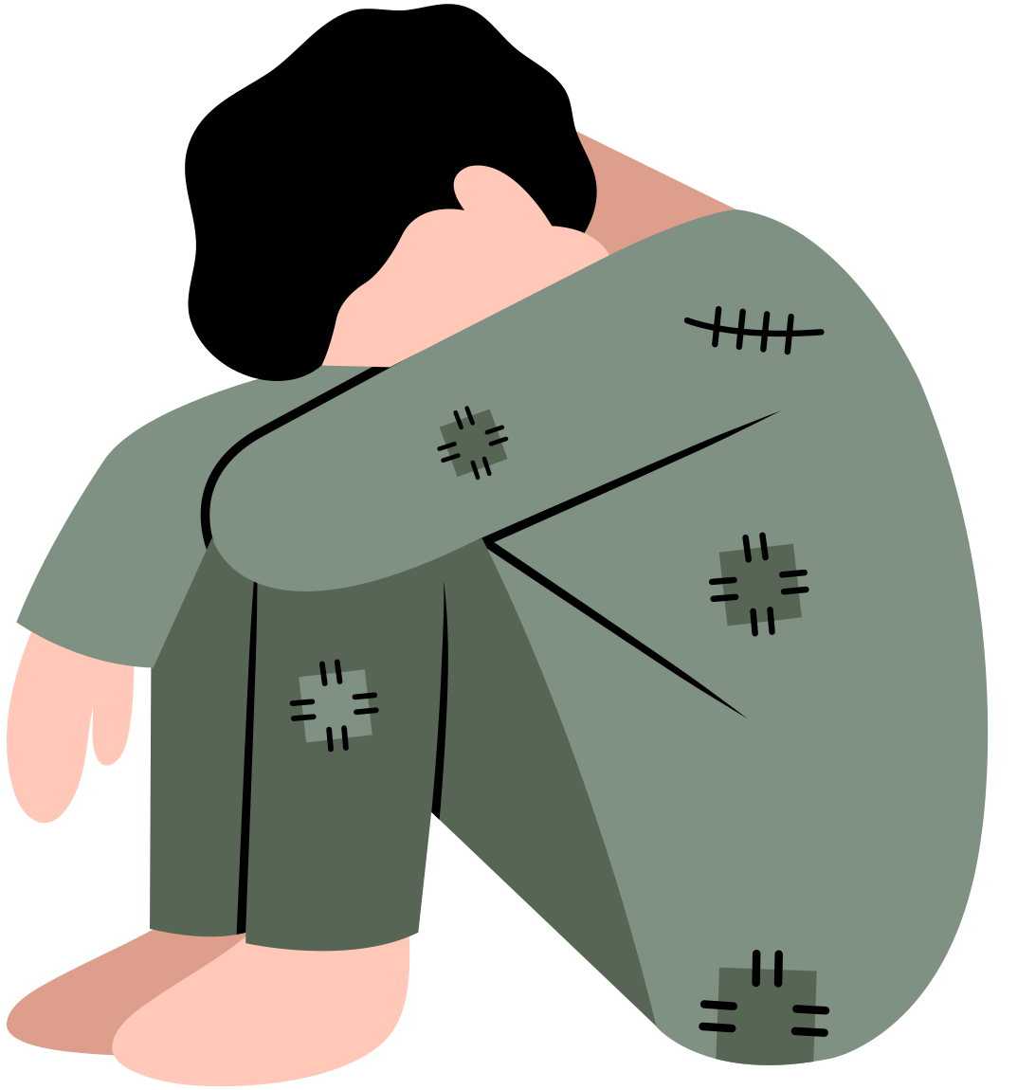


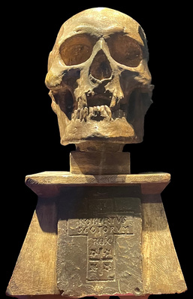
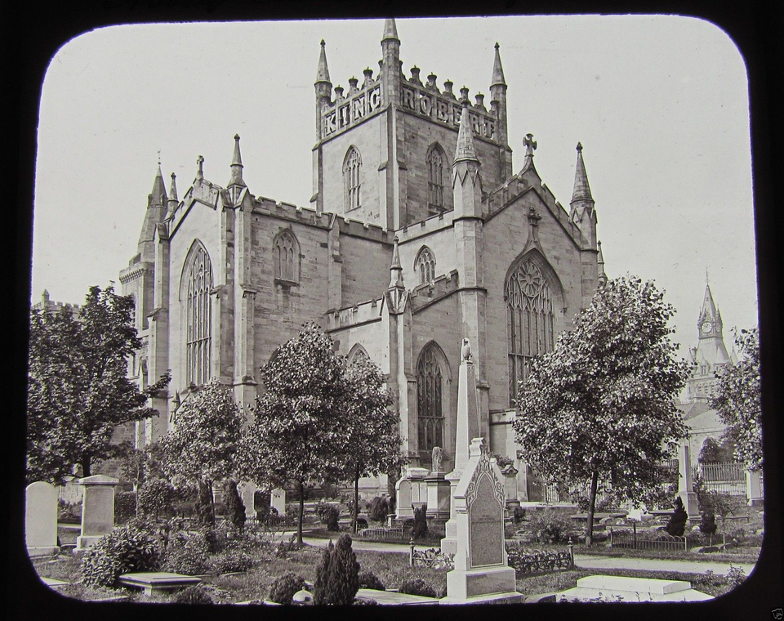

Slide 6


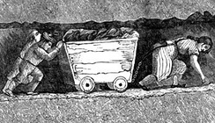
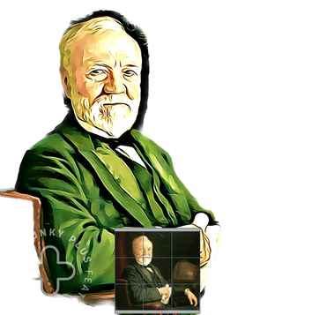






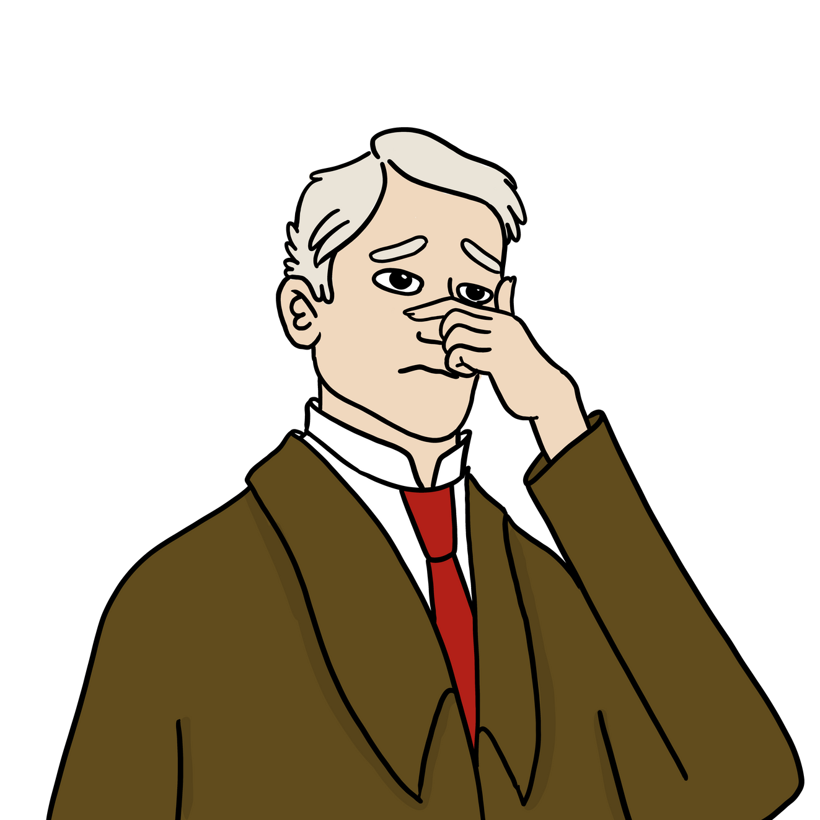
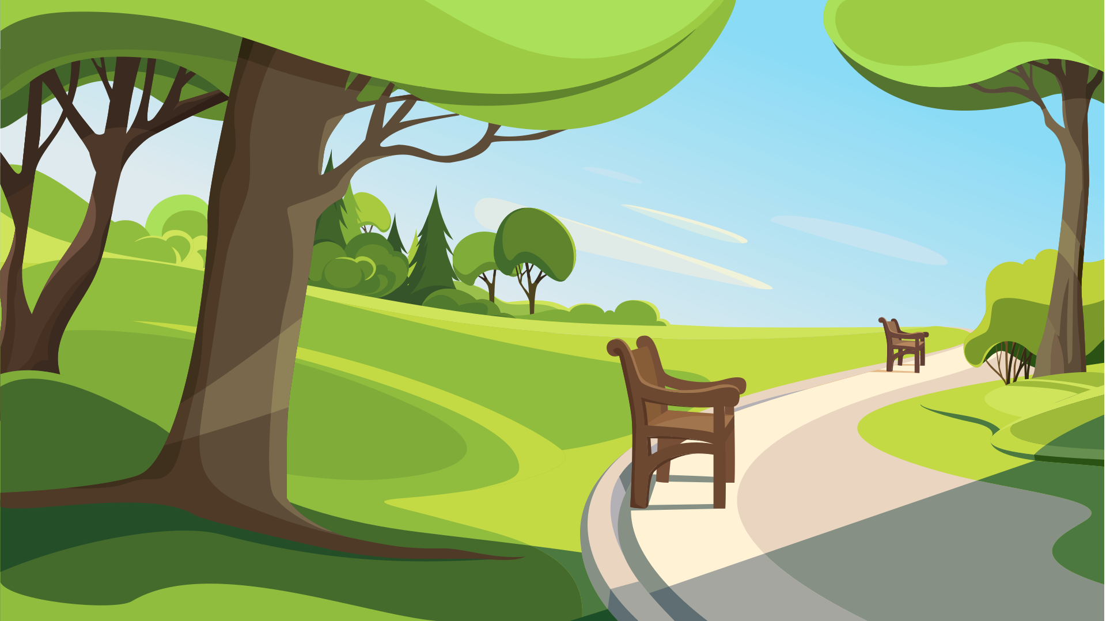

Slide 7
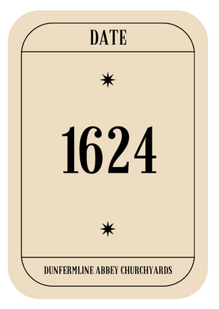
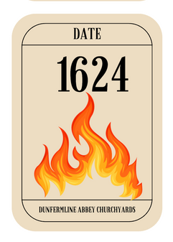
Timeline activities
  Race to build a timeline (work in two teams)
Look at your cards which will be either a date or an event. Work together to put the date cards into chronological order. Then match up the event cards to the correct date. The team who finish first and match up their cards correctly are the winners.
  Matching pairs (work in pairs)
Mix up your one set of date and event cards and turn face down in 4 rows of 6 cards. Turn over two cards at a time and try to match up an event card to the correct date card. When you have a correct match remove these and the person with the most correct pairs is the winner.

Slide 8
Travel Back in Time at the Dunfermline Abbey Churchyards
  Spot the differances: looking at how the Abbey Churchyards have changed over time
RESOURCES FOR PRIMARY SCHOOLS

Slide 9
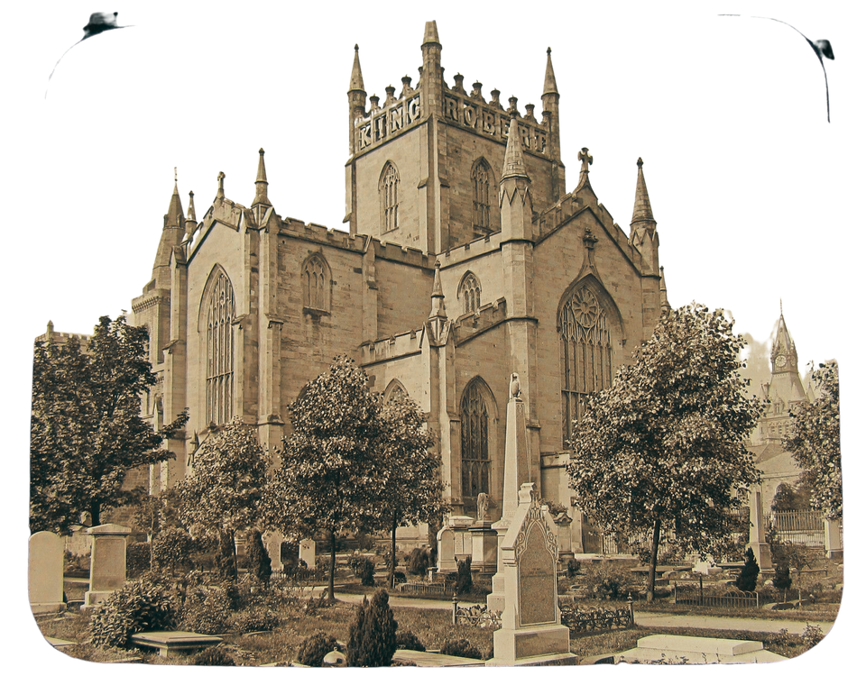
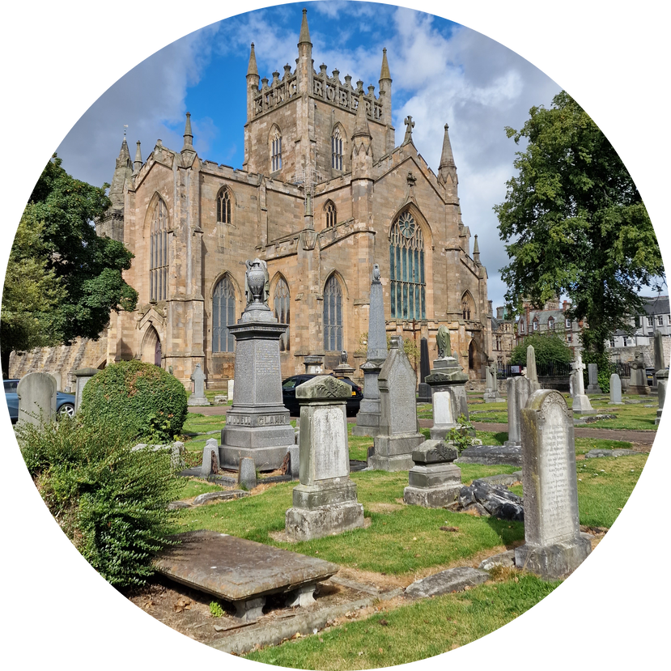
  Now you have become more familiar with the history and site of Dunfermline Abbey Churchyards, the next task is to begin to understand how the site has changed over the years.
  In the next slides you will see 4 historic images of the Abbey Churchyards and a recent image of the same view.
  Your task is to try and find the differences between the site then and now.

Slide 10
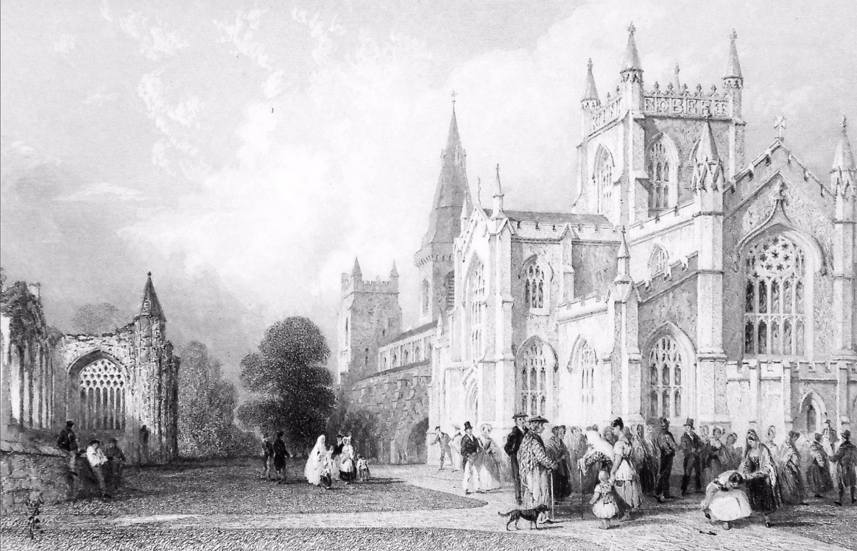
Dunfermline Abbey New Churchyard
This image is found in William Beattie's book Scotland Illustrated, which was printed in 1837.
  What do you think the people are doing? Who are they?

Slide 11
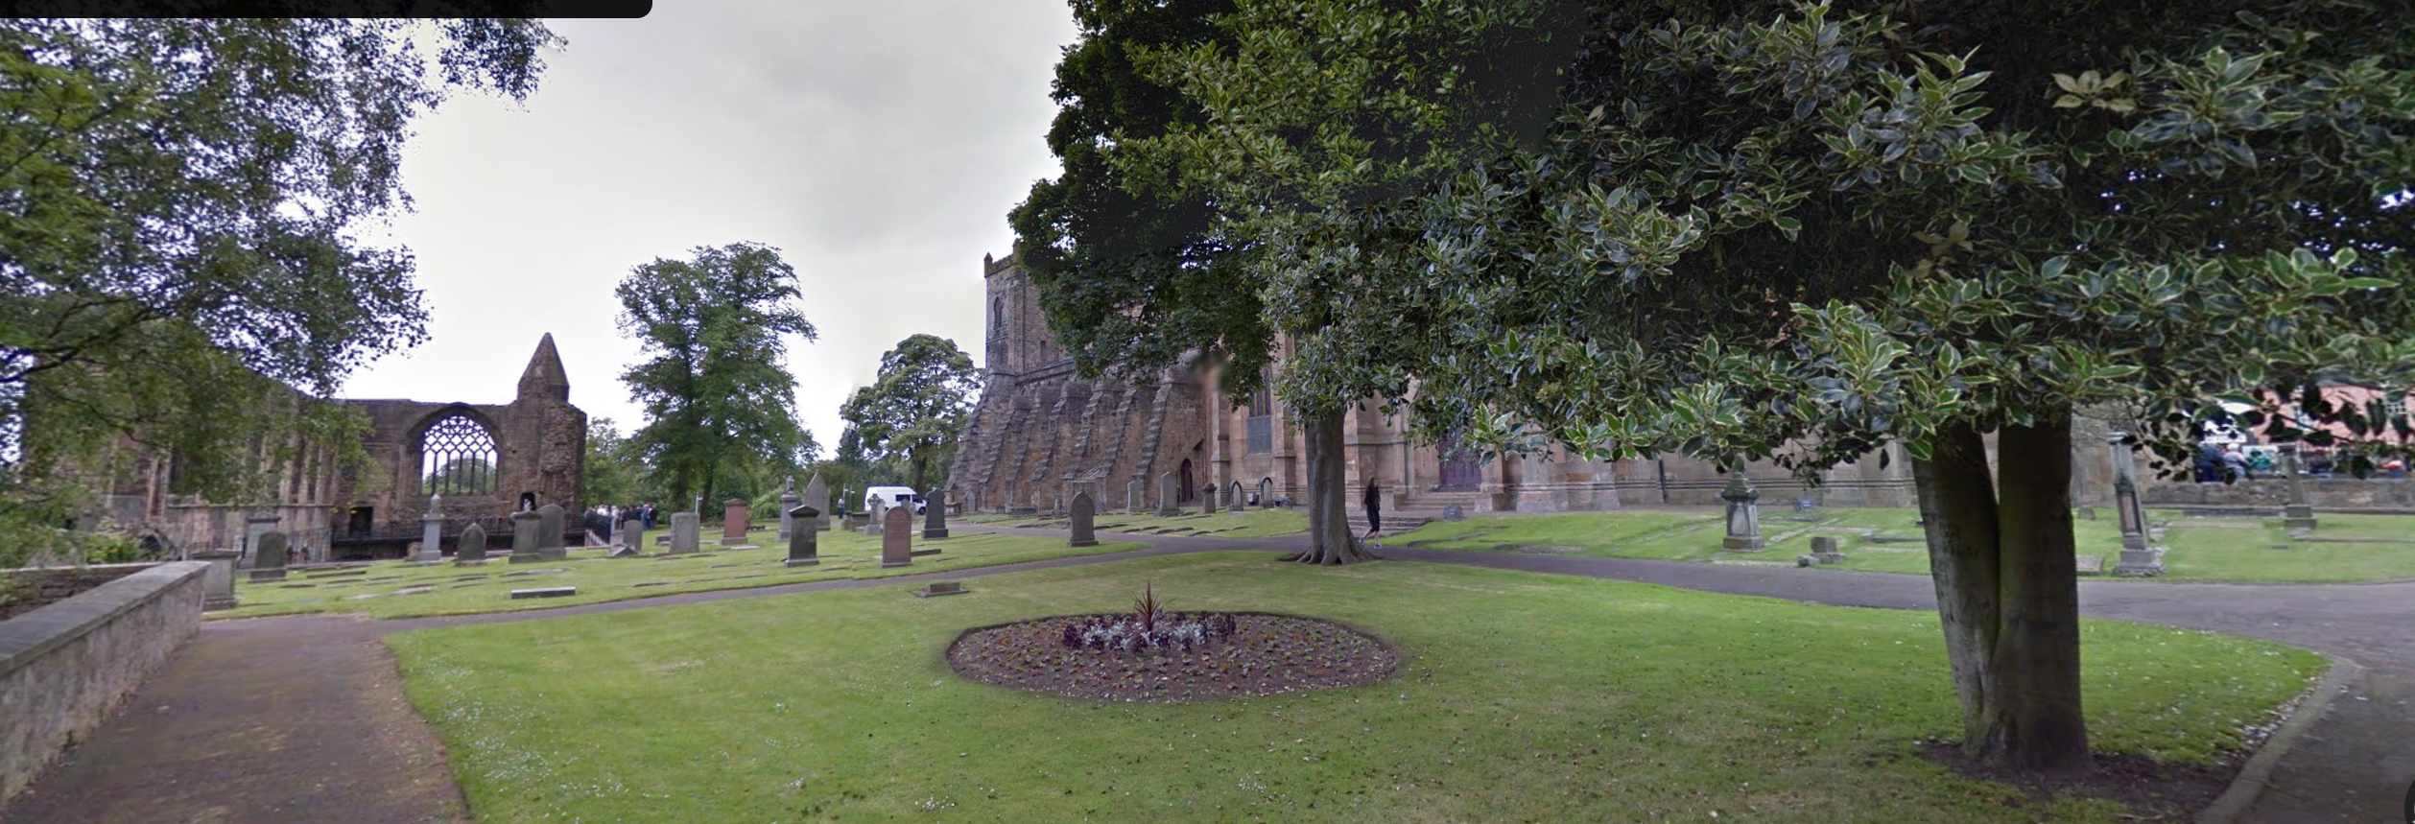
Dunfermline Abbey New Churchyard
This is a modern photograph.
  Why do you think it is difficult to capture the same view you saw in the 1837 drawing in this photograph?
  Can you see any people? What do you think they are doing?

Slide 12
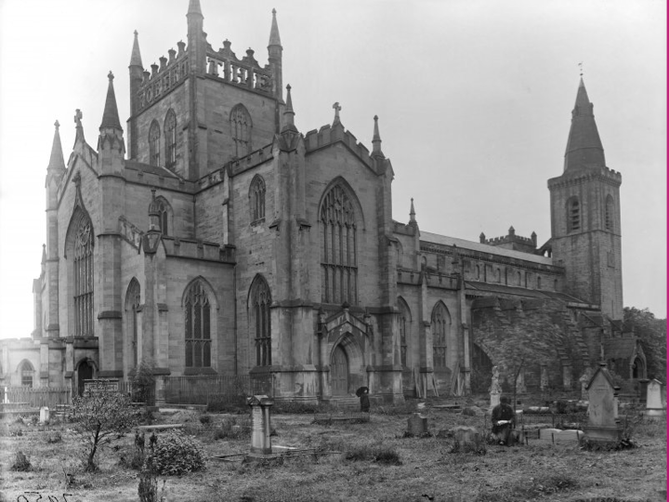
Dunfermline Abbey Old Churchyard
We don’t know exactly when this photograph was taken but it was sometime during the Victorian period.
  How many people can you see? What do you think they are doing?

Slide 13
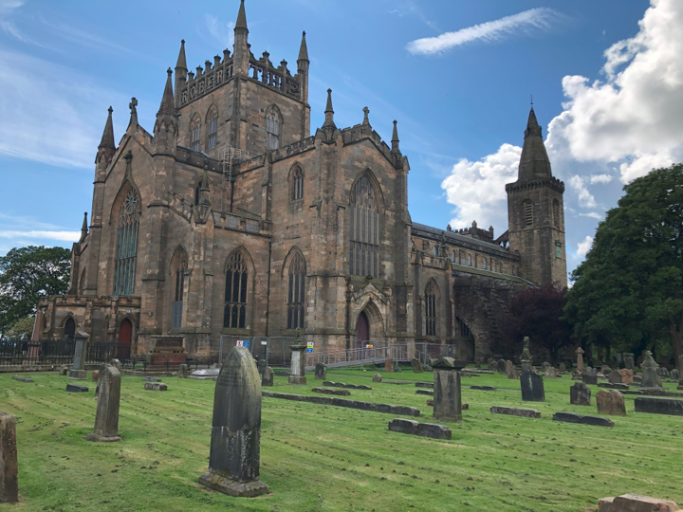
Dunfermline Abbey Old Churchyard
This is a modern photograph.
  Look closely at the ground, what do you think happened just before this photo was taken?

Slide 14
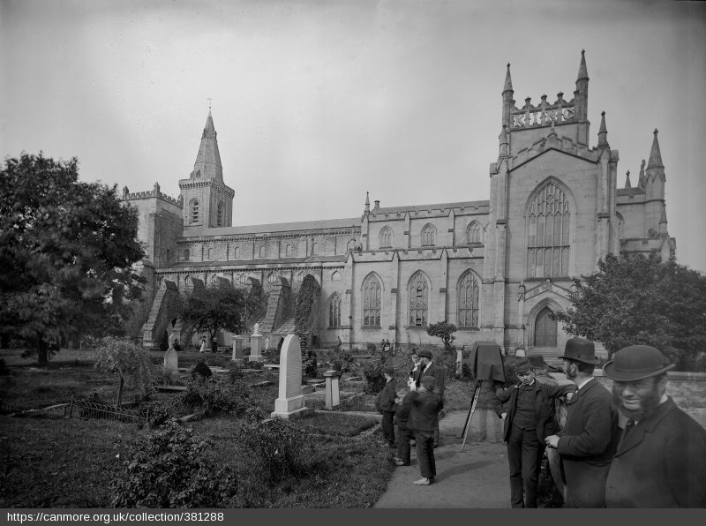
Dunfermline Abbey New Churchyard
This photo dates to around 1878, which is also when the person on the gravestone being photographed died.
  Why do you think people in Victorian times might photograph a gravestone?

Slide 15
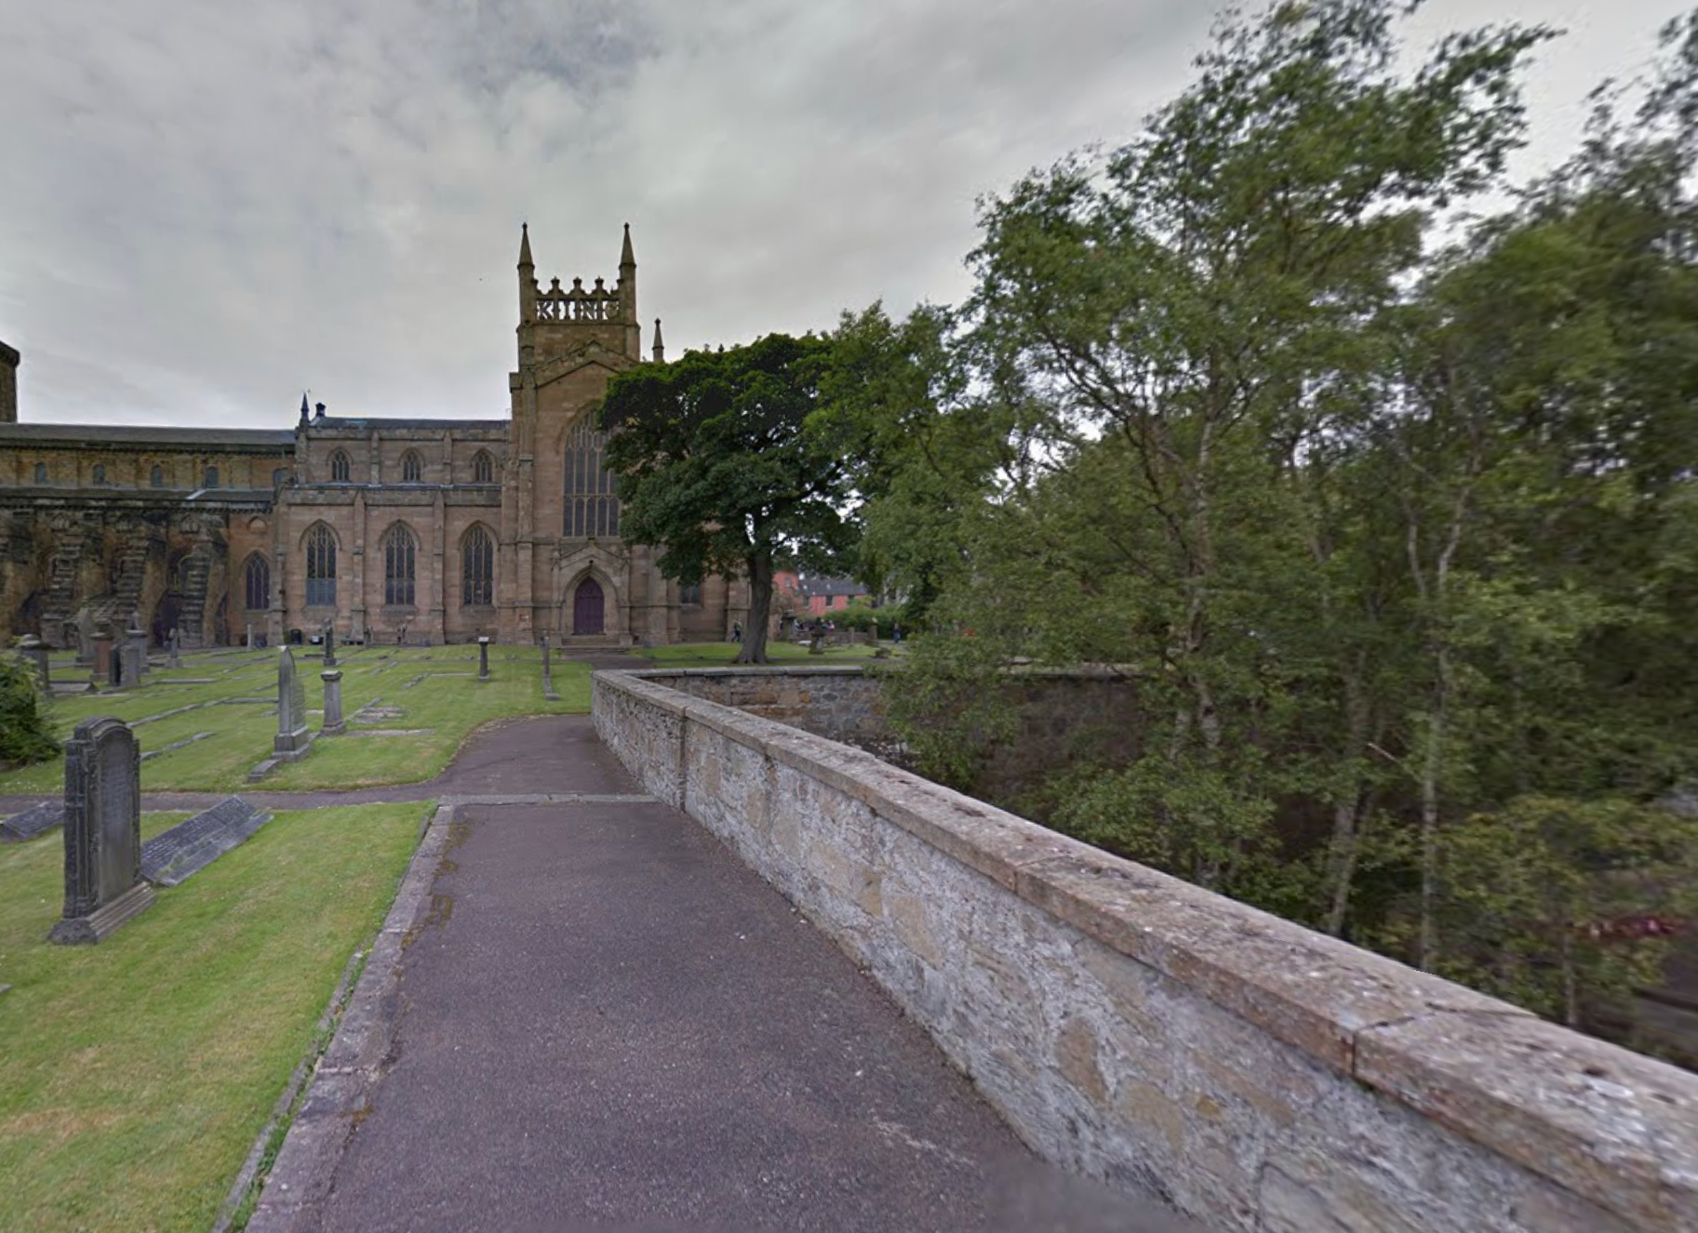
Dunfermline Abbey New Churchyard
This is a modern photograph.
  What word can you see at the top of the tower? What have you noticed about other views of the tower?

Slide 16
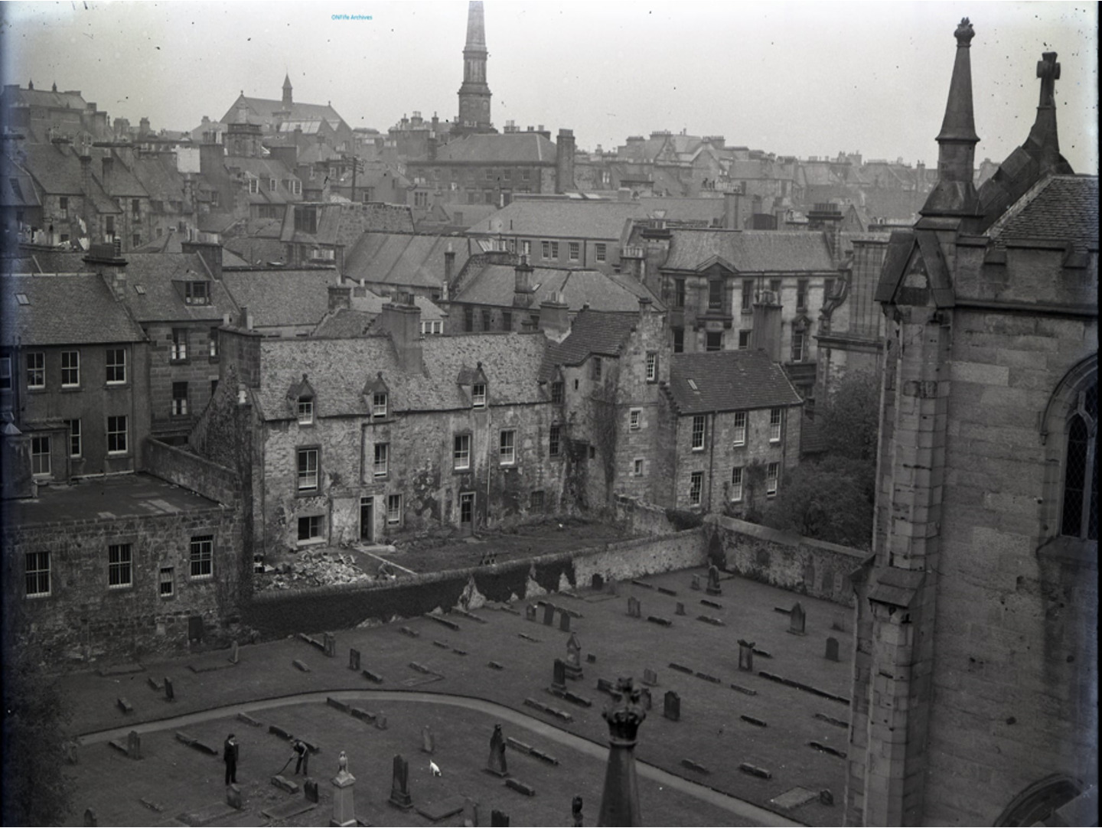
Dunfermline Abbey Old Churchyard
We don’t know exactly when this photograph was taken but it was sometime during the early 20th century.
  How many people can you see? What do you think they are doing?

Slide 17
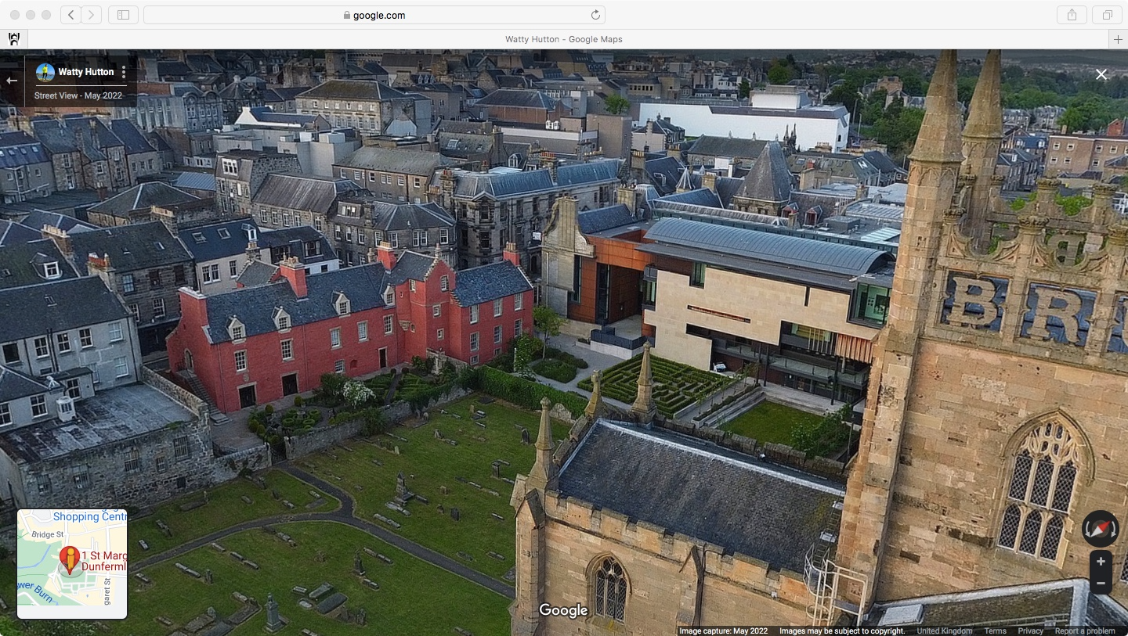
Dunfermline Abbey Old Churchyard
This is a modern photograph.
  What do you notice has changed about Abbot House?

Slide 18

What differences did you spot between the historic and modern pictures?
Some ideas to get you going …
  The number of people at the site
  The clothes they were wearing.
  The clothes that were missing (shoes)
  Differences in technology
  How well looked after the site was.

Slide 19

Something to think about …
  Was there anything that was similar, or the same?
  How tidy the grounds were
  Someone taking a photograph – someone had to take the modern photographs …

Slide 20
Review
  I have a better understanding of the changes in Dunfermline Abbey Churchyards over time …
  I can use observation skills and clues from a source to look for differences and similarities…

