Slide 1


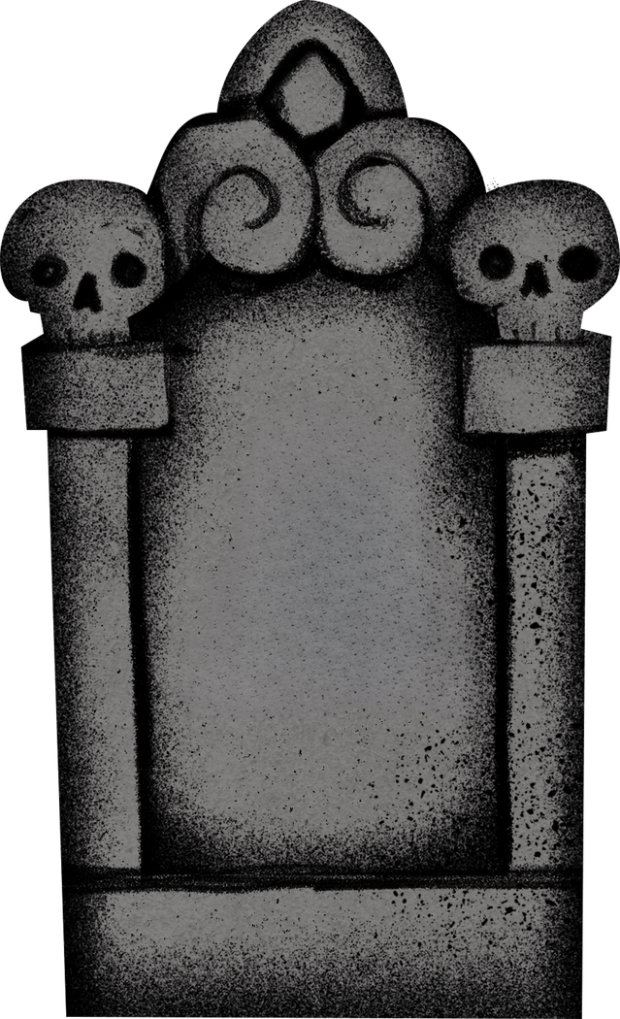
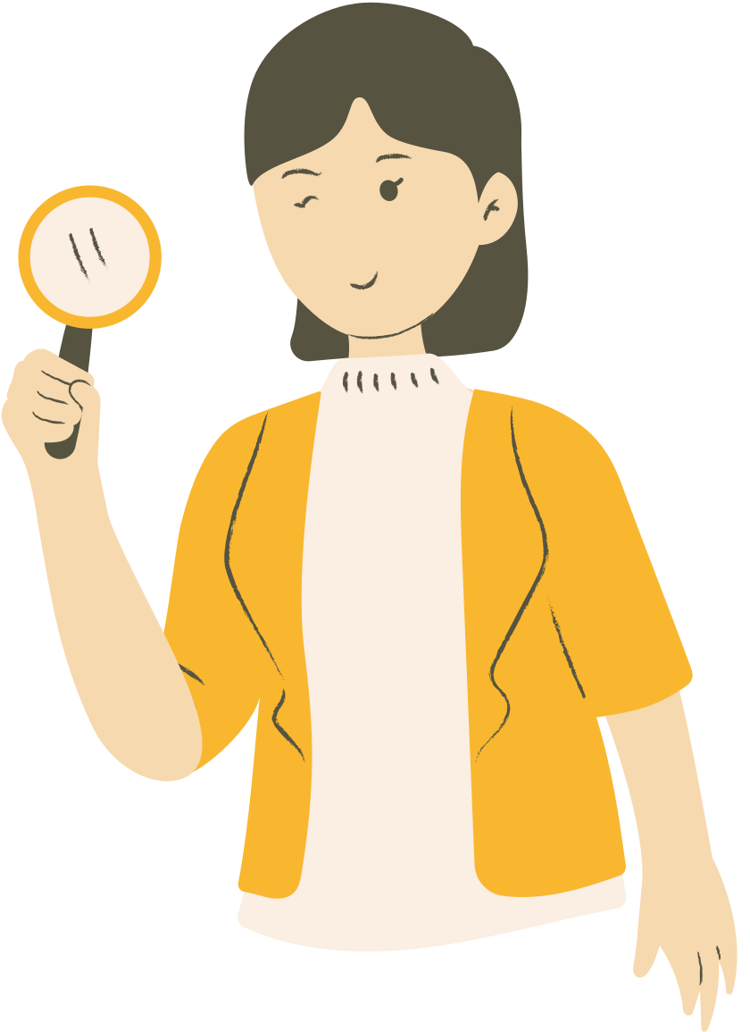
DUNFERMLINE ABBEY CHURCHYARDS
What can gravestones tell us?
RESOURCES FOR PRIMARY SCHOOLS

Slide 2
Activities:
  Looking at gravestone inscriptions and lettering
  Different types of gravestone symbols
  The jobs people did in the past
  People’s personality and qualities
RESOURCES FOR PRIMARY SCHOOLS

Slide 3
What can gravestones tell us?
  Looking at gravestone inscriptions and lettering
RESOURCES FOR PRIMARY SCHOOLS

Slide 4
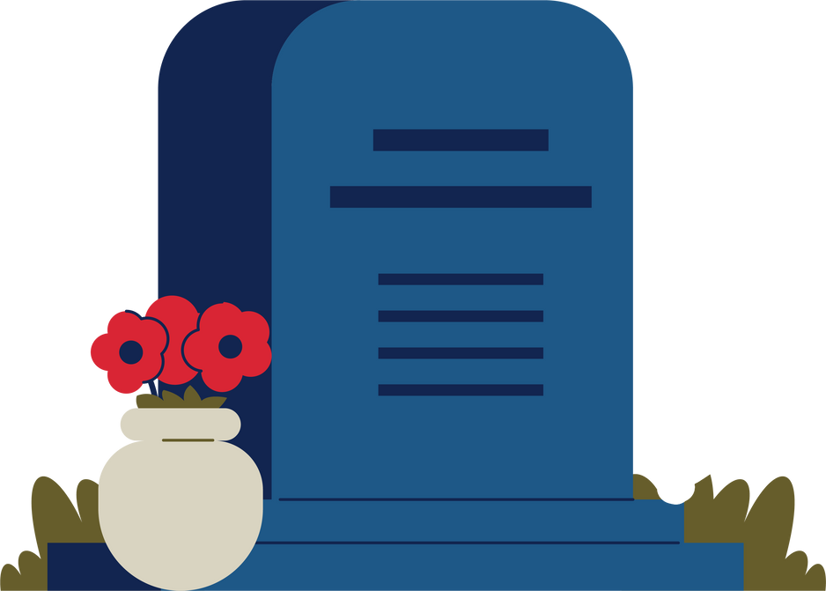
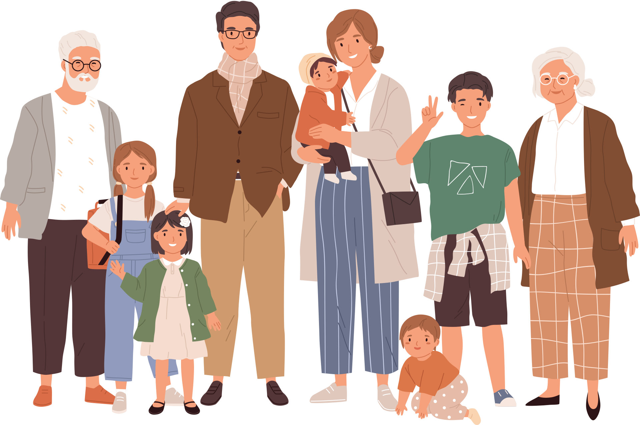
  Gravestones usually have writing on them called inscriptions.
  Inscriptions often give information about the person buried in the grave, and their family.
  You will notice the gravestones in the Dunfermline Abbey Churchyards can have different styles of letters and different types of information carved on them.
A
A
A
A

Slide 5
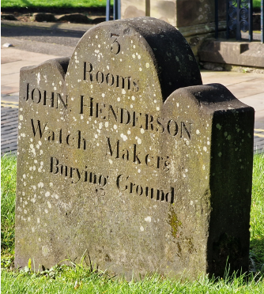
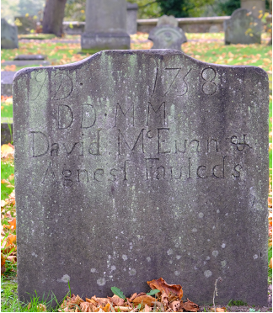
Activity 1: Styles of letters
  Look at these two gravestones.
  Do you think the letters look similar to those printed in books or do they look more like handwriting?
  What else do you notice about the writing?
  Why do you think these look different? Which style of lettering do you think is earliest in date?

Slide 6
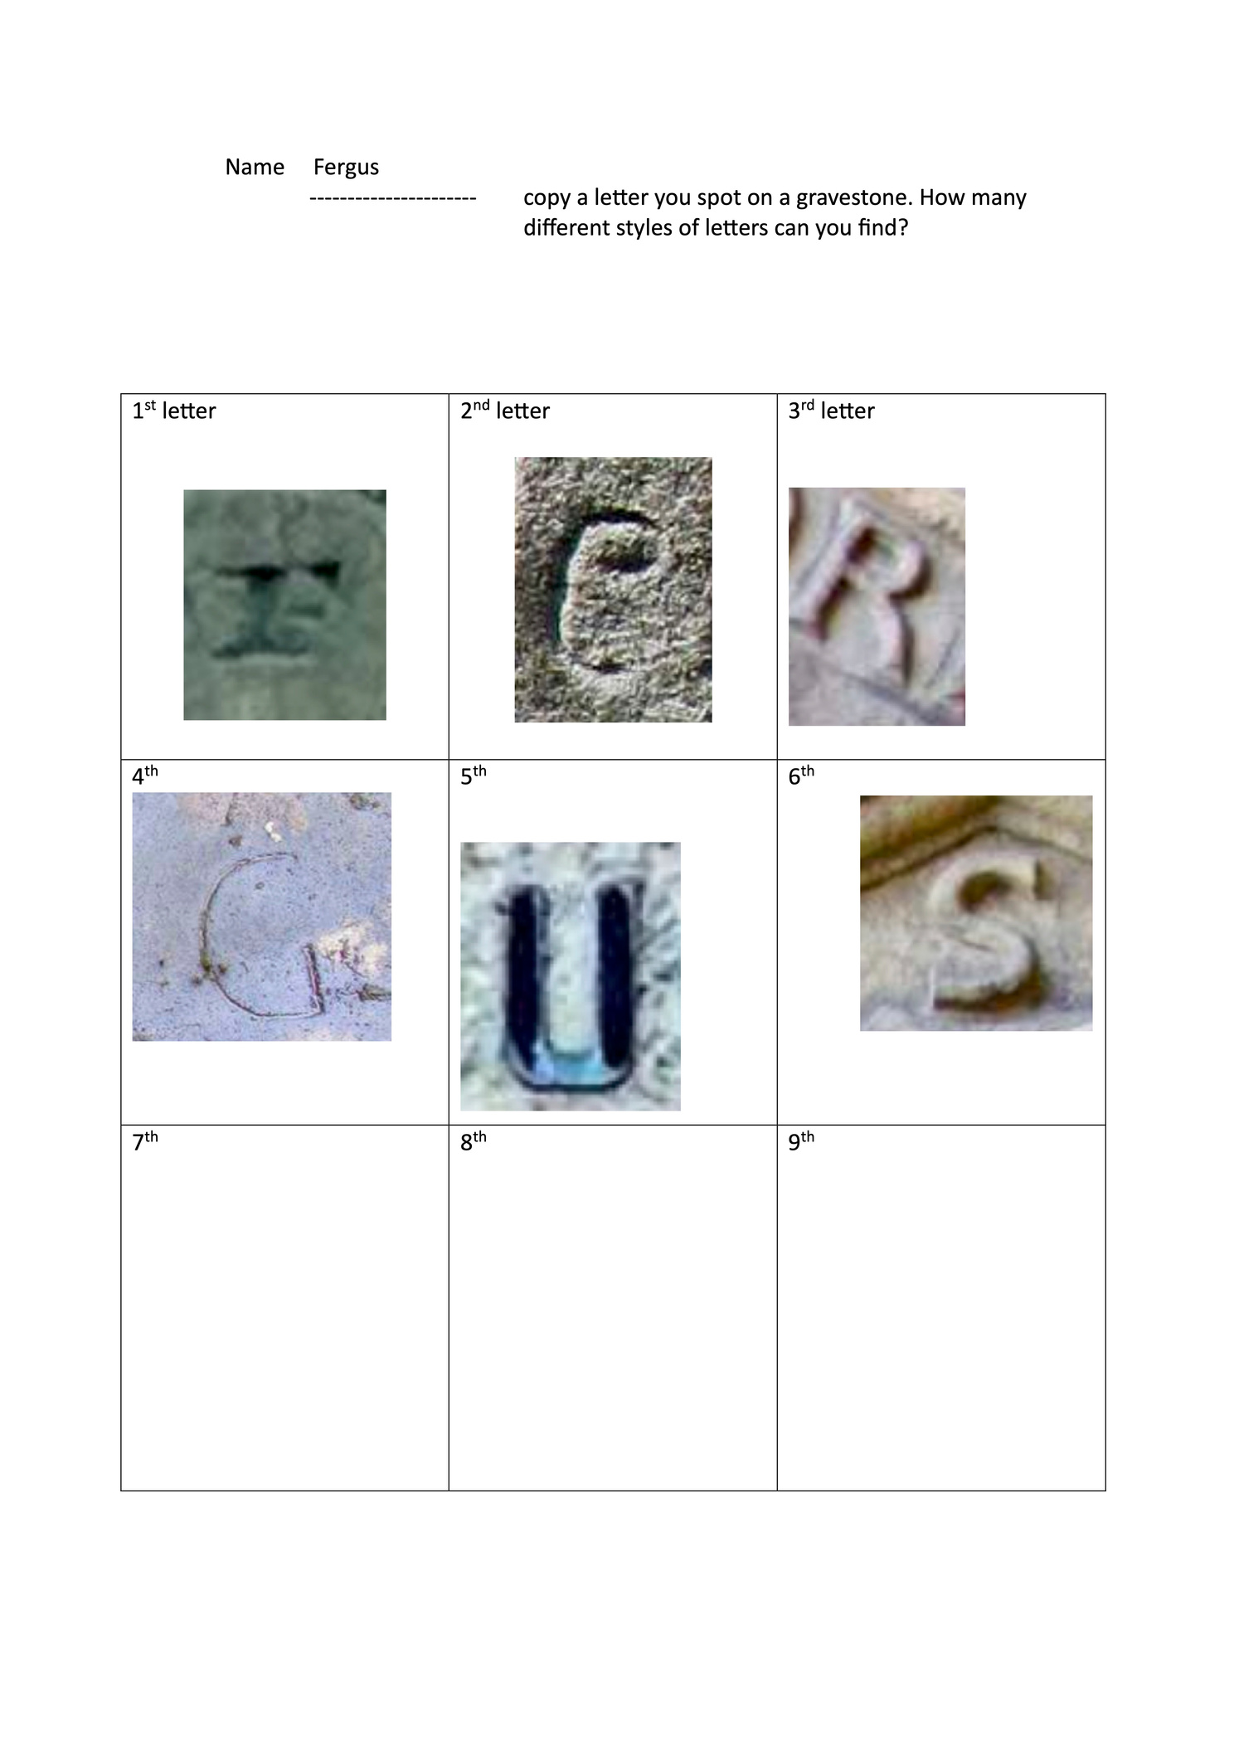
Activity 2: I-spy gravestone letters
  Have a look around the rest of the graveyard and see what styles of lettering you can find.
  Write your name using a different style of letters copied from gravestones.

Slide 7
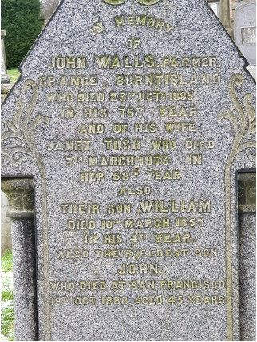
Activity 3: The information given about people on gravestones
  It is not just the style of lettering that may not be the same. The information given about the people mentioned on gravestones can also be different.
  Have a look again at the two inscriptions in Activity 1 and the inscription here - what do they tell us about the people who died?

Slide 8
Name of Person | What I found out about them

Slide 9
Name of Person | What I found out about them

Slide 10
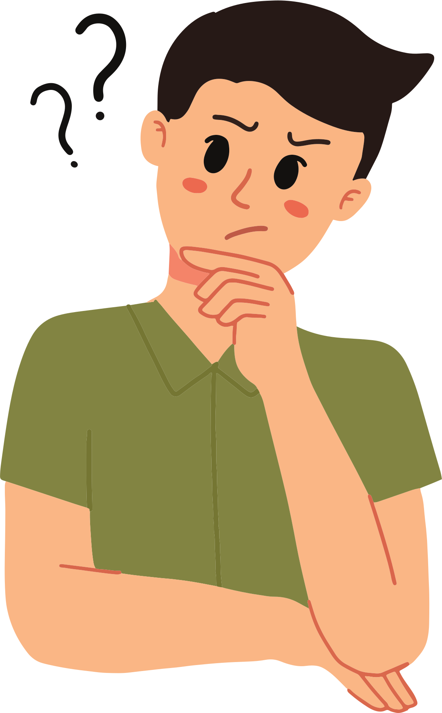
What would you not see on a gravestone? | Reason why
  Can you think of any information that you would not find on a gravestone?
  Why do you think these details would not be included?

Slide 11
What can gravestones tell us?
  Different types of gravestone symbols
RESOURCES FOR PRIMARY SCHOOLS

Slide 12

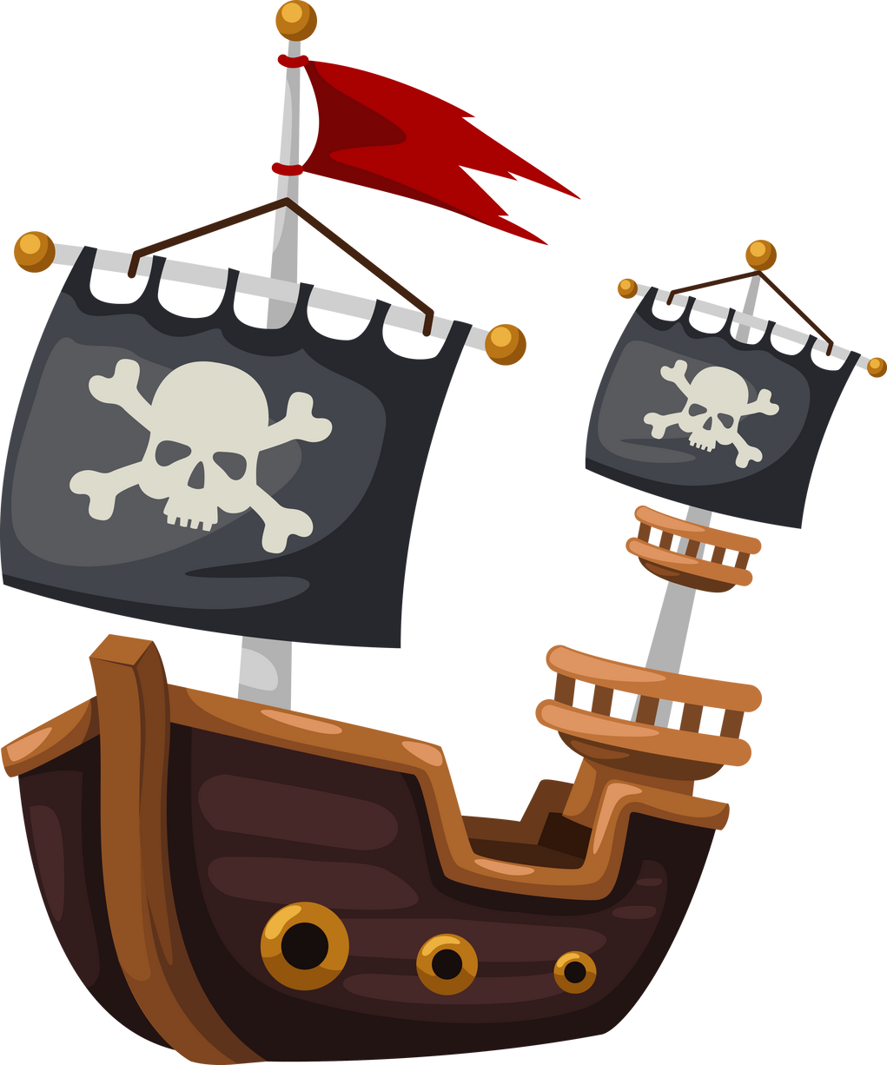
  Some gravestones have pictures carved on them that have special meanings. These pictures are called symbols.
  Symbols can give us clues to what people thought and did in the past.
  Many symbols represent people’s ideas about religion and about death. For example, skulls and crossbones mean death and the end of a person’s life on earth.
  Skulls and crossbones are sometimes wrongly thought to mark the graves of pirates. But these symbols were used on pirate flags to scare people because this was a symbol of death!

Slide 13
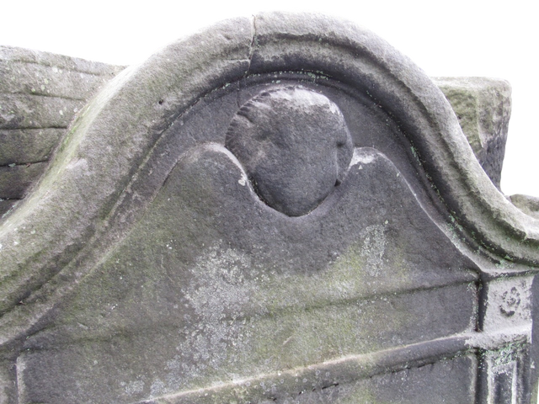
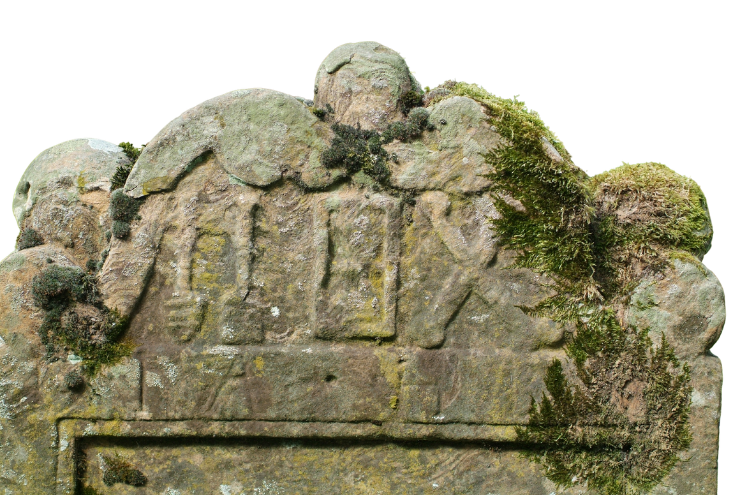
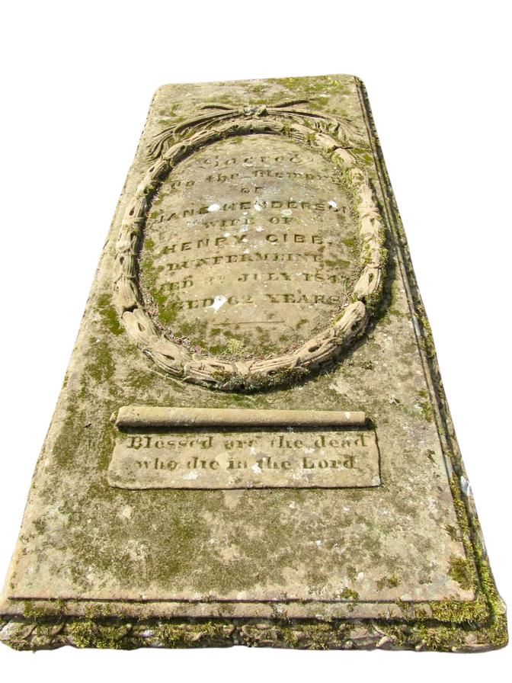
  Other symbols represent the belief in a life in heaven after death. A very popular symbol of this type is a face with wings, called a winged soul.
  Another example of a symbol which represents death is the hourglass. The example here has winged souls above and is next to the shovel and spade used to dig graves.
  Another example of a symbol of the belief of life in heaven after death is a wreath made from leaves in the shape of a circle.

Slide 14

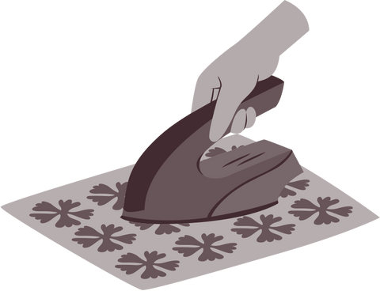
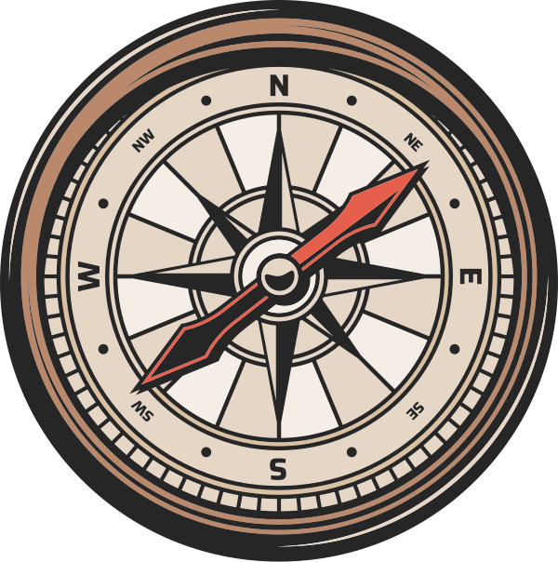

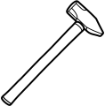

  Some gravestones have symbols carved on them that tell us what jobs people did in the past.
  The next few slides show photographs of carvings of the different tools people used. Can you work out which jobs use these tools for?
Which job?
  Weaver
  Tailor
  Sailor
  Butcher
  Blacksmith

Slide 15
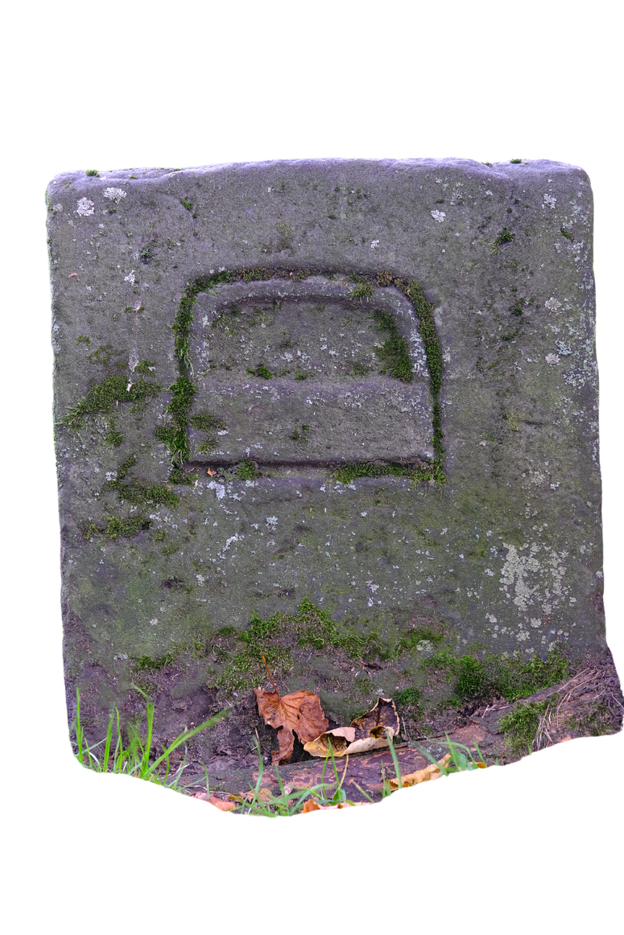
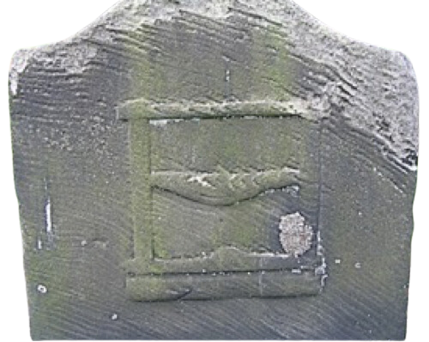
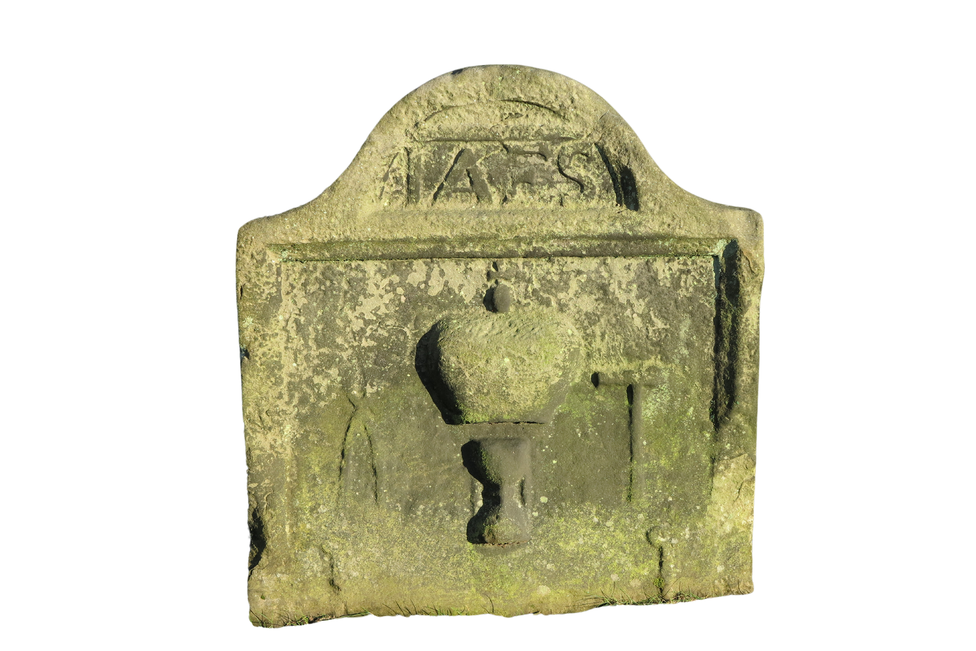
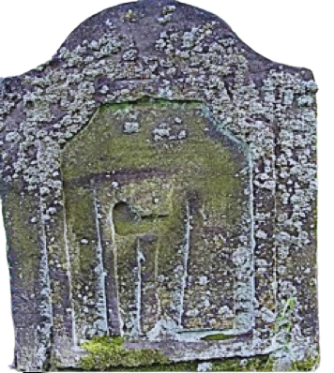
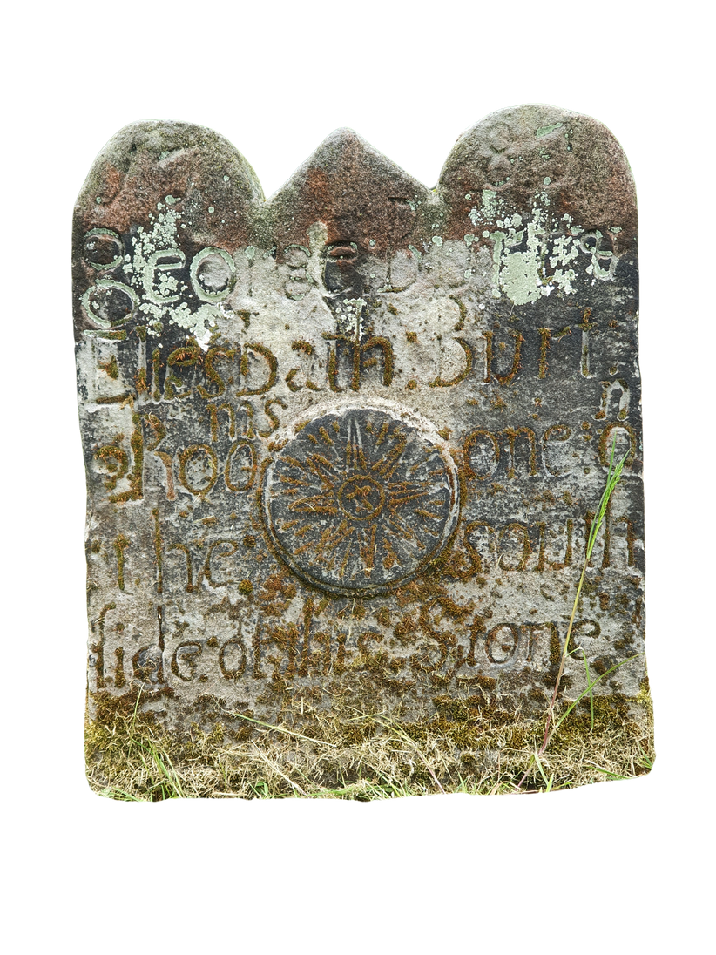
Can you work out the jobs symbolised by these tools?

Slide 16
What can gravestones tell us?
  Which jobs people did in the past
RESOURCES FOR PRIMARY SCHOOLS

Slide 17
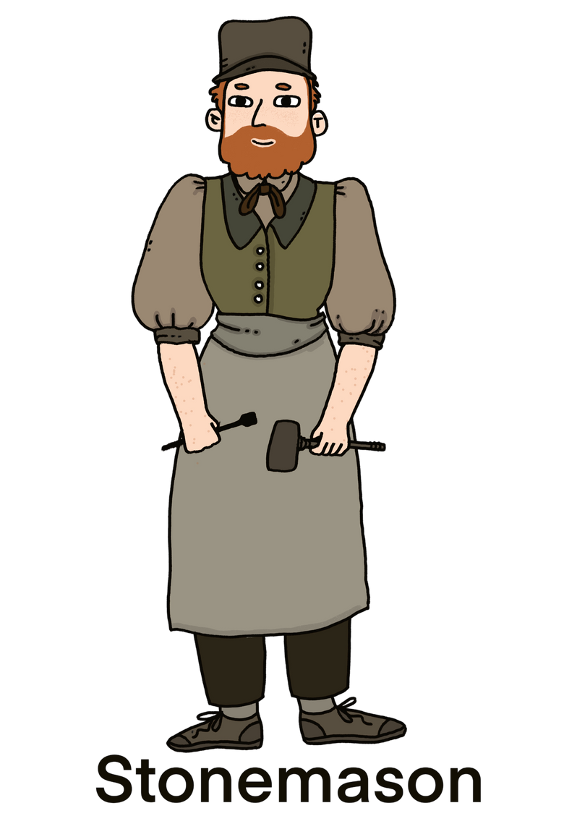
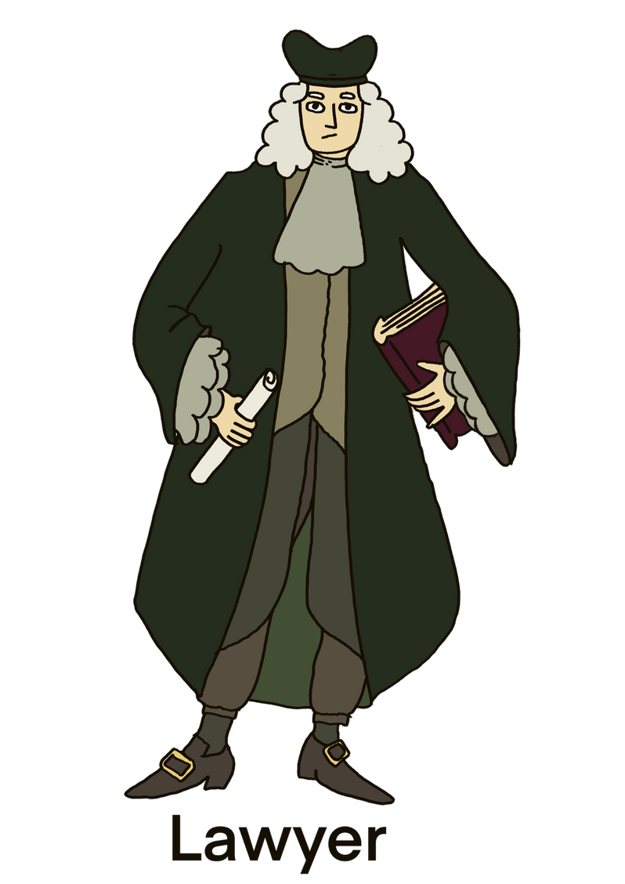
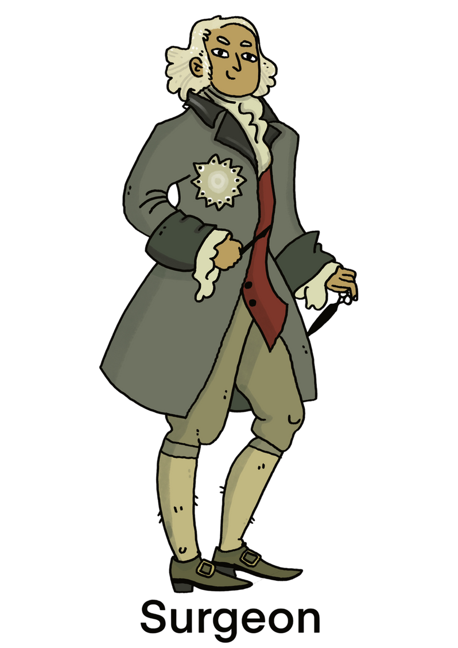
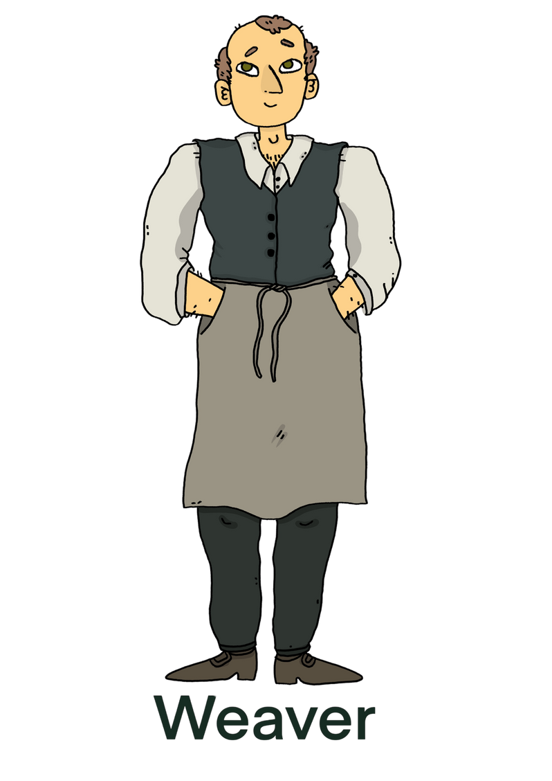
  Inscriptions can tell us about people but also show how life may have changed today.
  One of the things gravestones can tell us is about the jobs people did.
Activity 1
  The next few slides show photographs of gravestone inscriptions. Which jobs can you find mentioned in these inscriptions?

Slide 18
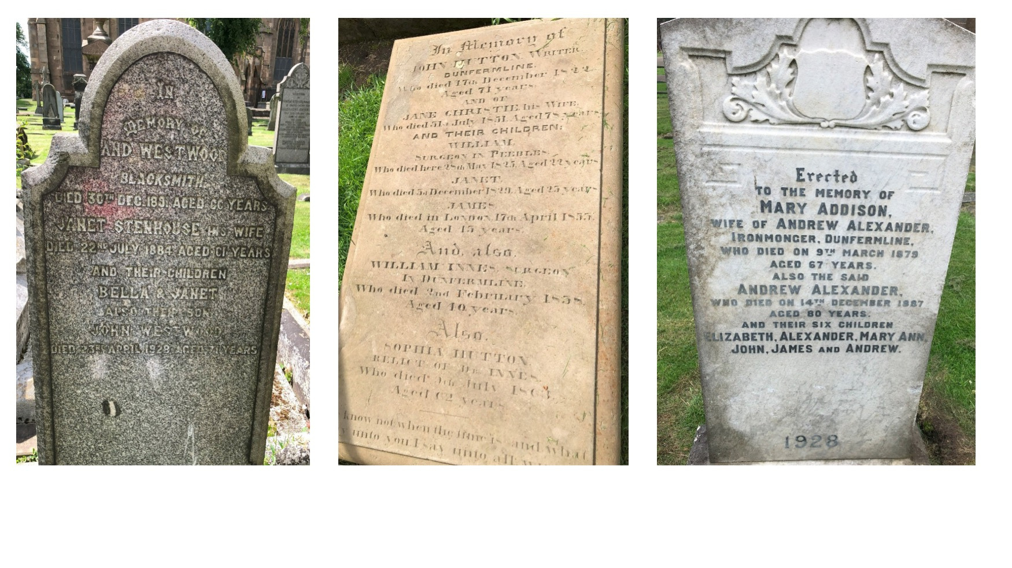

Slide 19
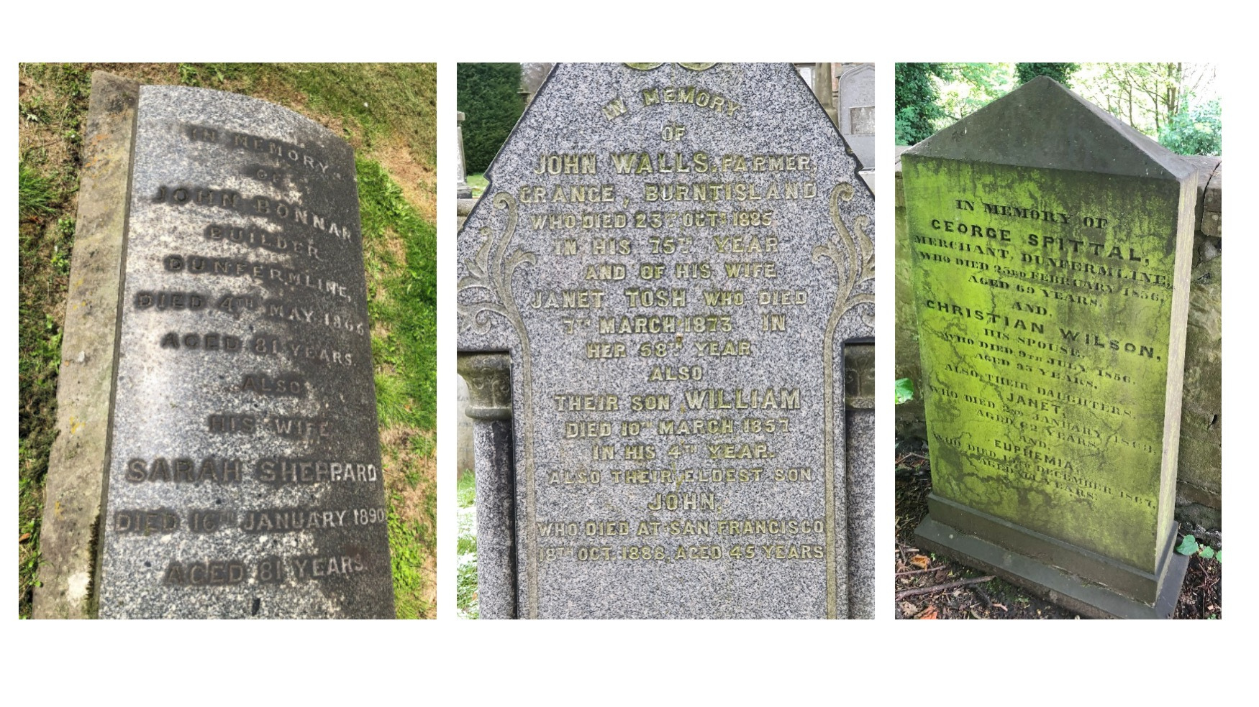

Slide 20
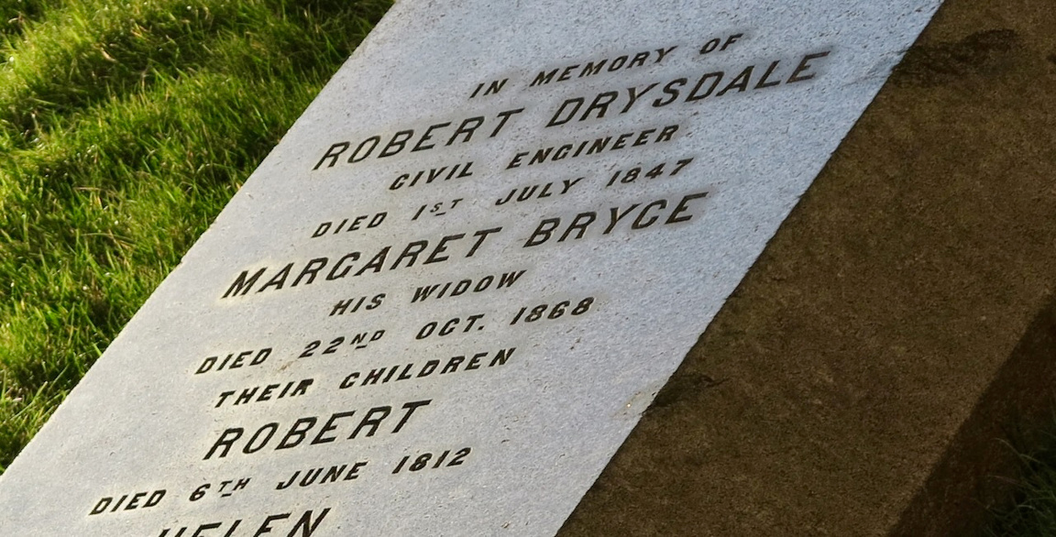
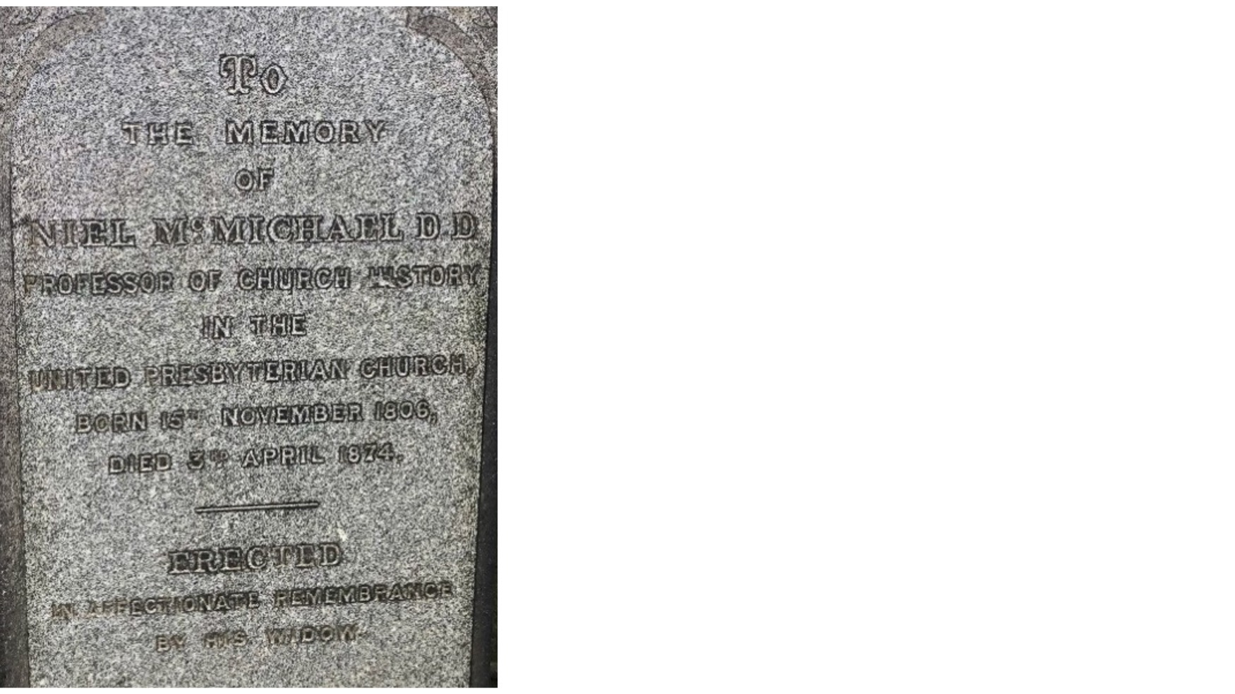
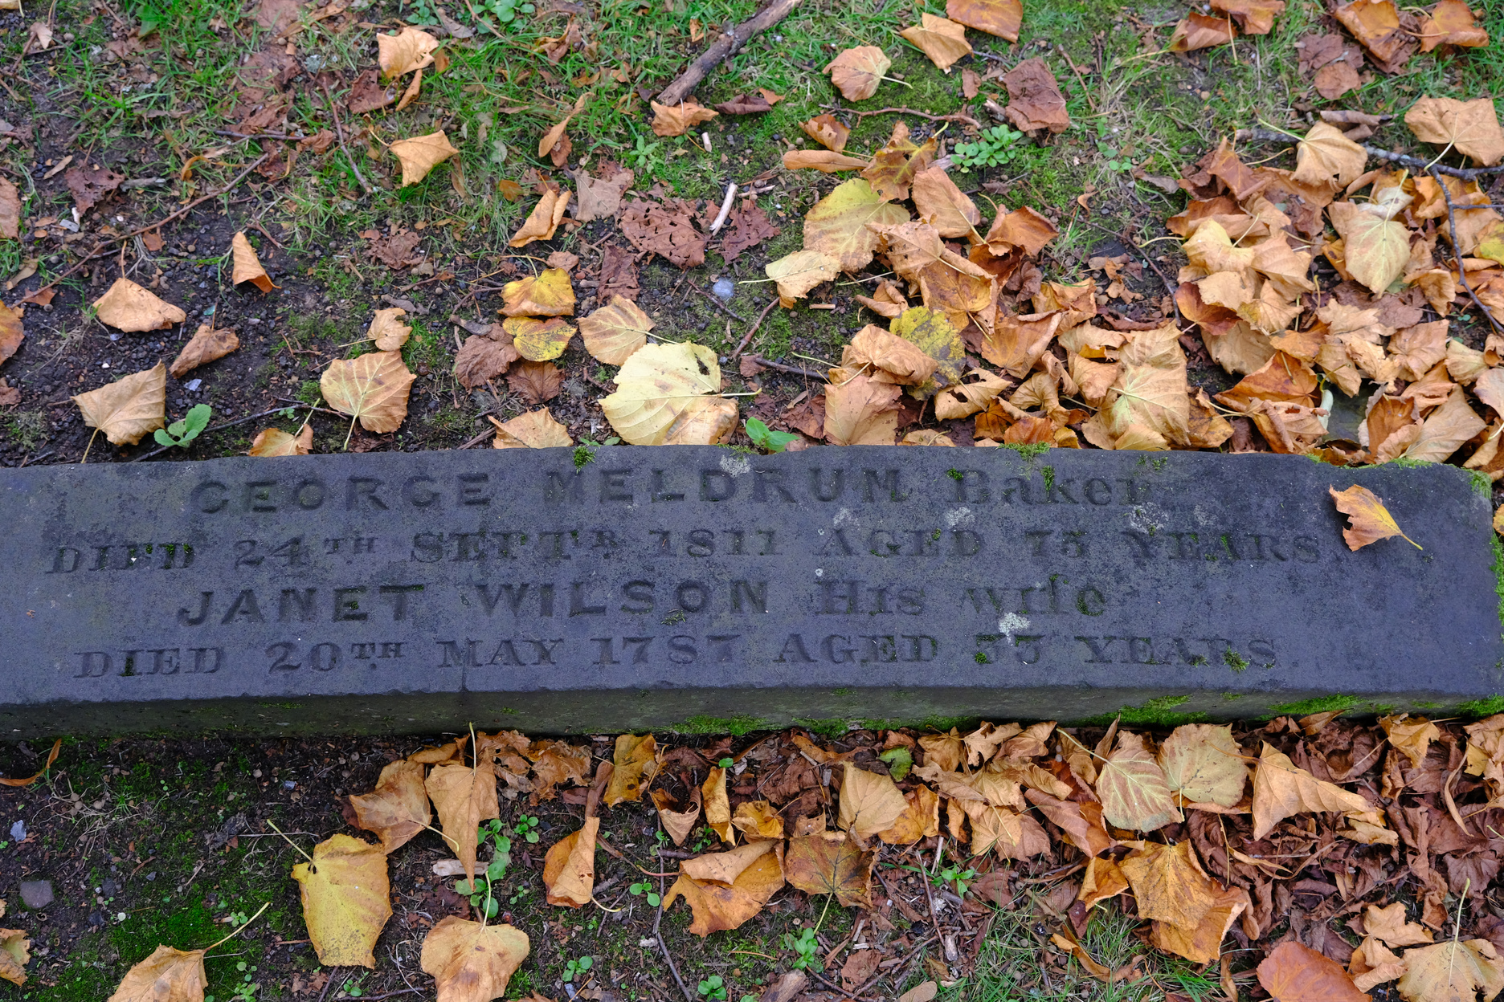
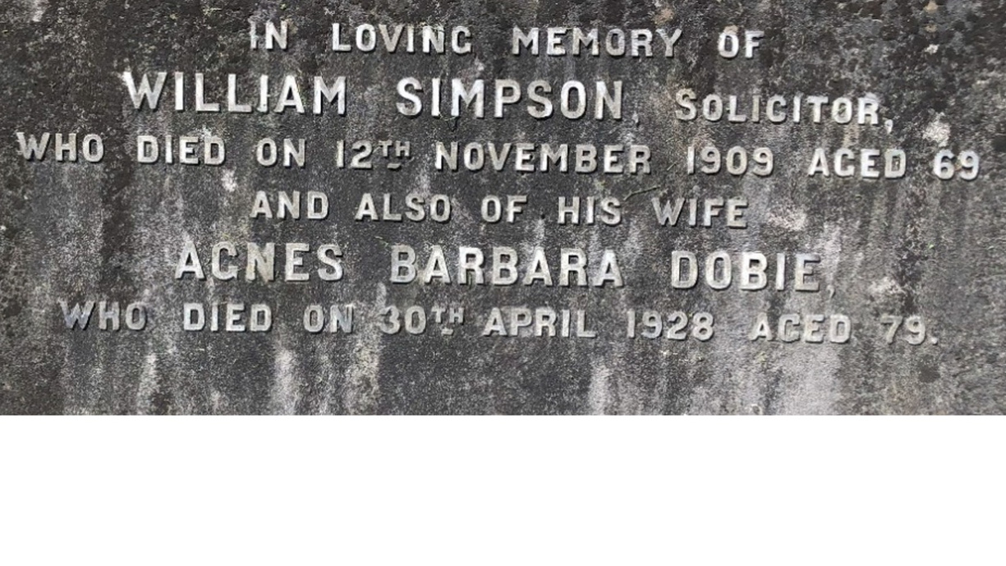

Slide 21
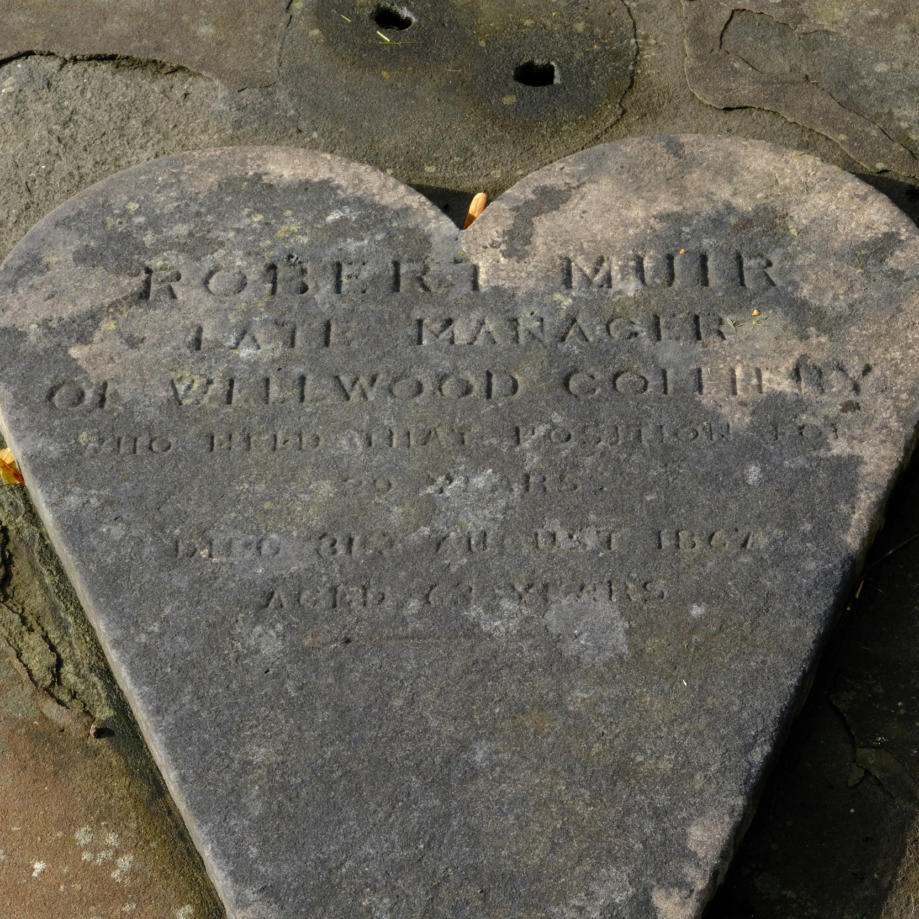
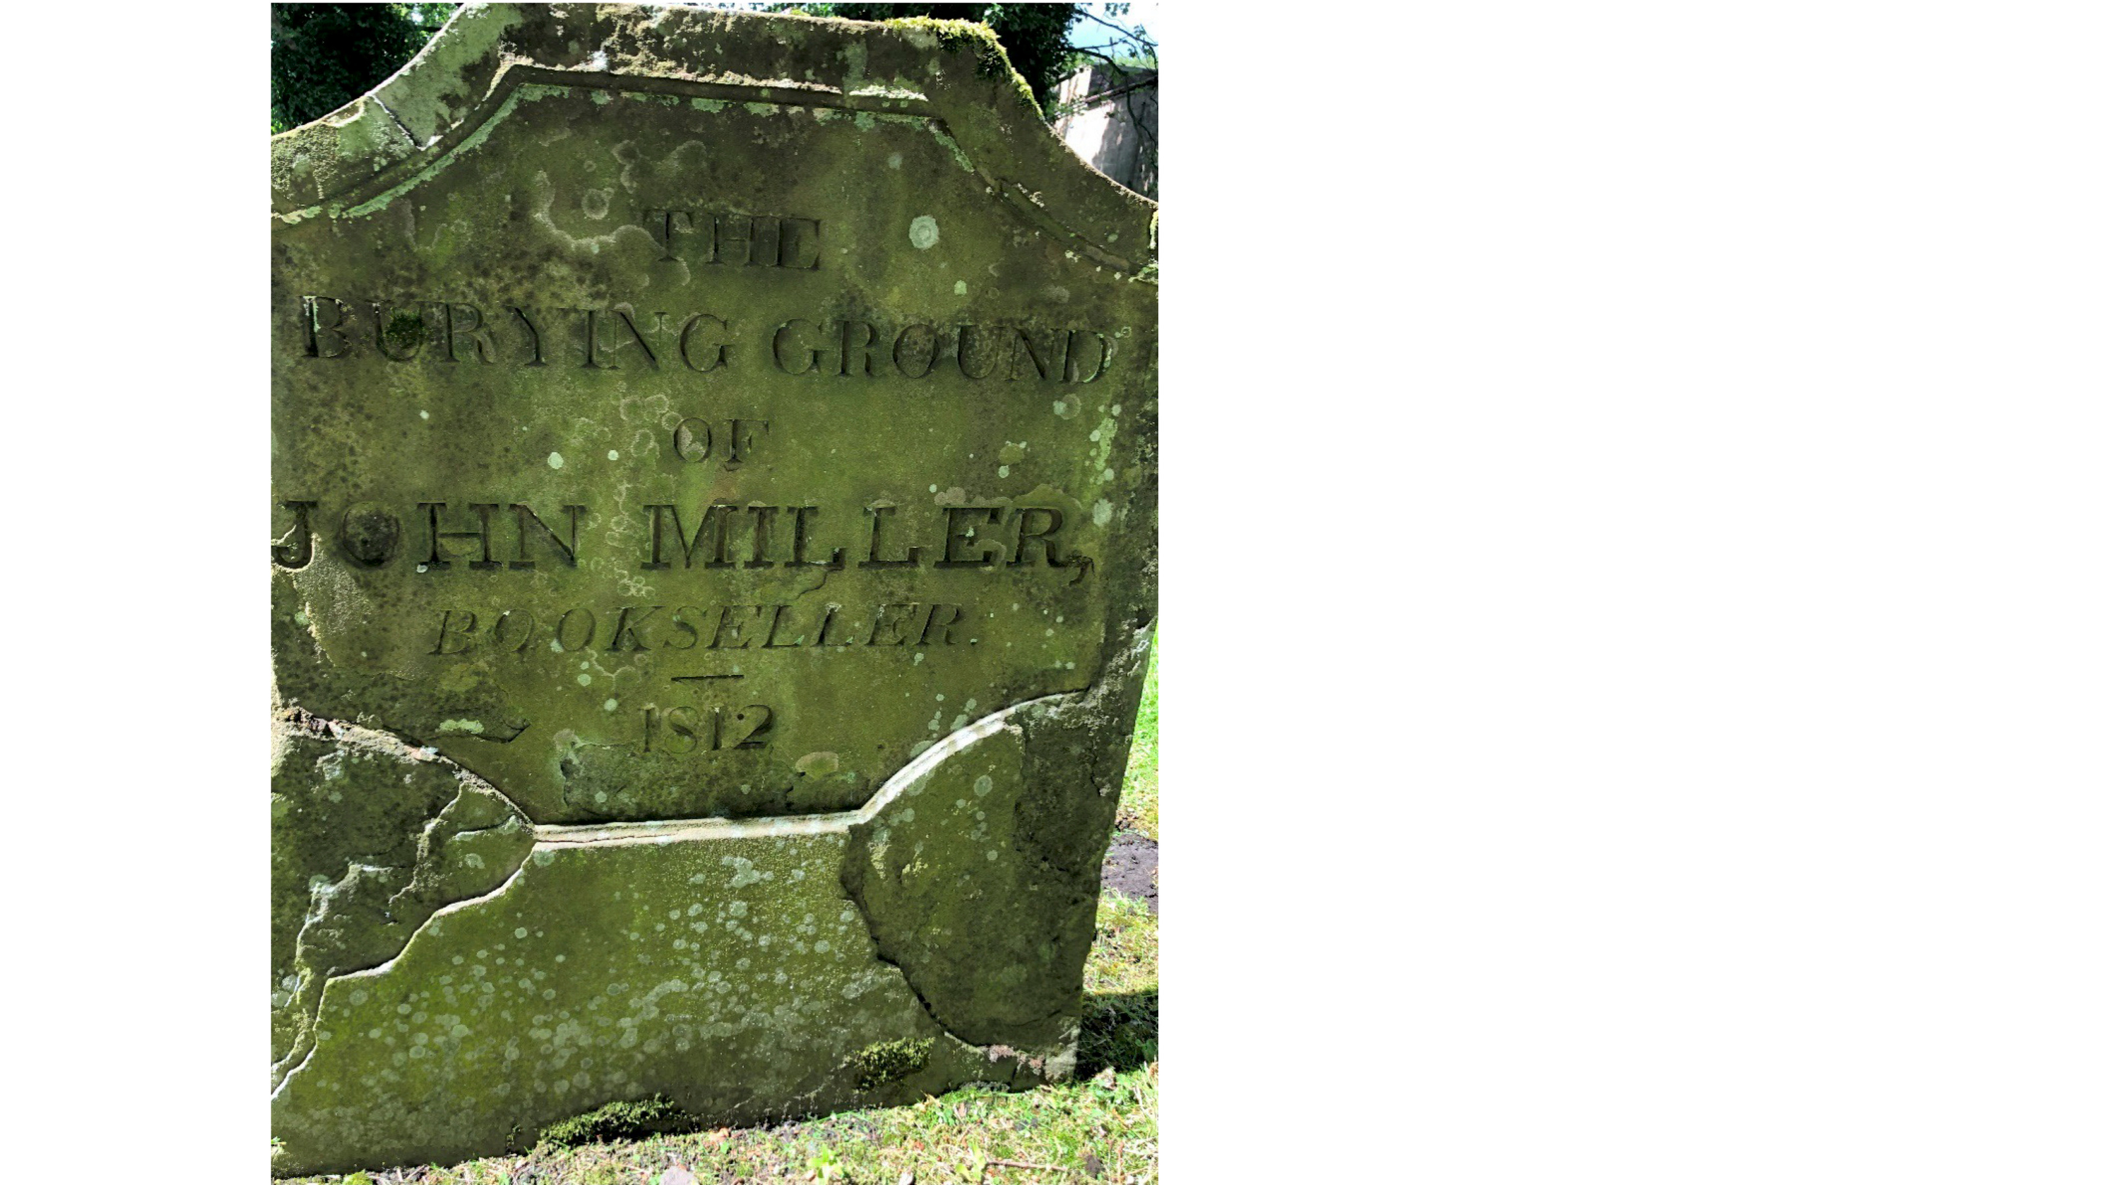
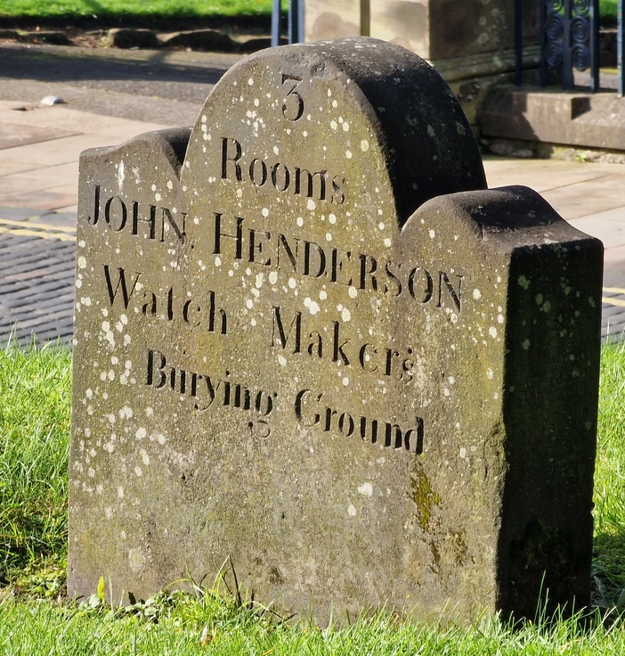
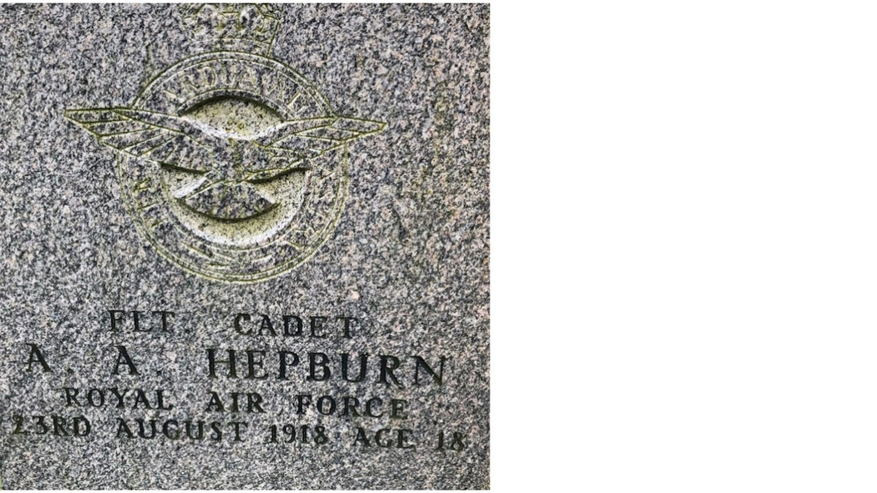

Slide 22
Activity 2
  Can you find any other examples of jobs on the gravestones in Dunfermline Abbey Churchyards?
  Make a note of the person’s name and the job they did.
Job | Person’s name

Slide 23
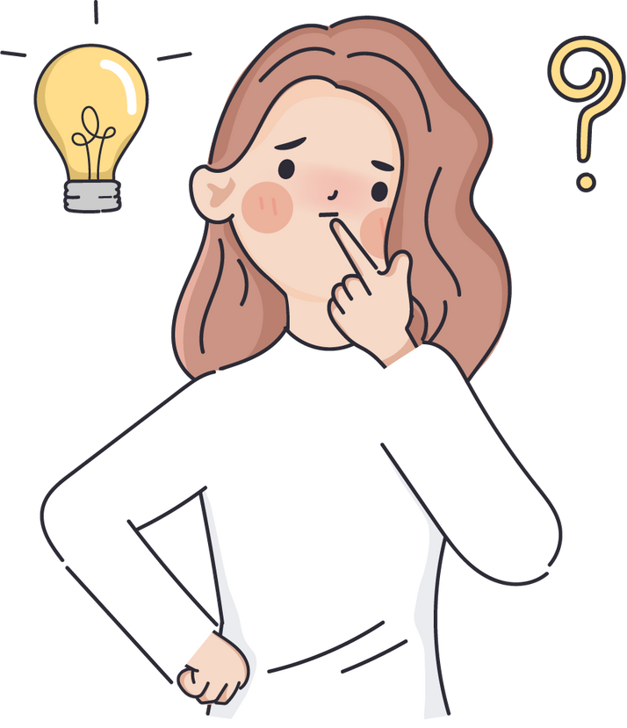
Activity 3
Many different jobs are mentioned on gravestones at Dunfermline Abbey. Looking at the jobs identified in Activities 1 and 2.
  Are there any jobs that surprise you?
  Which jobs do we still have today?
  Which jobs are no longer done?
  Which ones are similar to jobs done today?

Slide 24
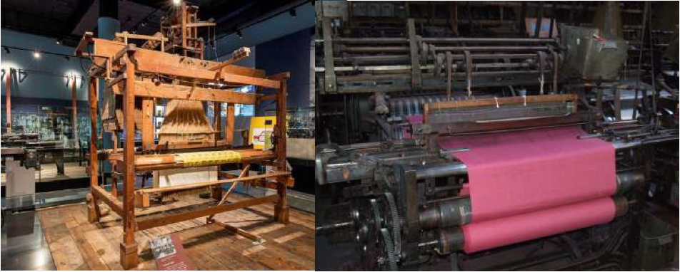
Activity 4 - How is work today different to the past?
  This gravestone has the symbols of a loom and shuttle.
  Who would use those tools?
  Have a look at the images below the gravestone.
  How has fabric making changed over time?
  Why do you think it has changed?

Slide 25
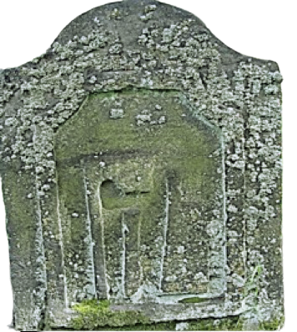
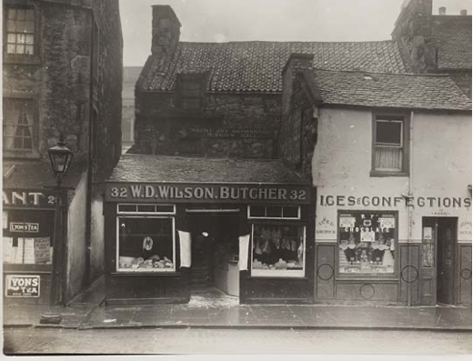
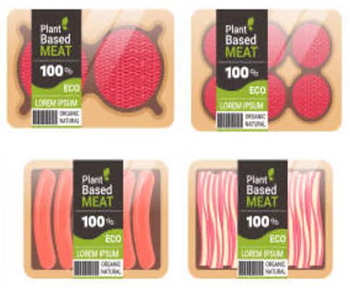
  This gravestone has the symbols of an axe, knife and cleaver.
  Who would use these tools?
  Have a look at the images below the gravestone.
  How has preparing meat changed over time?
  Why do you think it has changed?

Slide 26
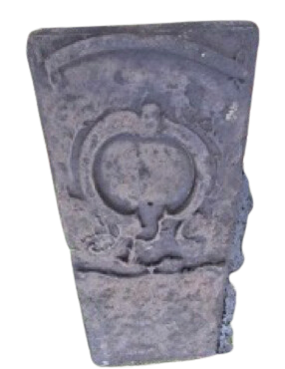
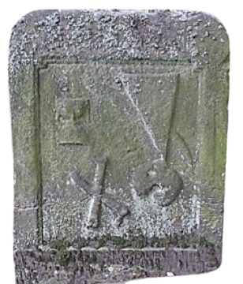
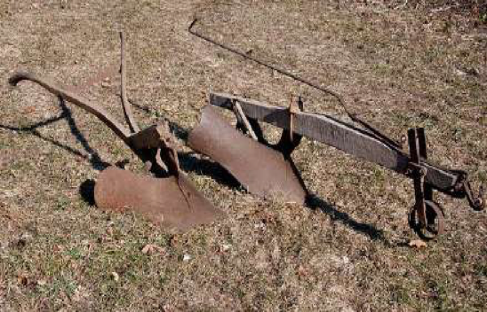
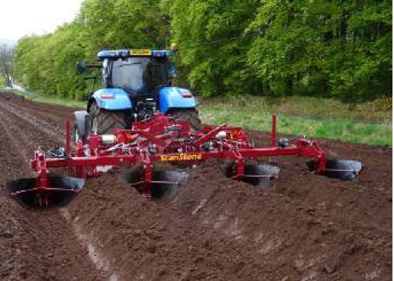
  These are symbols of the plough parts called the sock and coulter (they are next to skull, an hourglass and crossed bones).
  The next gravestone has tools for animals to pull the plough, called a yoke and swingletree.
  Who would use these tools?
  Have a look at the images below the gravestone.
  How has farming changed over time?
  Why do you think it has changed?

Slide 27
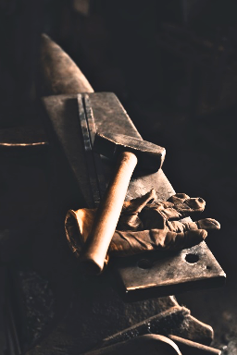
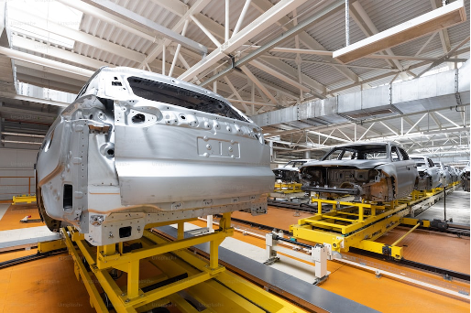
  These symbols are a hammer and tongs.
  Who would use these tools?
  The other carvings are a crown and hourglass. The crown is the symbol of the ‘Hammermen’ who were metalworkers.
  Have a look at the images below the gravestone.
  How has metalworking changed over time?
  Why do you think it has changed?

Slide 28
Activities: what can gravestones tell us?
  People’s personalities and qualities
RESOURCES FOR PRIMARY SCHOOLS

Slide 29
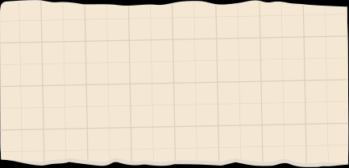
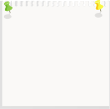
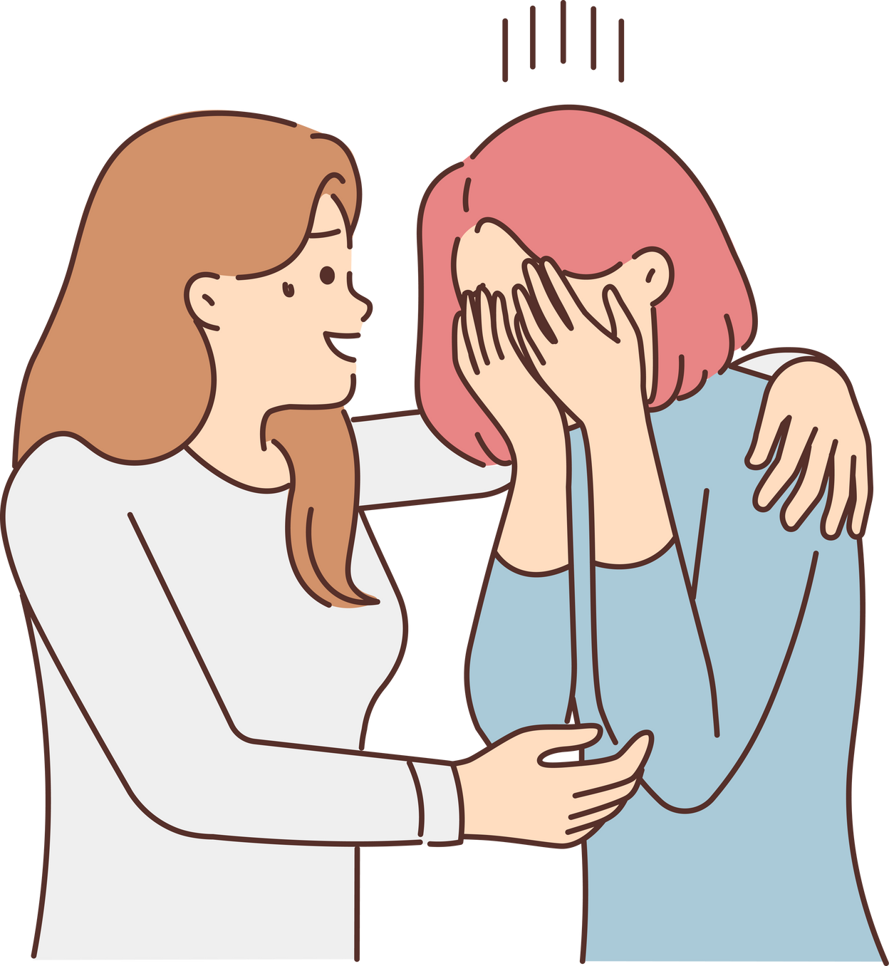
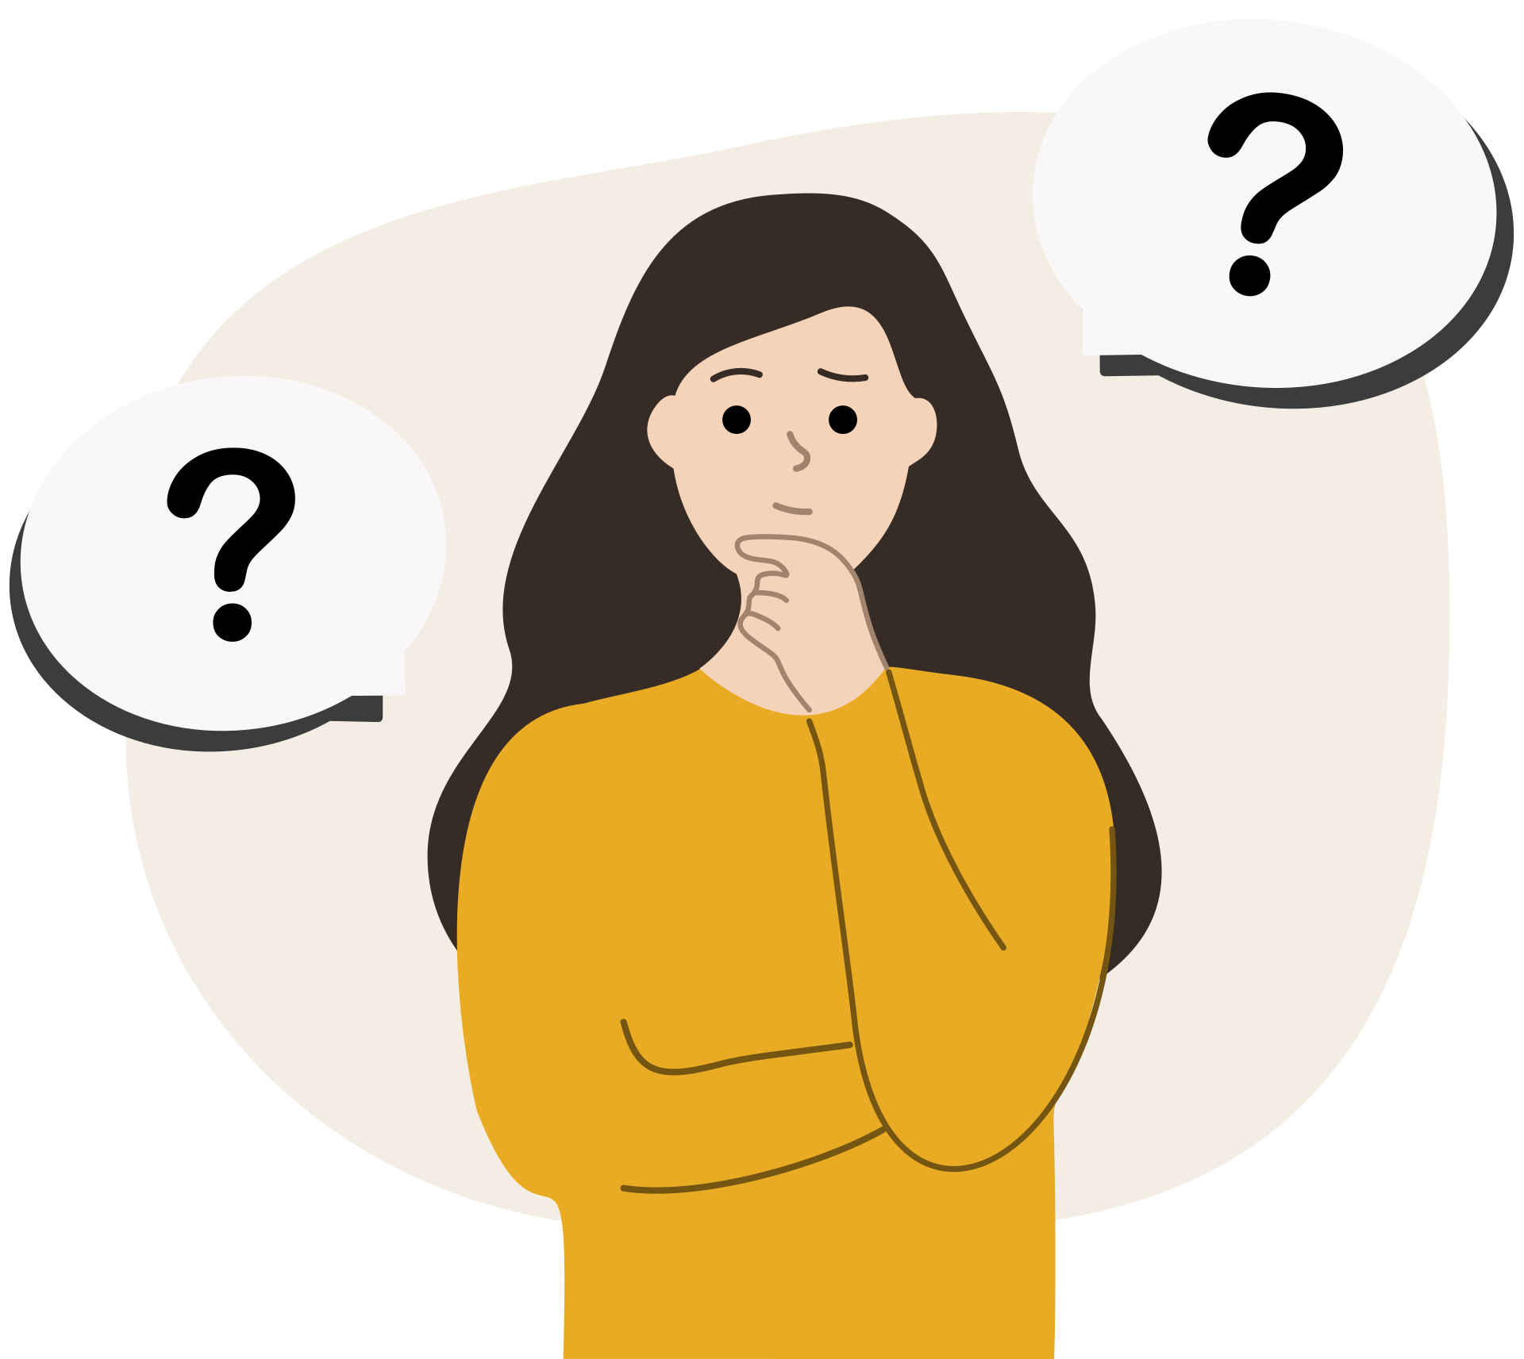





considerate?
WHO AM? WHAT AM I LIKE?
AM I...
funny?
shy?
grumpy?
friendly?
kind?

Slide 30




supports others
DRAW A FIGURE
  Draw pictures around it to show what you are like.
  You can draw on the clothes you like to wear as well.
  You can use the ideas from the previous slide to help
positive

Slide 31

QUALITIES
  The words that we use to describe ourselves are called qualities.
  Qualities are the things that make you who you are.
  Some people have qualities on their gravestones.
  They might be words you don’t recognise today.
FAITHFUL UNTO DEATH
Faithful means
being loyal

Slide 32

QUALITIES
  Here is another word which may be unfamiliar - affectionate
  On the gravestone it means his nieces loved him
affectionate means loving
HIS AFFECTIONATE NIECES

Slide 33





WHO DO YOU ADMIRE?
WHY?

Slide 34





affectionate
WHAT QUALITIES WOULD YOU LIKE SOMEONE TO WRITE ABOUT YOU?
fair
helpful
friendly
funny

Slide 35

REVIEW
  I can say what the word qualities means …
  I know some people who are admired…
  I can give 3 examples of personal qualities …

